Slide 1
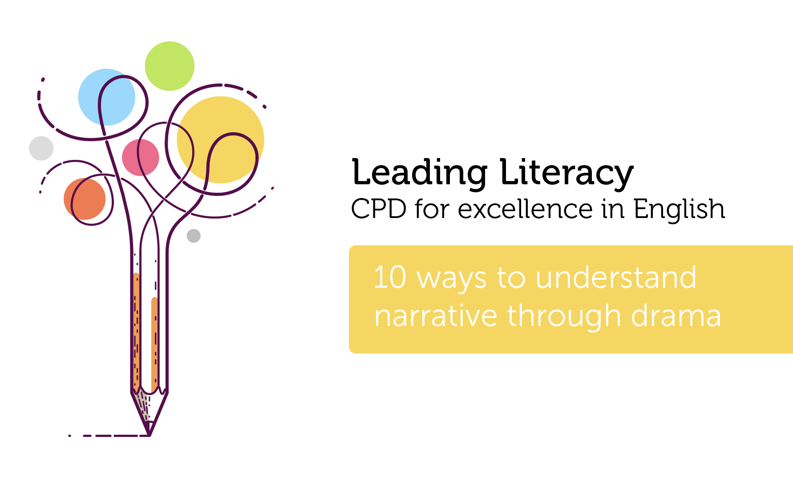

Course creator: Ruth Baker-Leask

Slide 2
Benefits of drama in understanding narrative
Drama can support children to:
engage with texts that they might otherwise find ‘difficult’
reflect on the text as a whole, giving a well-informed, personal response
understand plot and action
understand the setting (time and place) and how this influences action
predict and discuss future actions and their consequences
recognise themes and subtext
understand and discuss mood atmosphere
understand characters’ traits and infer their feelings, motives and intentions
explore the language used by characters to express thoughts and feelings
feel more confident when answering inference questions

Slide 3

1. Be brave and get involved!

Slide 4

2. Make space

Slide 5

3. Find the time

Slide 6
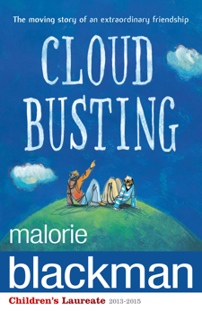







4. Choose the text carefully

Slide 7

5. Choose the right moment
(in the lesson and the text)

Slide 8

6. Provide models of language

Slide 9

7. Practise the strategies until they become familiar to the class

Slide 10

8. Never miss an opportunity

Slide 11
9. Set ground rules

Slide 12

10. Have fun!

Slide 13
10 ways to understand narrative through role play and drama
Be brave and get involved
Make space
Find the time
Choose the text carefully
Choose the right moment (in the lesson and the text)
Provide models of language
Practise the strategies until they become familiar to the class
Never miss an opportunity
Set ground rules and…
Have fun!

Slide 14
Thank you!
Course creator: Ruth Baker-Leask

