Slide 1


Course creator: James Clements
@MrJClements

Slide 2

Analysis, discussion and booktalk
Analysis and close reading
A thread to unravel
Reading for the gist
Word level, sentence level, text level…
‘Soft analysis’- booktalk

Slide 3
Comprehension relies on…
Background knowledge (facts, concepts, experience)
Vocabulary
Language structures (syntax, grammar, semantics)
Verbal reasoning (inference, metaphors)
Literacy knowledge (genres, text types, print concepts)

Slide 4
Analysis, discussion and booktalk
Analysis and close reading
A thread to unravel
Reading for the gist
Word level, sentence level, text level…
‘Soft analysis’- booktalk

Slide 5
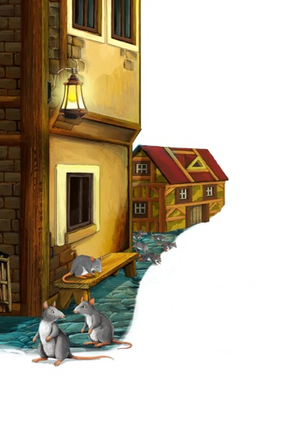
The Pied Piper of Hamelin - I
Hamelin Town's in Brunswick,
By famous Hanover city;
The river Weser, deep and wide,
Washes its wall on the southern side;
A pleasanter spot you never spied;
But, when begins my ditty,
Almost five hundred years ago,
To see the townsfolk suffer so
From vermin, was a pity.
Robert Browning

Slide 6
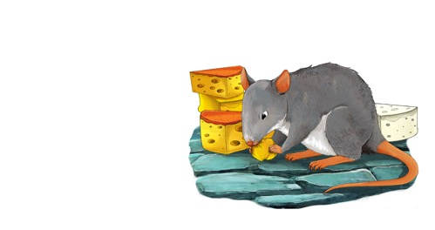
The Pied Piper of Hamelin - II
Rats!
They fought the dogs and killed the cats,
And bit the babies in the cradles,
And ate the cheeses out of the vats,
And licked the soup from the cooks' own ladles,
Split open the kegs of salted sprats,
Made nests inside men's Sunday hats,
And even spoiled the women's chats,
By drowning their speaking
With shrieking and squeaking
In fifty different sharps and flats.
Robert Browning

Slide 7

Booktalk

Slide 8

Booktalk
Aiden Chambers’ Tell Me Beginnings:
Was there anything you liked about this text?
Was there anything you disliked about
this text?
Was there anything that puzzled you?
Were there any patterns or connections that you noticed?

Slide 9
No Man is an Island
No man is an island,
Entire of itself,
Every man is a piece of the continent,
A part of the main.
If a clod be washed away by the sea,
Europe is the less.
As well as if a promontory were.
As well as if a manor of thy friend's
Or of thine own were:
Any man's death diminishes me,
Because I am involved in mankind,
And therefore never send to know for whom the bell tolls;
It tolls for thee.
John Donne

Slide 10
Booktalk
Aiden Chambers’ Tell Me Beginnings:
Was there anything you liked about this text?
Was there anything you disliked about
this text?
Was there anything that puzzled you?
Were there any patterns or connections that you noticed?

Slide 11
Key questions
  Is there space on the curriculum for analysis, discussion and booktalk?
  Is the approach consistent across the school? Do we want it to be?
  How do we balance the need to analyse and explain with the need to explore and ponder?

Slide 12
Thank you!
Course creator: James Clements
@MrJClements

