Slide 1
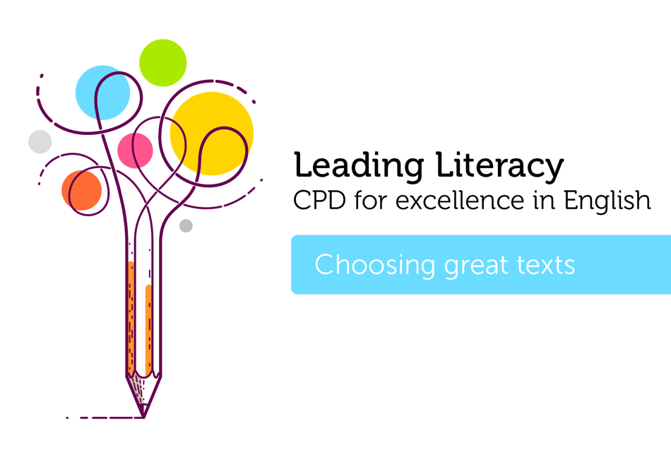

Course creator: James Clements
@MrJClements

Slide 2
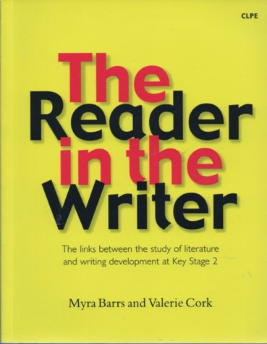
Choosing the right texts…

Slide 3
Valuable texts for writing
Traditional tales - the clear and regular narrative patterns support an understanding of story structure, and the repetition of key language and archetypal characters allows for familiarity to build up across texts
Rich and lyrical texts - these contain 'poeticised speech’, which enables children to appreciate how figurative language can be used to communicate different effects
Emotionally powerful texts - these can draw children into a story, causing them to empathise with characters they have come to care about
(Barrs and Cork, 2001)

Slide 4

What type of books might we choose for our curriculum?
‘Classic’ stories and poems
Books with beautiful language
Mirrors, windows and sliding doors
Big ideas
Books with an emotional bang
Knowledge of the world
Old favourites

Slide 5
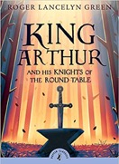
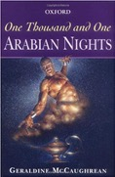
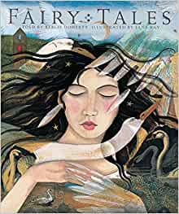
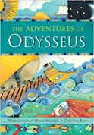
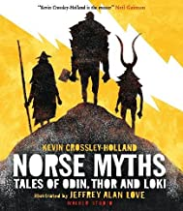
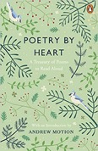
‘Classic’ stories and poems

Slide 6
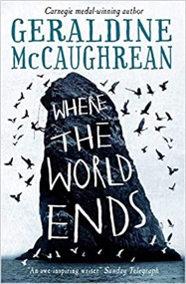
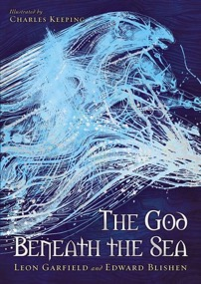
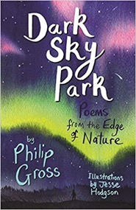
Beautiful language

Slide 7

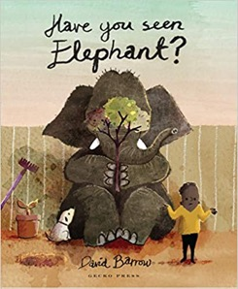
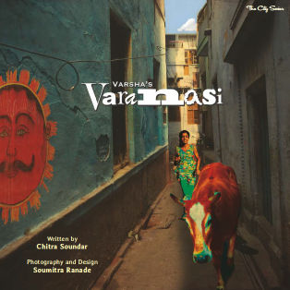
Mirrors, windows and sliding doors
Sims Bishop (1990) Mirrors, Windows and Sliding Doors

Slide 8
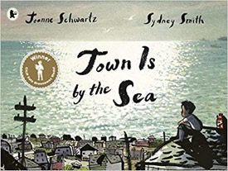
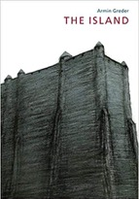
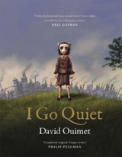
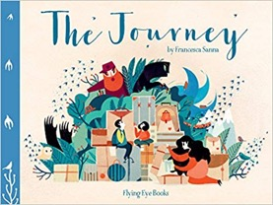
Big ideas

Slide 9
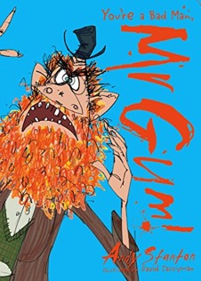
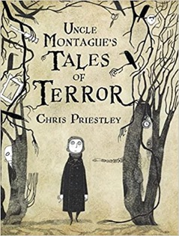
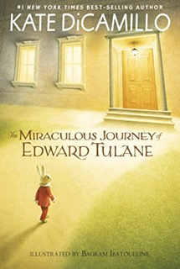
Books with an emotional bang

Slide 10
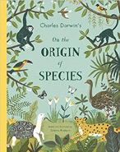
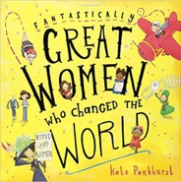
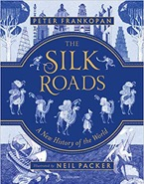
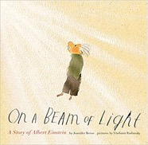
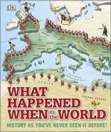
Knowledge of the word

Slide 11
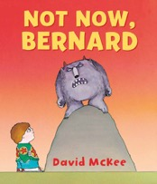
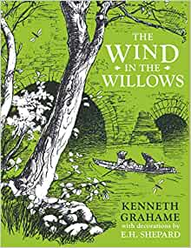
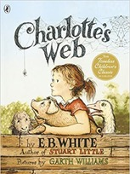
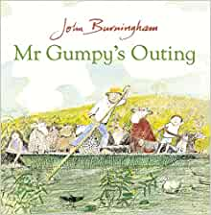
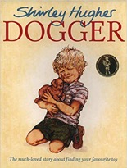
Old favourites

Slide 12
Which types of books might we choose for our curriculum?
‘Classic’ stories and poems
Books with beautiful language
Mirrors, windows and sliding doors
Big ideas
Books with an emotional bang
Knowledge of the world
Old favourites

Slide 13
Key questions
Who chooses the books that will be studied?
Who chooses the books that will be shared?
How can you make sure that the texts children encounter reflect:
The school community?
The local community?
The country?
Other places, times and experiences?
How do we balance consistency and opportunity?
How do we keep our selections fresh and relevant?

Slide 14
Thank you!
Course creator: James Clements
@MrJClements

