Slide 1
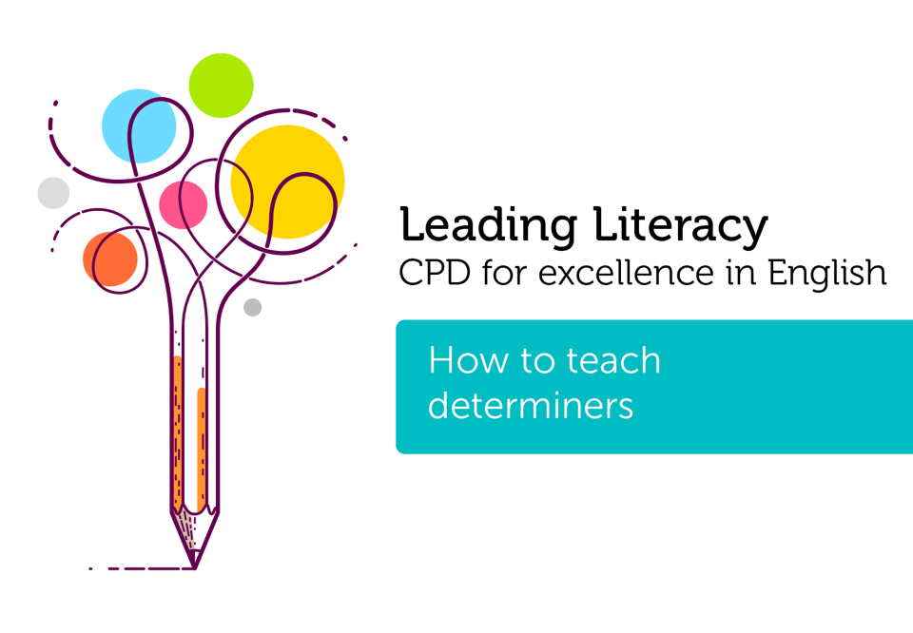

Course creator: Shareen Wilkinson
@ShareenAdvice

Slide 2
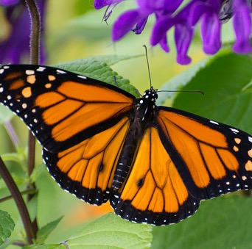
What are determiners?
Determiners specify or determine a noun.
Determiners normally come before a noun.
Notes:
Determiners are first introduced on year 4 in the NC but are an important part of spoken language for younger pupils.
They specify or determine a noun. An, a, the are in Year 3 in the NC.
Coming before a noun is very important as it helps us to truly identify the difference between a determiner and a pronoun.

Slide 3
Determiners
articles
numerals
demonstratives
quantifiers
possessives
Notes:
Umbrella term
Source for pictures: pixabay.com

Slide 4
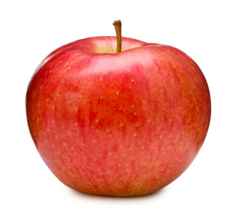
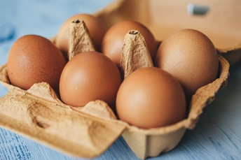

Articles – a, an, the
Notes:
Indefinate article – Before a word that begins with a vowel sound. Exceptions include
An hour (silent ‘h’) and with eu – a European.
Keep it simple for children.
Definate article – a (generally before an article.
Definate article – talks about a particular person or thing.
Source for pictures: pixabay.com

Slide 5
Determiners and pronouns
Some determiners can also act as pronouns.
His book/her book
Both a possessive pronoun and a possessive determiner
My book is better than his.
Pronoun only, because it is not specifying the noun
Notes:
My book is better than his book. (specifies the noun so can be both.)
Determiners specify a noun.
Independent possessive pronouns (also called absolute possessive pronouns) must be used without a noun.
My phone is dead. Pass me yours .
Did you know that Labrador is mine ?
The house on the corner is theirs .
Pronouns are standing in for the noun.

Slide 6
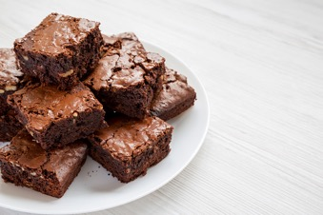
Demonstratives
this, that, these, those
Demonstrative determiners:
This movie is interesting.
That idea is amazing.
These brownies are scrumptious.
Those children are starving.
Demonstrative pronouns:
Here's a copy of the plan. Study this carefully.
Your notes are worthless. Read these instead.
The rolls I brought are fresh. Those are stale.
Original source: https://www.thoughtco.com/what-is-demonstrative-in-grammar-1690433
Notes:
In grammar, a demonstrative is a determiner or a pronoun that points to a particular noun or to the noun it replaces. There are four demonstratives in English: the "near" demonstratives this and these, and the "far" demonstratives that and those. This and that are singular; these and those are plural.
A demonstrative pronoun distinguishes its antecedent from similar things. (For example, "Let me pick out the books. I want these, not those.") When a demonstrative comes before a noun, it's sometimes called a demonstrative adjective or a demonstrative determiner ("Son, take this bat and hit that ball out of the park").

Slide 7

Possessives
its, our, their, my, your, his, her, one’s
My handbag was stolen last week.
The dog wagged its tail.
Their classroom was a mess!
Your home is spotless.
Notes:
To change one’s mind (formal language).

Slide 8

Quantifiers
all, enough, some, any, no, much, few, little, both, many, either, each, every, another, other
Would you like any dinner today? (determiner)
That’s lovely of you but I don’t want any. (pronoun)

Slide 9
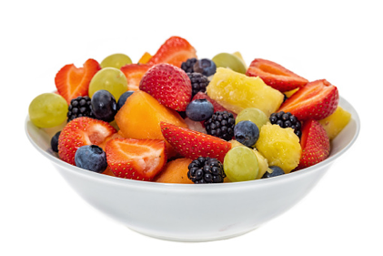
Numerals (symbol or name):
one(1), two(2), three(3), four(4), five(5)
Please can I order three fruit salads?

Slide 10
Riddles
Choose from the following word classes:
pronoun adjective determiner preposition
What am I?
I come before a noun and any adjectives.
I can specify a noun.
I can quantify a noun.
What am I?
Further subject knowledge: UCL English grammar knowledge organiser
I think that…
This is because…
Notes:
Words like this, that and these are pronouns if they do not appear before the noun.
‘a noun’ or singular noun.
I like that very much.
Determiner
Make sure they demonstrate their knowledge using an example sentence.
Determiners always come first in the noun phrase.
Pronoun:
I can replace a noun.
I can be in the possessive form.
I can be within a relative clause.
Determiners are required with singular nouns.
To speak about a singular noun generally, use an indefinite article (a or an).
To speak about a plural noun generally, do not use a determiner.
To speak about a singular noun specifically, use a definite article, demonstrative pronoun, possessive pronoun or quantifier.
To speak about a plural noun specifically, use a definite article, demonstrative pronoun, possessive pronoun or quantifier.

Slide 11
Circle the three determiners in the sentence below.
William didn’t have any cereal in the house, so he went out to buy some cornflakes.
29.5%
Notes:
Chilren need to be taught this explicitly as only 29.5% of children got this across the country.
Using what we know, justify your answer.
any cereal
the house
some cornflakes

Slide 12

But there was one thing Meesha found hard to make…
...friends.

Slide 13
Different meanings
Show children different sentences and ask them to explain the meaning.
It was the silver car with a huge scratch at the side.
It was a silver car with a huge scratch at the side.

Slide 14



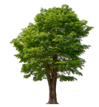
Fill in the determiners a or an?
_______ egg
_______ passport
________ hour
________ tree
Notes:
A or an?

Slide 15
Complete the sentences
During _______holidays, we visited ______castle.
I think that…
This is because…

Slide 16
Thank you!
Course creator: Shareen Wilkinson
@ShareenAdvice

