Slide 1


Course creator: James Clements
@MrJClements

Slide 2
The simple view of reading
Language comprehension processes
good
Word recognition
processes
good
Word recognition
processes
poor
poor
Language comprehension processes
Primary Framework for literacy and mathematics
Primary National Strategy – Crown copyright 2006

Slide 3
Fluency
The bridge between word recognition and language comprehension
Word-reading:
Pace
Accuracy
Automaticity
Language comprehension:
Prosodic elements (stress, pace, volume, intonation)
Taking note of the clues the author gives the reader
Tone

Slide 4

‘Words mean more than what is set down on paper. It takes the human voice to imbue them with the shades of deeper meaning.’
Maya Angelou

Slide 5
Activities for building fluency
  Reading aloud
  Paired reading
  Specific strategies: echo reading and choral reading
  Reader’s theatre
  Playing with texts:
situational expressions
moving the emphasis

Slide 6

Echo reading
"Glorious, stirring sight!" murmured Toad… “The poetry of motion! The real way to travel! The only way to travel!”

Slide 7
Echo reading
"Glorious, stirring sight!" murmured Toad…"The poetry of motion! The real way to travel! The only way to travel!”
“Here today - in next week tomorrow! Villages skipped, towns and cities jumped - always somebody else's horizons! O bliss!
O poop-poop! O my! O my!"

Slide 8
Choral reading
From a Railway Carriage
Faster than fairies, faster than witches,
Bridges and houses, hedges and ditches;
And charging along like troops in a battle,
All through the meadows the horses and cattle:
All of the sights of the hill and the plain
Fly as thick as driving rain;
And ever again, in the wink of an eye,
Painted stations whistle by.
Robert Louis Stevenson

Slide 9
Situational expressions
What do you want?
I don’t believe it.
What did he say?
1. thrilled
2. determined
3. puzzled
4. calm
5. terrified
6. angry

Slide 10
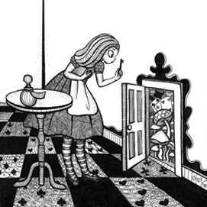
Moving the emphasis
‘Whatever shall I do next?’ said Alice.
‘Whatever shall I do next?’ said Alice.
‘Whatever shall I do next?’ said Alice.
‘Whatever shall I do next?’ said Alice.
‘Whatever shall I do next?’ said Alice.

Slide 11
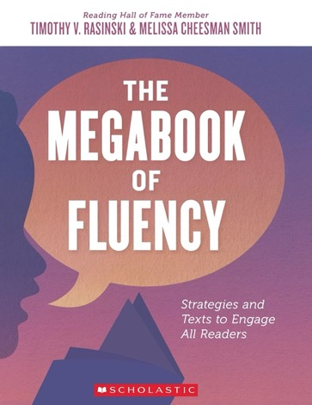

Slide 12
Key questions
Does our curriculum include opportunities for children to practise fluent reading?
Does this continue as children grow older?
Do we model fluent reading?
Do we find time in a busy curriculum for children to read aloud?

Slide 13
Thank you!
Course creator: James Clements
@MrJClements

