Slide 1


Course creator: Ruth Baker-Leask

Slide 2
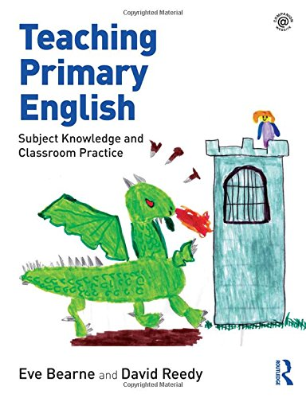
What to expect…
Improvised drama is central to the teaching of narrative in primary classrooms, but exploring more formal dramatic techniques can also support understanding.
‘Drama is recognised both as a creative activity in its own right and a vehicle for learning subject content in different curriculum areas…all forms of drama have value and creative potential.’
Bearne, E. Ready, D. (2018) Teaching Primary English, Abingdon: Routledge, pp 74-75

Slide 3
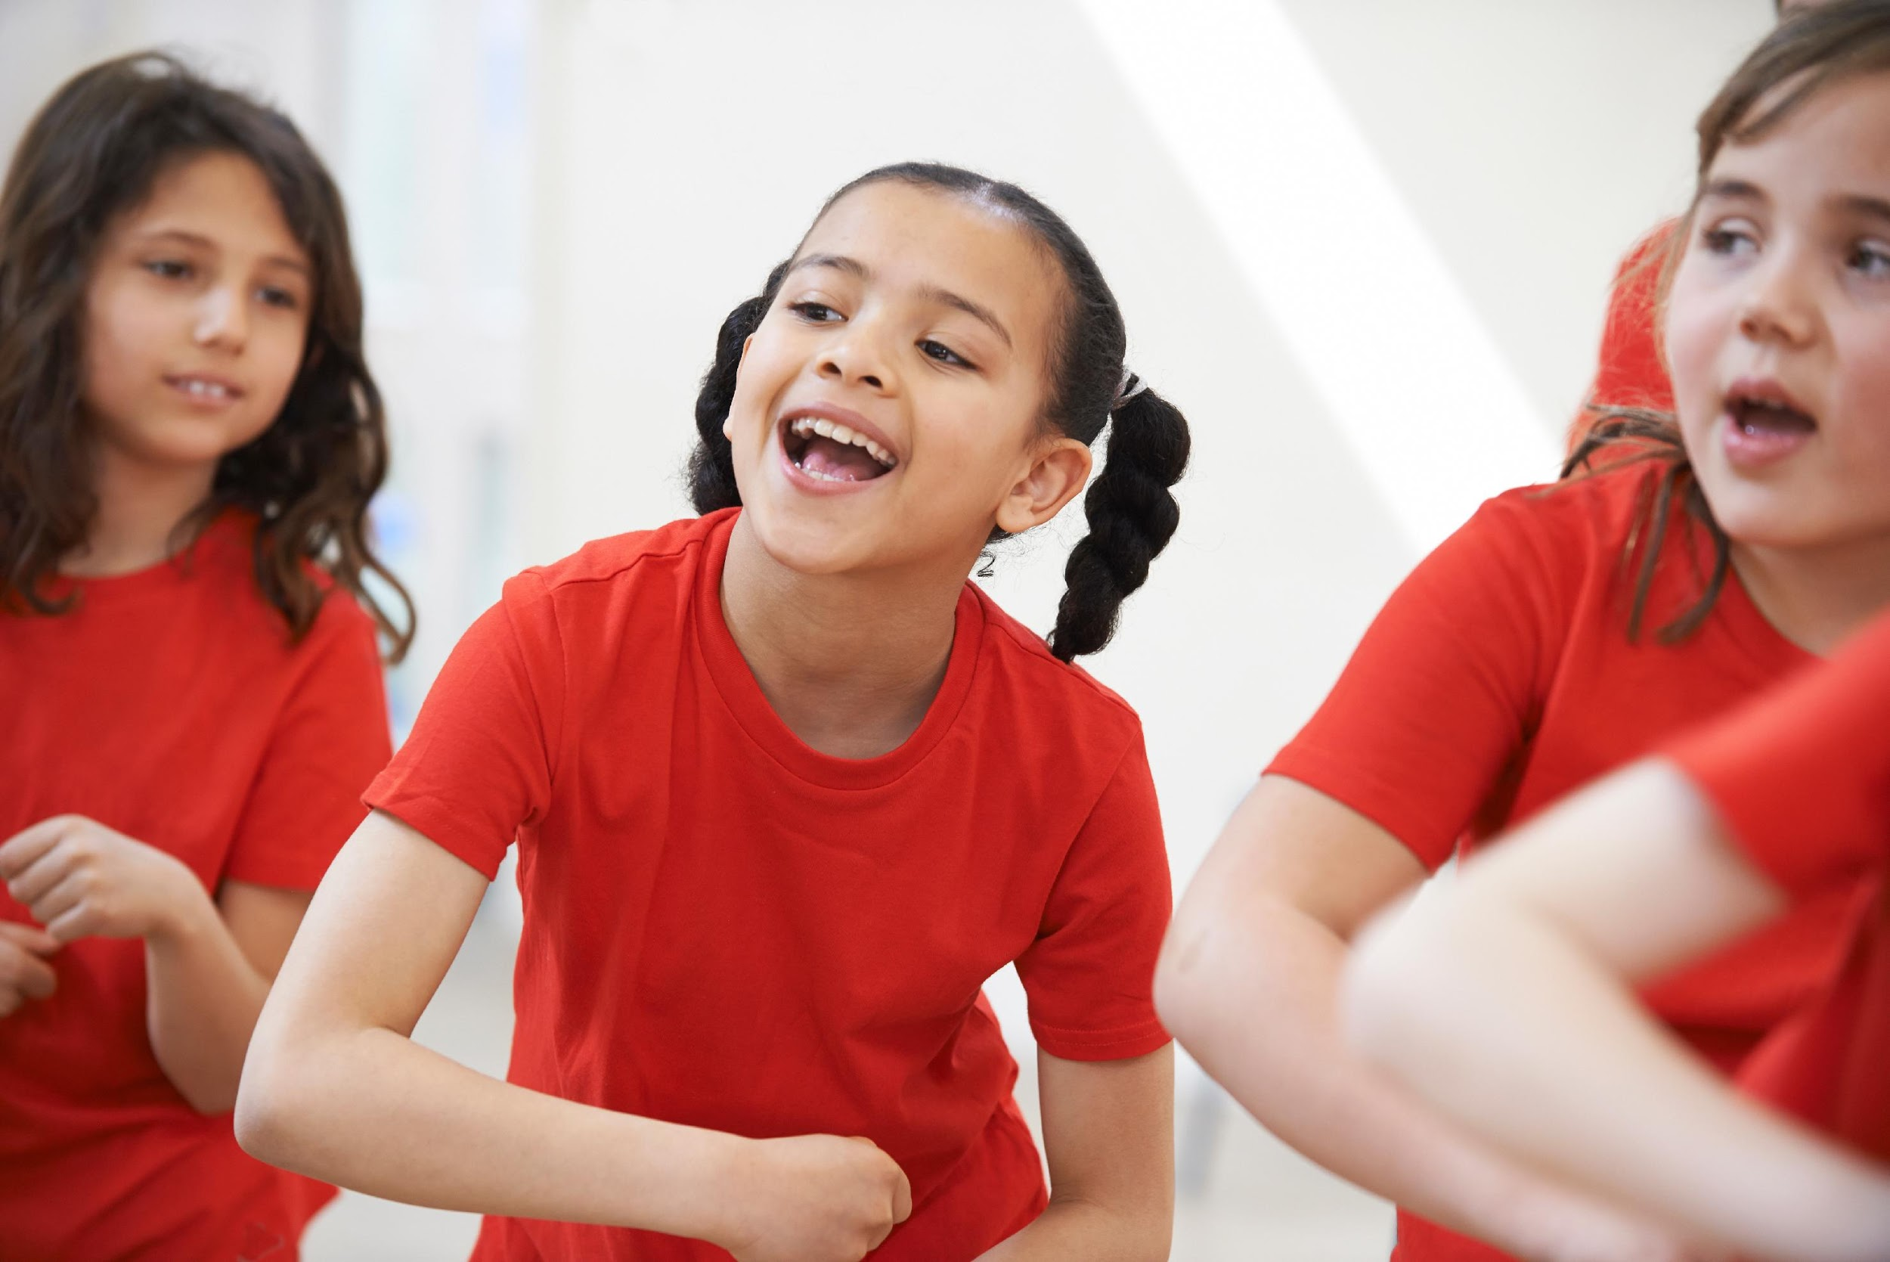
What to expect…
  During this session we will explore how to:
use dramatic performances of narratives to deepen children’s understanding of texts.
use a range of strategies to support children when performing (reader’s theatre, and Whoosh).

Slide 4

What is reader’s theatre?
Reader’s theatre is an engaging way to help children think more carefully about the overall impact of a text as well as becoming familiar with the characters, their motives, relationships, and role within the story.
The teacher turns a narrative text, or well-chosen extract, into a script for the children to perform. In groups, children discuss the script and how best to perform it to convey the plot and themes of the story. You may choose to keep it simple or provide the children with props and costumes to bring the story alive.

Slide 5
What is reader’s theatre?
Alternatively, the children can start by reading the text and then changing it into a playscript, discussing how best to convey the detail and actions that are not obvious from the dialogue. This is less straightforward but leads the children to read the text closely.
Dramatic performances must have an audience. Dedicate time for your children to perform to one another, after which they should be given the opportunity to suggest how each others’ performances could be improved.

Slide 6
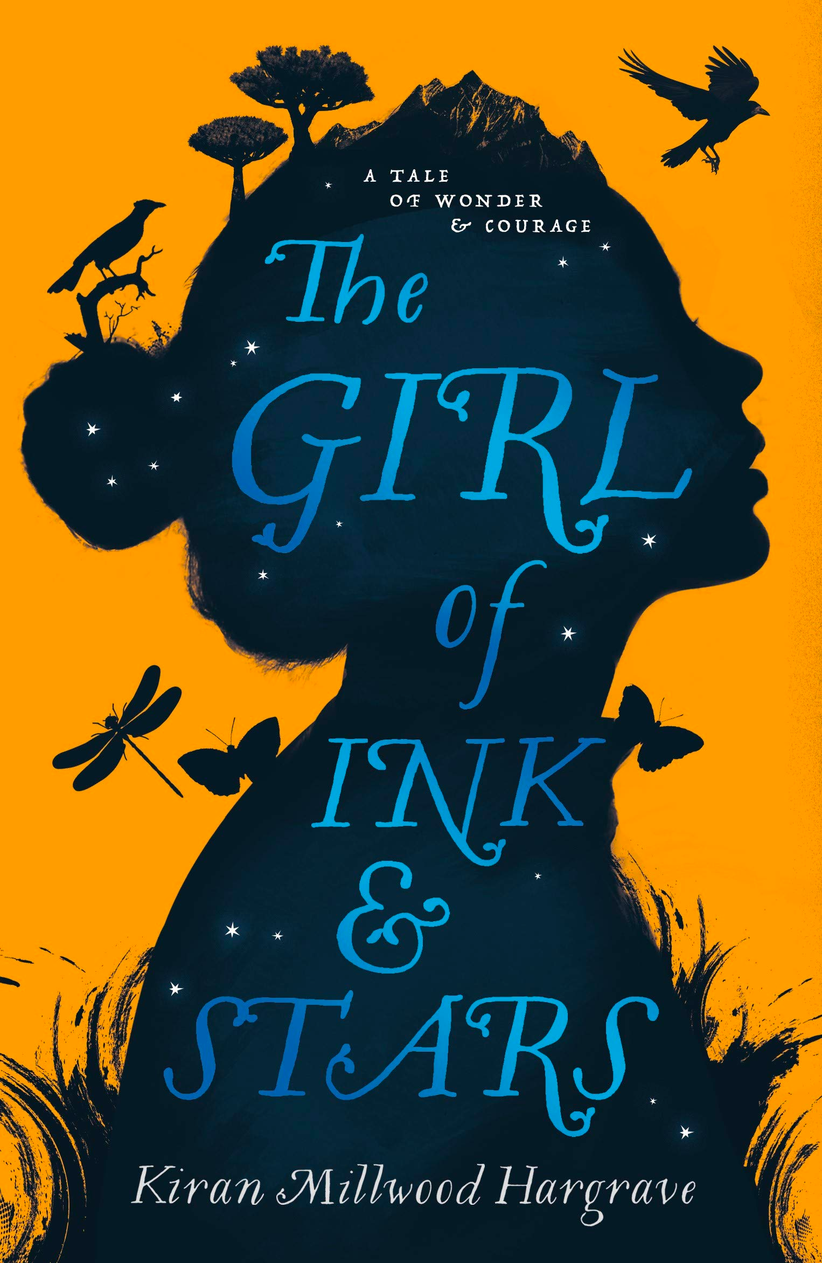
The Girl of Ink and Stars by Kiran Millwood Hargrave

Slide 7
Scripting
“Cata’s missing.” I pushed the words out. “I just saw her mother.”
“Cata?”
I rolled my eyes impatiently. “The girl who sits at the back.”
Lupe shifted from one foot to another. She had that look on her face, like Pep sauntering away from a broken dish.
I stared at her. “What?”
“What, What?” said Lupe, pulling her satchel higher on to her shoulder.
“You know something.” I stepped forward.
“No, I don’t.” She stepped back.

Slide 8
Exploring pitch, tone, volume and pace
I raised my eyebrow the way Da had taught me.
Lupe wilted. “I’m sure it’s nothing. It’s just, she was working in the kitchen this summer, and I asked her to go to the orchard for me yesterday, to get some –”
“The orchard!” The sick feeling in my stomach was back. “Lupe, you know we’re not allowed.”
“Yes, of course I know, but I hadn’t had dragon fruit in ages. I needed them on my birthday, didn’t I?”
I had never had dragon fruit and was not even sure that they looked like, but I did know that they were Lupe’s favourite, grown in the Governor's orchard at the edge of the forest. Out of bounds to everyone except his guards and a few of his servants.

Slide 9
Reader’s theatre and poetry
Poems can be performed in a similar way, although obviously there is no need for a script. In groups, children read a poem closely and decide how each line should be read to convey its meaning to an audience using body movements and gestures.
Children may choose to:
      read in chorus to emphasise certain lines
      make noises and choose actions that highlight the words that reflect the mood of a poem
      use their bodies to form structures and shapes that represent the imagery of the poem
      explore pitch, tone, volume and pace when reading

Slide 10
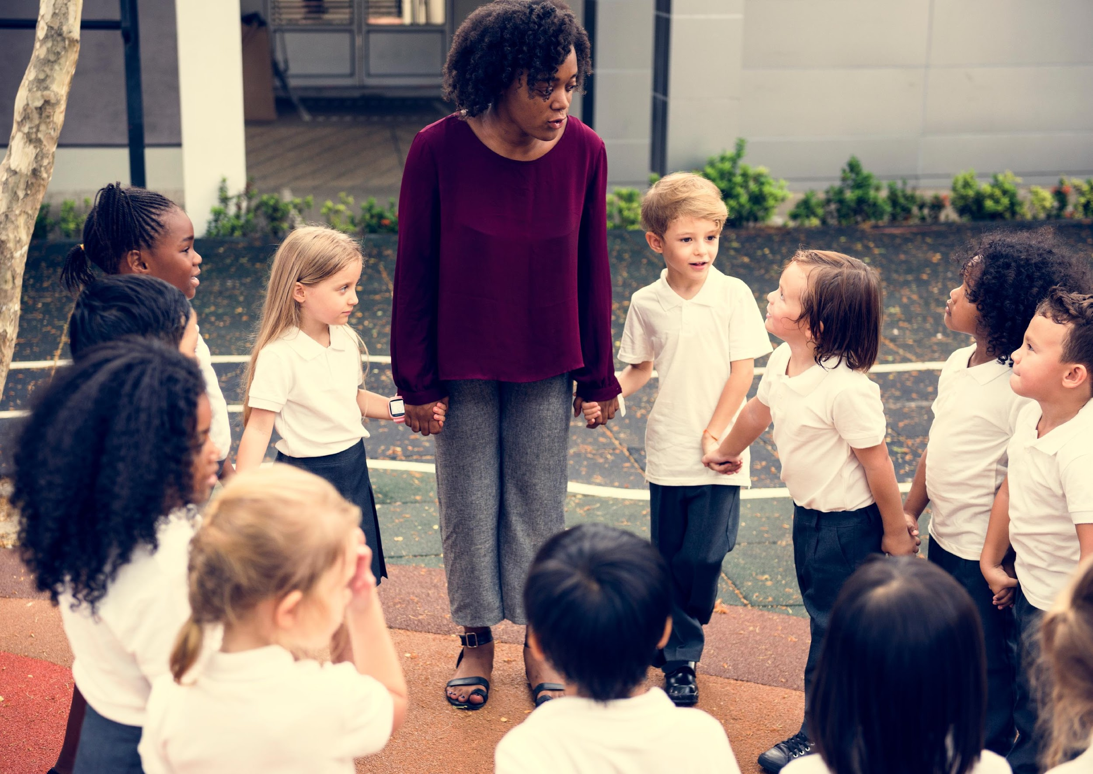
What is Whoosh?
Whoosh was devised by Dr Joe Winston of The University of Warwick and I first encountered it when attending a drama workshop at Royal Shakespeare Company with my Year 5 class. It is a technique used by actors and directors when exploring the staging of a play.

Slide 11
How to Whoosh
You begin with everyone in a circle.
You may choose to place a handful of useful props inside the circle before you begin.
Someone sitting in the circle (often the teacher) then reads a narrative, pausing at natural breaks in the text and asking a number of children to use the props or their bodies to create the scene that has just been described.
Similar to freeze frame, when they are happy with their pose they stay still while the other children critique their choices and suggest revisions (they may even move their classmates into new positions)
The next part of the narrative is then read and the children move into new positions while others join the scene to add additional detail to the tableaux.
When a change of scene is required, the reader says “Whoosh!” and the children return to their places in the circle to begin all over again.

Slide 12
A Midsummer Night’s Dream
Titania and Bottom are in her fairy bower, where Bottom commands the fairies to do things for him like ‘scratch my head’ and ‘bring me the honey bag’. Titania eventually sends the other fairies away so Bottom can ‘wind thee in my arms’ and he can sleep.
Oberon and Puck arrive at Titania’s bower and Oberon tells Puck he has already met with Titania since she fell in love with ‘this hateful fool’ and that she agreed to give him the changeling boy and sent him straight to Oberon’s bower. He tells Puck that ‘now I have the boy, I will undo / This hateful imperfection of her eyes’ and he gives Titania the antidote before waking her up.
When Titania sees Bottom and Oberon, she cannot believe what has happened to her and that she was in love with ‘an ass’, asking Oberon ‘How came these things to pass? Oh, how mine eyes do loathe his visage now!’ Puck then takes away Bottom’s transformed head and returns him to normal, before Oberon and Titania dance. Puck then interrupts them when he hears the ‘morning lark’ and the three fairies leave as Theseus arrives, sounding a hunting horn, with Egeus and Hippolyta.
Synopsis from Shakespeare Learning Zone, www.rsc.org.uk

Slide 13
Performance: some words of advice
Some children will be nervous when performing in front of their peers so make sure there are some ground rules for drama such as:
work collaboratively with all members of the class
listen to the views of others
never make personal comments
drama is structured fun, so always stay focused on the activity
perform with your audience in mind at all times

Slide 14
Performance: some words of advice
Some children will be nervous when performing in front of their peers so make sure there are some ground rules for drama such as:
work collaboratively with all members of the class
listen to the views of others
never make personal comments
drama is structured fun, so always stay focused on the activity
perform with your audience in mind at all times
Make sure you have the space to perform before you begin the activity

Slide 15
Performance: some words of advice
Some children will be nervous when performing in front of their peers so make sure there are some ground rules for drama such as:
work collaboratively with all members of the class
listen to the views of others
never make personal comments
drama is structured fun, so always stay focused on the activity
perform with your audience in mind at all times
Make sure you have the space to perform before you begin the activity
Begin by explaining what the children will be doing during the session.
Drama can be exciting for children but you don’t want this to tip into anxiety
if they are unsure of the expectations

Slide 16
Benefits of drama in understanding narrative
Drama can support children to:
engage with texts that they might otherwise find ‘difficult’
reflect on the text as a whole, giving a well-informed, personal response
understand plot and action
understand the setting (time and place) and how this influences action
predict and discuss future actions and their consequences
recognise themes and subtext
understand and discuss mood atmosphere
understand characters’ traits and infer their feelings, motives and intentions
explore the language used by characters to express thoughts and feelings
feel more confident when answering inference questions

Slide 17
Thank you!
Course creator: Ruth Baker-Leask

