Slide 1
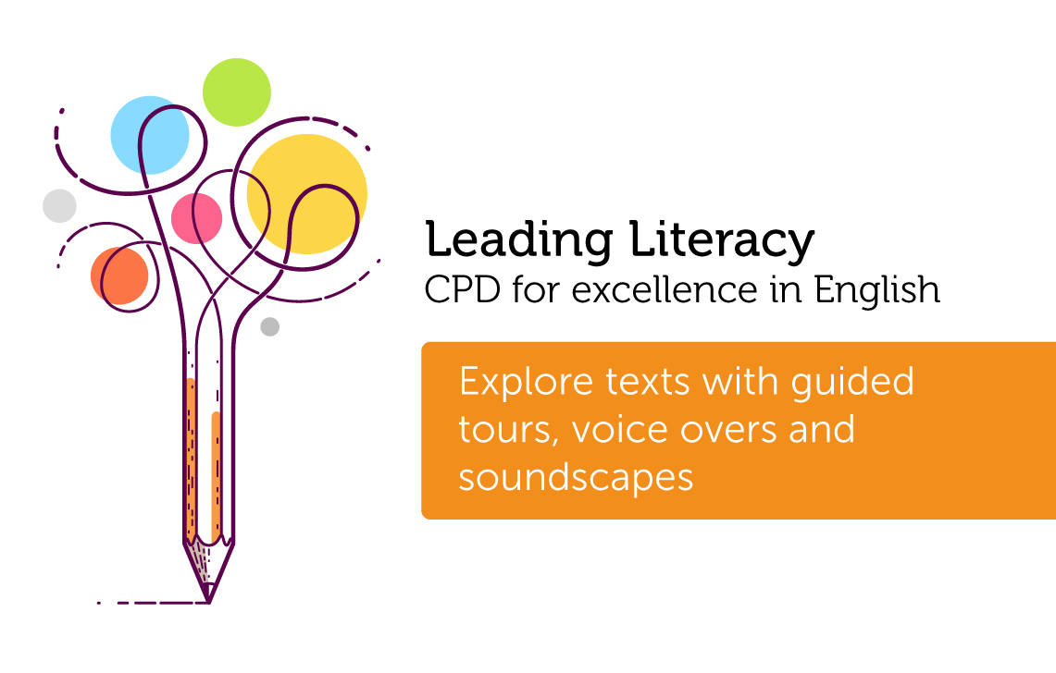

Course creator: Ruth Baker-Leask

Slide 2

What to expect…
Drama can support children in understanding how settings, characters and themes are central in creating the mood or atmosphere of a story. By the end of KS2 children are expected to be able to ‘describe settings, characters and atmosphere’ (DFE:2014) when writing, and therefore need to be expert in evaluating this when reading.
During this session we will explore how to:
use drama techniques such as soundscapes, tour guide and voice overs to support children in becoming immersed in the setting and atmosphere of a narrative
support children to reflect on the impact of a text, evaluating mood and atmosphere

Slide 3
What is a soundscape?
Using voices props and percussion instruments, children represent the mood or atmosphere of a chapter, scene or passage from a chosen text.
The children work in pairs or groups to create their soundscape. This is then played as the text is read aloud, with the children altering the pace and volume to correspond with changes in the action. They may choose to represent characters with different sounds that reflect their mood and personality.
Soundscapes works well when the children are given sequential passages from the text, which can then be played in turn to demonstrate the changing moods of the text.
Finally the children evaluate the effectiveness of each other’s composition.

Slide 4
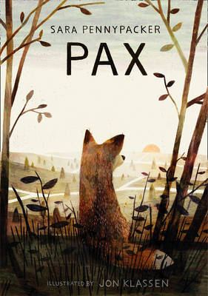
Pax by Sara Pennypacker

Slide 5
Pax by Sara Pennypacker
Pax shook the night’s rain off his back and headed for the road without even stretching his stiff muscles, straining for his boy’s scent.
He couldn’t find it – the night’s winds had swept the ground clean of any trace. But among the hundreds of odours rising on the early morning breeze, he found something that reminded him on his boy: acorns. Peter had often scooped up handfuls and sprinkled them over Pax’s back, laughing to see him shake them off and then crack them to get the meat. The familiar scent seemed a promise now, and he trotted toward it.
Page 25

Slide 6

The Explorer by Katherine Rundell

Slide 7
The Explorer by Katherine Rundell
A burning branch cracked, spat red, and fell in a cascade of sparks. Fred leapt away, stumbling backwards into the dark and smacking his head against something hard. The branch landed exactly here he’d been standing seconds before. He swallowed the bile that rose in his throat and began to run again, faster and wilder.
Something landed on his chin, and he ducked, smacking his face, but it was only a raindrop.
The rain came suddenly and hard. It turned the soot and sweat on his hands to something like tar, but it began to quench the fire. Fred slowed his run to a jog, then to a stop. Gasping, choking, he looked back the way he had come.
Page 7

Slide 8
Soundscapes: some words of advice
If the children aren’t used to things that rattle and clang and ring then select the instruments that the children can choose from carefully, and have some headache pills to hand
You will need space in which the groups can compose and rehearse their soundscape without being distracted
Don’t worry about the time it takes. Drama activities can feel too time consuming when timetables are already crowded; however, the benefits of children being immersed in such activities far outweigh the time they take

Slide 9

What is tour guide?
In role as a tour guide, children imagine a scene from a familiar narrative and give a guided tour of the location. You can use images, drawings, maps and props to support this.
Children add a voice over to an image, film or a the live reading of a story. This supports the children’s understanding of the sequence of events within a story and how the setting and character’s actions influence the plot. It is particularly effective when added to film clips of the children’s own enactments of the story
With both of these techniques it is important that children use language appropriate to the task. It is helpful for the children to listen to examples of voice overs, making notes of the words and phrases specific to the task.
What is voice over?

Slide 10
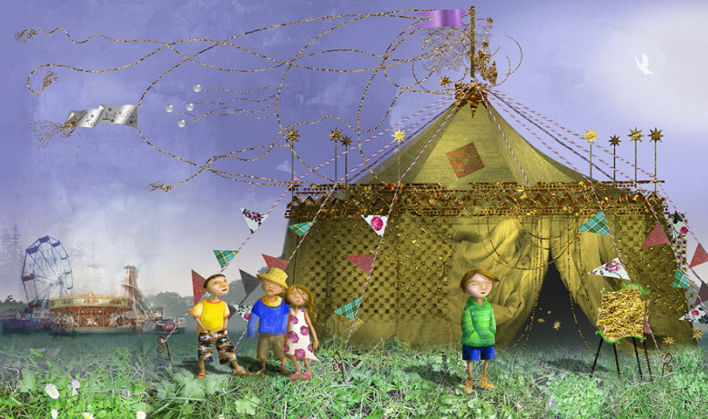
Leon and the Place Between by Angela McAllister, illustrated by Grahame Baker-Smith
Leon and the Place Between, Angela McAllister, Templar (2009)

Slide 11
Leon and the Place Between by Angela McAllister, illustrated by Grahame Baker-Smith
‘On behalf of Ring Master Tours let me welcome you to the Majestic Circus. We hope you enjoy your visit. Please be careful of the tent pegs as you walk around the site. In front of you, you will notice the Big Top, the arena where most of the ‘magic’ will happen for you today. If you listen carefully you will hear the sound of the band tuning up as the acrobats and performers prepare for the show.’

Slide 12
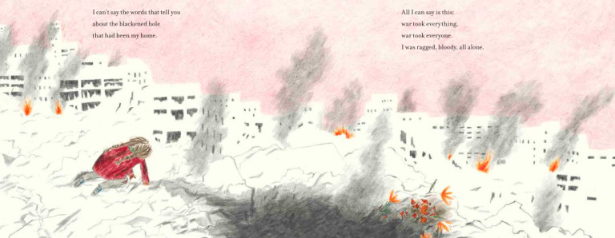
The Day War Came by Nicola Davies, illustrated by Rebecca Cobb
The Day War Came, Nicola Davies, Walker Books (2019)

Slide 13
Benefits of drama in understanding narrative
Drama can support children to:
  engage with texts they might otherwise find ‘difficult’
  reflect on the text as a whole, giving a well-informed, personal response
  understand plot and action
  understand the setting (time and place) and how this influences action
  predict and discuss future actions and their consequences
  recognise themes and subtext
  understand and discuss mood atmosphere
  understand characters’ traits and infer their feelings, motives and intentions
  explore the language used by characters to express thoughts and feelings
  feel more confident when answering inference questions

Slide 14
Thank you!
Course creator: Ruth Baker-Leask

