Slide 1
Course creator: Ruth Baker-Leask

Slide 2
What to expect…
Using drama in the classroom helps children to connect with a fictional world by being placed within it. By ‘becoming’ a character children find it much easier to imagine that character’s thoughts and feelings.
‘’[Drama] invites children to enter into a fictional world…to explore characters and their fortunes and misfortunes…to build empathy and to engage in problem solving.’
Matthews, D (2020) Drama and Story Telling, in Centre for Literacy in Primary Education The Power of a Rich Reading Classroom. London: Sage, pp 88

Slide 3
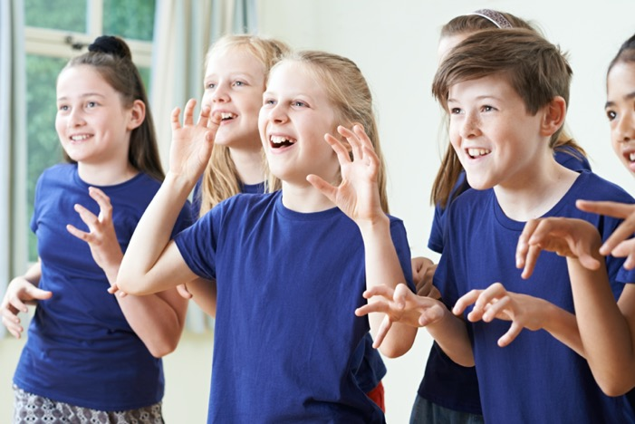
What to expect…
During this session we will explore how to:
use freeze framing and tableaux to explore a moment in time within narrative
use thought tracking in a variety of ways to aid comprehension

Slide 4
What is a freeze framing?
Freeze framing gives children an opportunity to explore a moment in time within a narrative, considering how the characters are feeling during certain events and how this will shape their future thoughts and actions.
In groups, the children improvise the action in a given part of a story and then, when given the instruction to ‘freeze frame’ by the teacher, they stand still, posed mid-action.
Alternatively the children can form a tableaux of the event (a motionless image) as a group, deciding where to stand and how to hold their faces and bodies. By doing this they must step inside the story, imagining how characters might interact and using their facial expressions and gestures to convey the characters’ feelings.

Slide 5
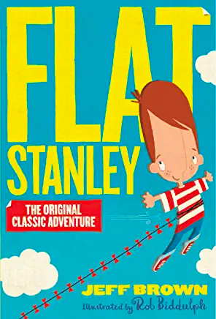
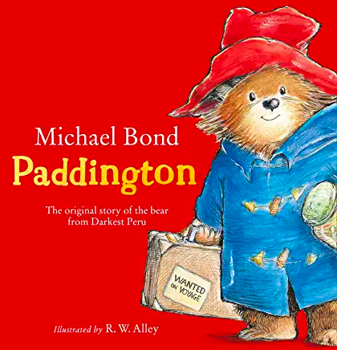
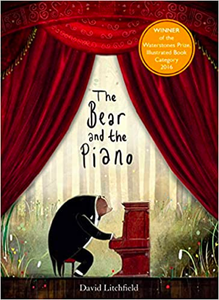
Strike a pose…
The Brown’s finding Paddington alone on the platform
Stanley’s family on finding him a little flatter than usual
The Bear returning to the forest to see his friends and family
Three boys playing on Sudden Hill

Slide 6
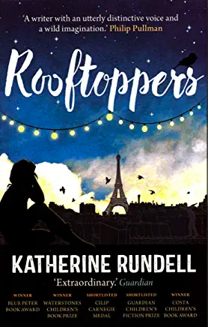
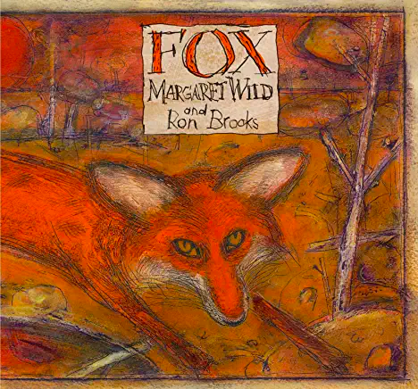
Strike a pose…
Auggie’s first day in class
Dog and Magpie meeting Fox for the first time
The welfare visit to Charles and Sophie’s home
At home with Omar’s family when the bombs start dropping

Slide 7
What is thought tracking?
Thought tracking is an essential companion strategy to a freeze frame or tableaux .
Once the children are frozen mid-action, you tap each character’s shoulder in turn and they voice their internal thoughts and feelings at that moment in the story. Alternatively, other children in the class can suggest what each character might be thinking. You can also ask the children to write their ideas on speech bubbles and hold them above the frozen characters.
This technique also works well with illustrations and photographs.

Slide 8
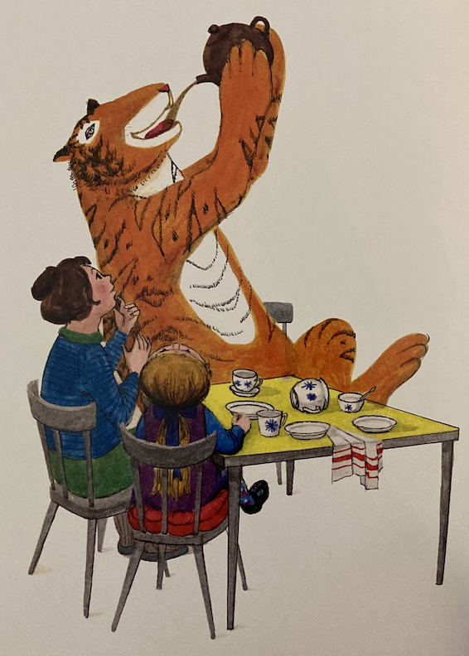
Do be careful with that teapot, dear - it was a wedding present!
Well, this is a good blend. Now, what to eat next?
admiration contentment excitement
hope
The Tiger Who Came To Tea by Judith Kerr. HarperCollins (1968)

Slide 9
A monster, you say! Well that doesn’t sound good. Sounds more like you needed saving from the monster rather than it saving your life.
She’s so young – what does she
know?
frustration
disappointment
fear
I can’t believe they won’t listen. What can I do now?
The Secret of Black Rock by Joe Todd-Stanton. Flying Eye Books (2017)

Slide 10
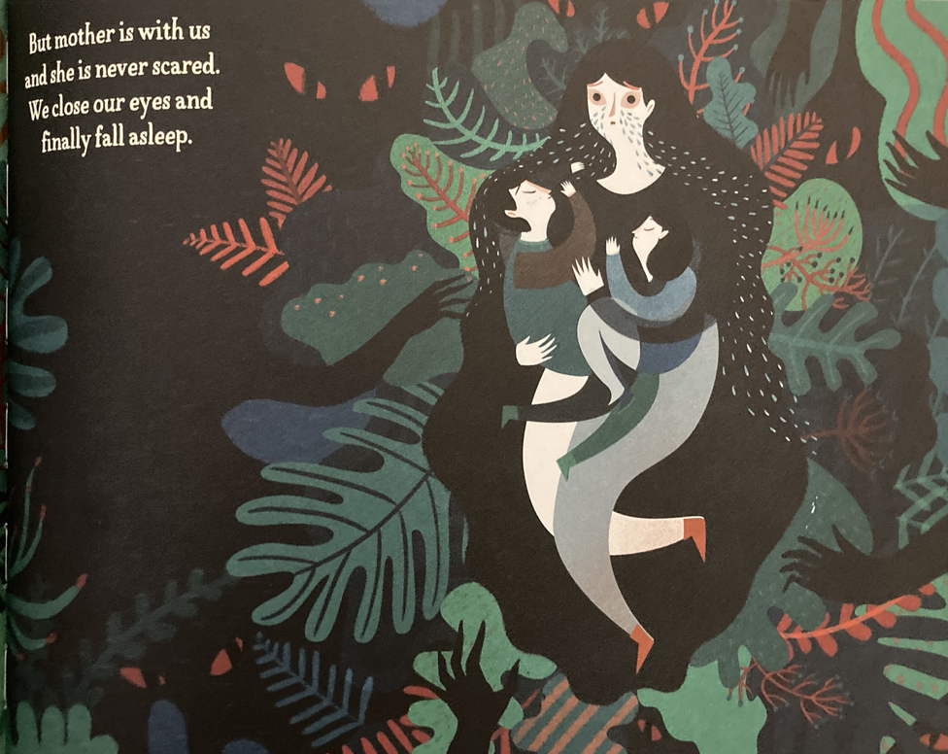
The Journey by
Francesca Sanna. Flying Eye Books (2016)

Slide 11
The benefits of thought tracking
Thought tracking provides an opportunity for children to:
compare characters’ viewpoints
infer characters’ feelings and predict their actions
explore the relationships between characters and how this then influences the plot
imagine alternative endings (for writing)
compose internal dialogue (for writing)
compose convincing dialogue between characters

Slide 12
Benefits of drama in understanding narrative
Drama can support children to:
engage with texts that they might otherwise find ‘difficult’
reflect on the text as a whole, giving a well-informed, personal response
understand plot and action
understand the setting (time and place) and how this influences action
predict and discuss future actions and their consequences
recognise themes and subtext
understand and discuss mood atmosphere
understand characters’ traits and infer their feelings, motives and intentions
explore the language used by characters to express thoughts and feelings
feel more confident when answering inference questions

Slide 13
Thank you!
Course creator: Ruth Baker-Leask

