Slide 1
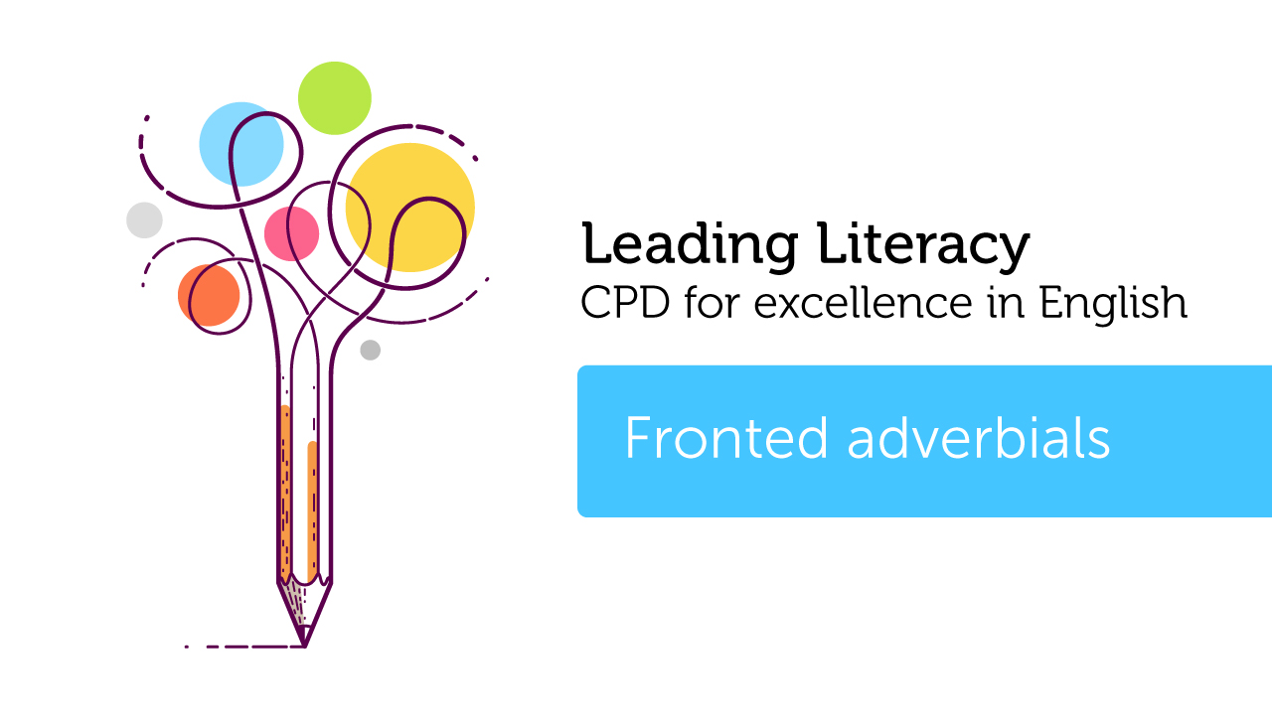

Course creator: Rachel Clarke: https://primaryenglished.co.uk

Slide 2
Fronted adverbials are adverbs or adverbial phrases that appear at the beginning (or front) of sentences.
Two grammatical terms that help children understand fronted adverbials are:
adverbs + phrases

Slide 3
Adverbs
Adverbs tell us how, when, where and how often something happens.
The dog ran quickly.
In this sentence the adverb quickly is telling us more about how the dog is running.

Slide 4
Quiz
Which of the following words are adverbs?
slowly
cautiously
once
earlier
carefully
nearby

Slide 5
Quiz
Which of the following words are adverbs?
slowly
cautiously
once
earlier
carefully
nearby
Answer: They all are.

Slide 6
  The cat walked slowly.
  Joe cautiously opened the door.
  I brushed my teeth twice yesterday.
  Earlier, I made Emily a cup of tea.
  Martha carefully chopped the carrots.
  The farmhouse was nearby.
Whilst many adverbs end –ly, not all do.

Slide 7
  The cat walked slowly. (how)
  Joe cautiously opened the door. (how)
  I brushed my teeth twice yesterday. (how often)
  Earlier, I made Emily a cup of tea. (when)
  Martha carefully chopped the carrots. (how)
  The farmhouse was nearby. (where)

Slide 8
  The cat walked slowly. (how)
  Joe cautiously opened the door. (how)
  I brushed my teeth twice yesterday. (how often)
  Earlier, I made Emily a cup of tea. (when)
  Martha carefully chopped the carrots. (how)
  The farmhouse was nearby. (where)
We can see that adverbs are extremely mobile. They can be used at the beginning, in the middle and at the end of sentences.
More about this later…

Slide 9
Phrases
Adverbials can be single words or adverbial phrases.
Jamie caught the bus earlier.
Jamie caught the bus earlier this morning.
A phrase is a group of words that work together.
A phrase does not include a verb.
An adverbial phrase tells us how, when, where and how often something happens in a sentence.

Slide 10
Quiz
Can you identify the adverbial phrases in these sentences?
In the middle of the forest, there was a haunted castle.
The children ran to school this morning.
Class 10 completed their work very quickly.
Every morning, I walk to the newspaper shop.
EXTENSION: Can you identify what each adverbial is telling us?

Slide 11
Quiz
Can you identify the adverbial phrases in these sentences?
In the middle of the forest, there was a haunted castle. (where)
The children ran to school this morning. (when)
Class 10 completed their work very quickly. (how)
Every morning, I walk to the newspaper shop. (how often)

Slide 12
Fronted adverbials
Adverbials can be moved around a sentence.
The children ran to school this morning.
This morning, the children ran to school.
When the adverbial is placed at the beginning of the sentence, it is called a fronted adverbial. We use a comma to mark that the adverbial has been brought to the start of the sentence.

Slide 13
Quiz
Can you locate the adverbials in each of these sentences and then rewrite them so that each sentence has a fronted adverbial?
I had a lovely hot shower first thing this morning.
I ate my breakfast next.
I put my school clothes on after that.
I made my way to school through the snow and slush.

Slide 14
Quiz
Can you locate the adverbials in each of these sentences and then rewrite them so that each sentence has a fronted adverbial?
I had a lovely hot shower first thing this morning.
First thing this morning, I had a lovely hot shower.
I ate my breakfast next.
Next, I ate my breakfast.
I put my school clothes on after that.
After that, I put my school clothes on.
I made my way to school through the snow and slush.
Through the snow and slush, I made my way to school.

Slide 15
Why do we use fronted adverbials?
  To shift focus from the subject (person/ thing) of the sentence to how, where or when the action of the sentence is taking place.
  To create clarity – for example when listing instructions that need to be followed in a particular order (first, after that, before doing that…) or specific manner (carefully, gently).
  To create interest in a text by ensuring that sentences don’t all start in the same way.
  To create cohesion by tying sentences together. (The boy was frightened. At the same time, he was exhilarated).

Slide 16
Thank you!
Course creator: Rachel Clarke: https://primaryenglished.co.uk

