Slide 1


Course creators: Christine Chen
and Lindsay Pickton: www.primaryeducationadvisors.co.uk

Slide 2
KS2 Greater Depth
The pupil can:
write effectively for a range of purposes and audiences, selecting the appropriate form and drawing independently on what they have read as models for their own writing (e.g. literary language, characterisation, structure)
distinguish between the language of speech and writing and choose the appropriate register
exercise an assured and conscious control over levels of formality, particularly through manipulating grammar and vocabulary to achieve this
use the range of punctuation taught at key stage 2 correctly (e.g. semi-colons, dashes, colons, hyphens) and, when necessary, use such punctuation precisely to enhance meaning and avoid ambiguity.

Slide 3
Formative Assessment
Enjoy & immerse:
Butterflies report
Capture & organise:
Minotaurs
}
Collaborative composition
Minotaurs
APPLY to another mythical creature

Slide 4
Golden Thread
Anatomy/ appearance
Nutrition
MINOTAURS
Overview :
Cause of extinction
Habitat
Behaviour

Slide 5
Golden Thread
Recount of …Our trip to the British Museum………….
By………………………………………………………………………………………………..
Lunch
Coach
Shop
Sculptures
Mummies
Intro
Home/
Sum-up
Use words, phrases, pictures

Slide 6
Projected outcome: Henry was right/wrong to dissolve the monasteries
Golden Thread
First point:
----------------
Second point:
----------------
Third point:
----------------

Slide 7
A Significant Challenge:
Impersonal Voice
The voice of an expert
Often formal, but not the same thing
Removal of all personal reference (author and audience)
As far from day-to-day language as we get
This will need gradual development over the years

Slide 8
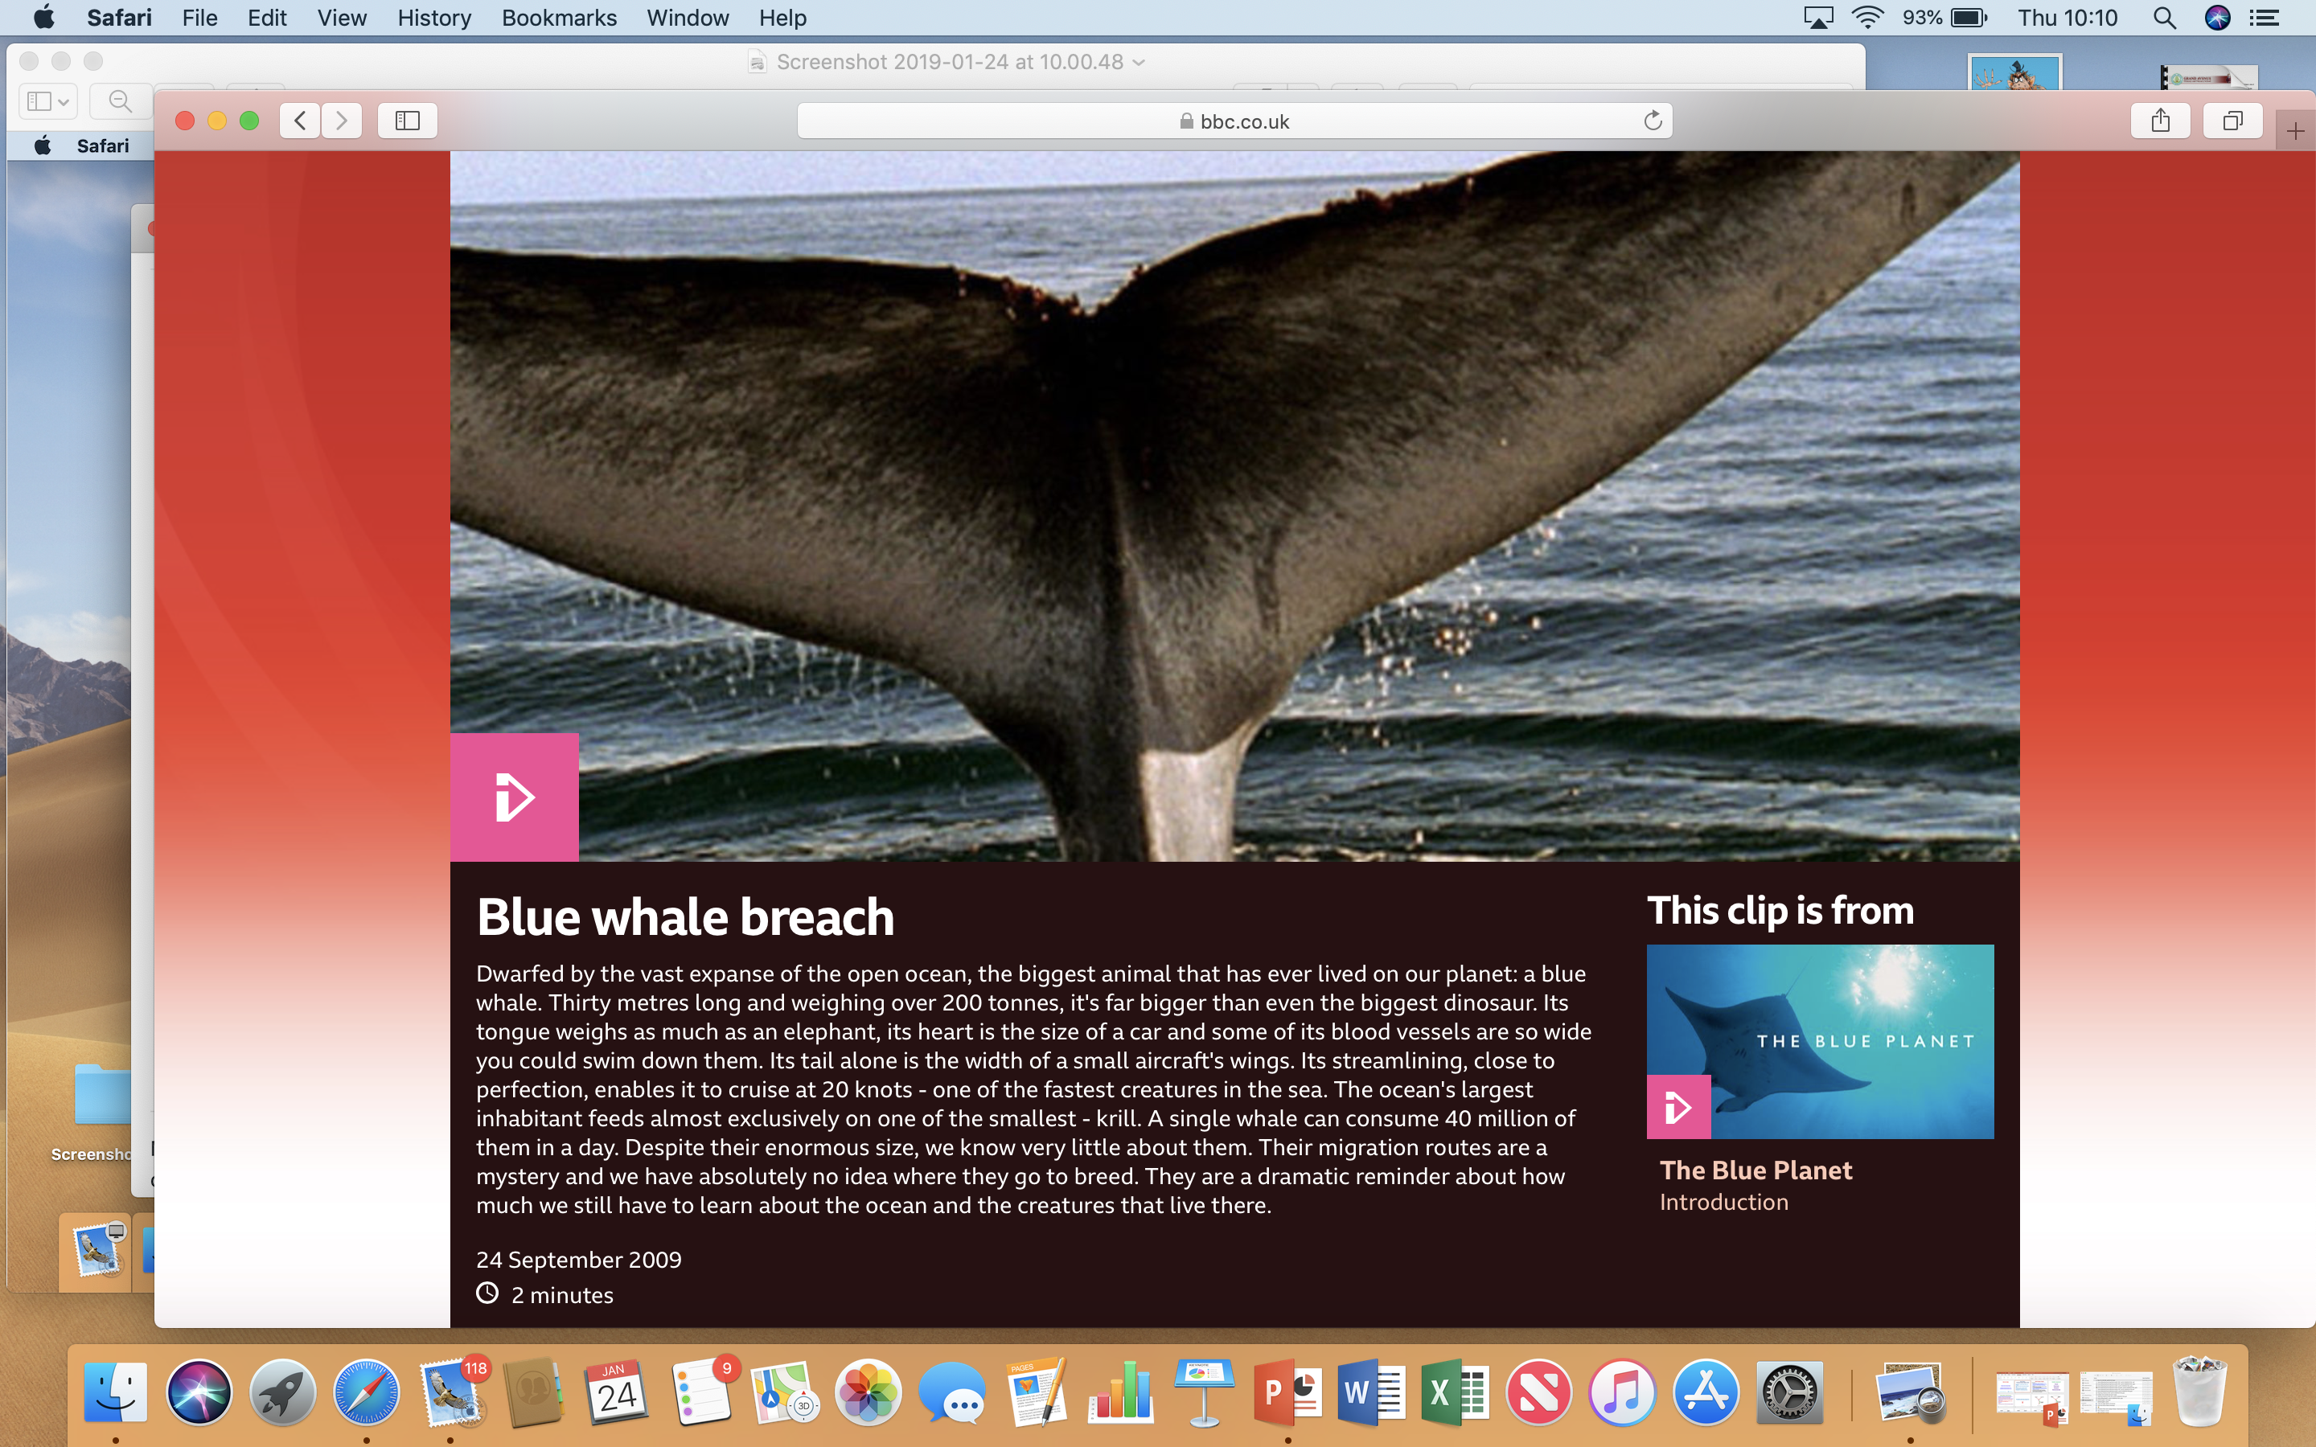

Slide 9
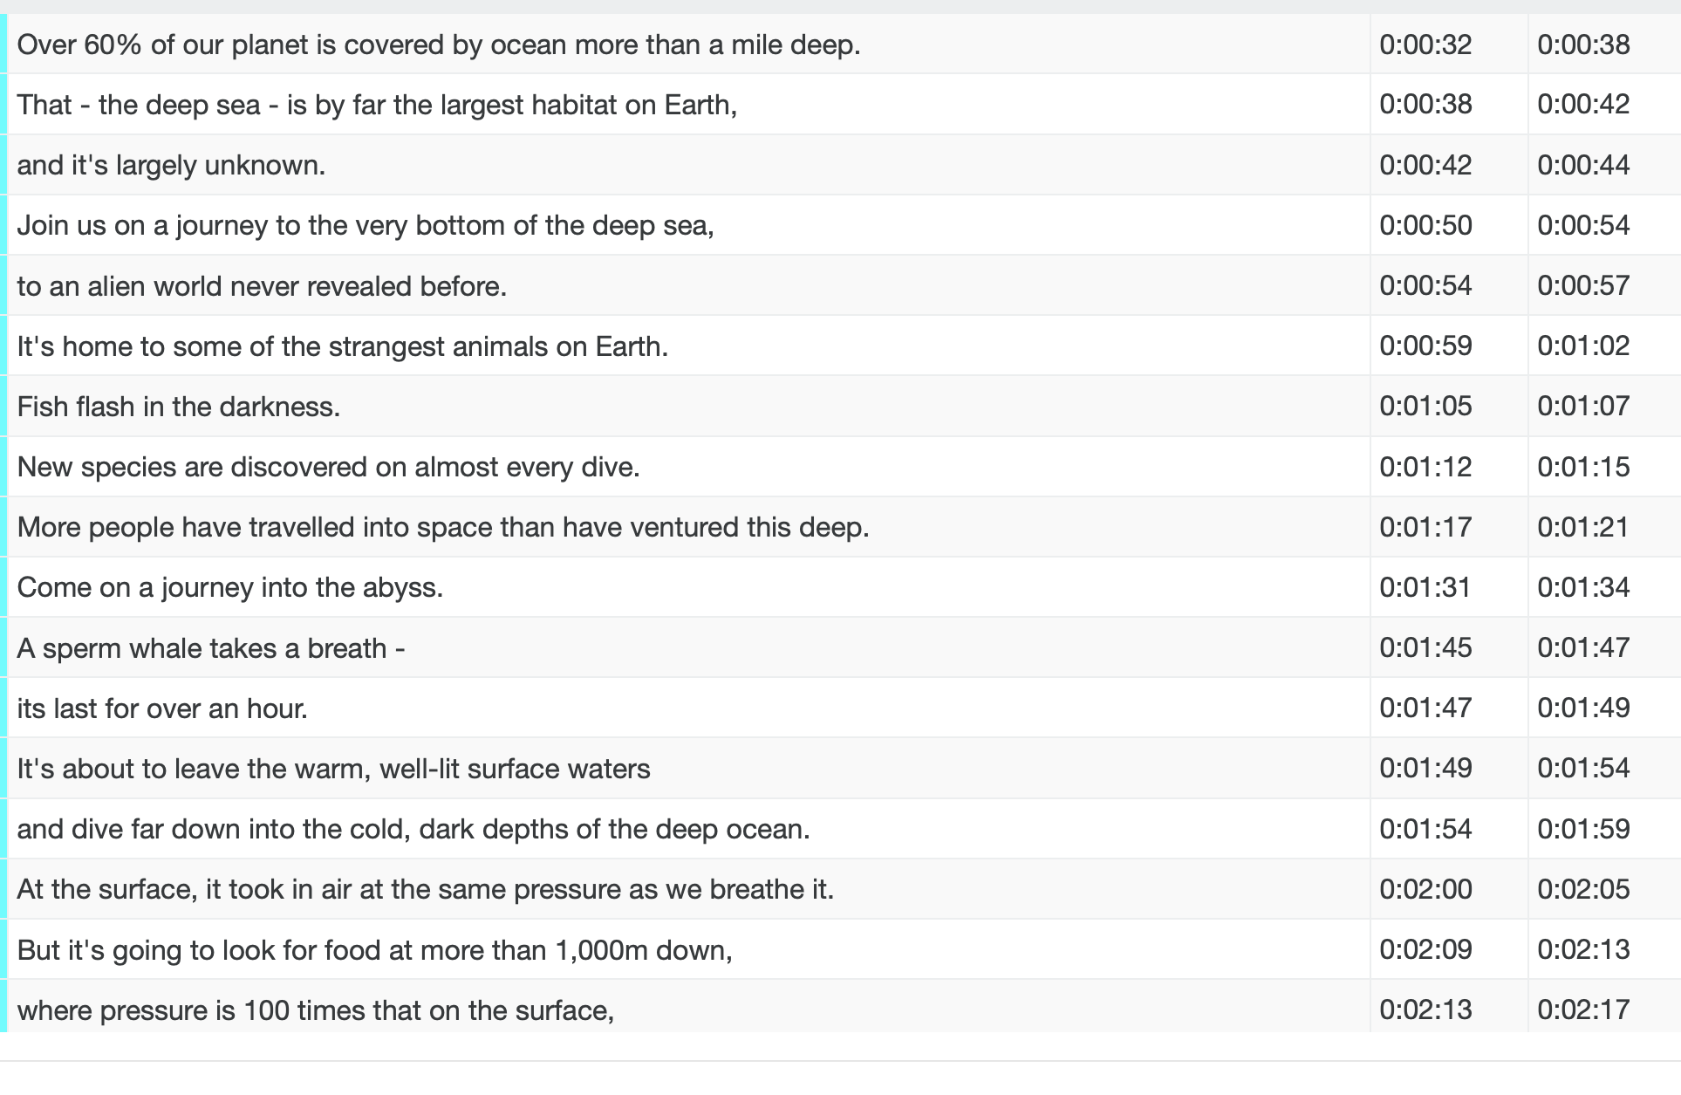
‘Voice’ - Transcripts

Slide 10
Impersonal tips
Avoid use of pronouns ‘I’ or ‘we’
Often in third person (‘they’, ‘it’, ‘he/she’, subject name e.g. ‘whales’)
Only use ‘you’ generally, in the sense of ‘one’: “The blood vessels are so large you could swim through them.” (That doesn’t mean you, personally!)
e.g. scientific/ historical/ geographical reports and news

Slide 11
Passive voice in formal, impersonal writing
The seeds were placed in the soil
The light is controlled by the switch
The sides are covered in foil for insulation
The process is known as ‘photosynthesis’
Tutankhamun's tomb was discovered by Howard Carter

Slide 12
Why do people die if they stop breathing?
In order to stay alive, human beings need a constant supply of oxygen (a gas found in the air) to all parts of the body. They also need to rid their bodies of a waste gas called carbon dioxide, which would otherwise poison them.
These two gases are carried round the body in the blood. Veins carry the blood to the heart and arteries carry blood away from the heart. Both veins and arteries divide into millions of tiny capillary blood vessels. Gases can move between the blood in the capillaries and the tiny cells which make up the human body.
When we have a puff of air, it goes into our spongy, air-saccy lungs. The oxygen bit of air ends up in the blood (which is gross when you think about it). Our clever blood gets the oxygen all the way to the heart.
The heart pumps this oxygen-carrying blood around the whole body through arteries which divide into capillaries to reach the body cells. Oxygen passes from the blood to the cells, and carbon dioxide (the waste gas) passes from cells into the blood. Veins take this waste-carrying blood back to the heart, which pumps it back into the lungs. There the carbon dioxide passes into air sacs.
Notes:
Discover para 3 accidentally!

Slide 13

…choose the appropriate
Register

Slide 14
Why do people die if they stop breathing?
In order to stay alive, human beings need a constant supply of oxygen (a gas found in the air) to all parts of the body. They also need to rid their bodies of a waste gas called carbon dioxide, which would otherwise poison them.
These two gases are carried round the body in the blood. Veins carry the blood to the heart and arteries carry blood away from the heart. Both veins and arteries divide into millions of tiny capillary blood vessels. Gases can move between the blood in the capillaries and the tiny cells which make up the human body.
When we have a puff of air, it goes into our spongy, air-saccy lungs. The oxygen bit of air ends up in the blood (which is gross when you think about it). Our clever blood gets the oxygen all the way to the heart.
The heart pumps this oxygen-carrying blood around the whole body through arteries which divide into capillaries to reach the body cells. Oxygen passes from the blood to the cells, and carbon dioxide (the waste gas) passes from cells into the blood. Veins take this waste-carrying blood back to the heart, which pumps it back into the lungs. There the carbon dioxide passes into air sacs.

Slide 15
Why do people die if they stop breathing?
In order to stay alive, human beings need a constant supply of oxygen (a gas found in the air) to all parts of the body. They also need to rid their bodies of a waste gas called carbon dioxide, which would otherwise poison them.
These two gases are carried round the body in the blood. Veins carry the blood to the heart and arteries carry blood away from the heart. Both veins and arteries divide into millions of tiny capillary blood vessels. Gases can move between the blood in the capillaries and the tiny cells which make up the human body.
The heart pumps this oxygen-carrying blood around the whole body through arteries which divide into capillaries to reach the body cells. Oxygen passes from the blood to the cells, and carbon dioxide (the waste gas) passes from cells into the blood. Veins take this waste-carrying blood back to the heart, which pumps it back into the lungs. There the carbon dioxide passes into air sacs.
When the human being breathes out, the carbon dioxide is pushed back out into the air. Breathing in and out is therefore essential because it ensures that life-giving oxygen is constantly replaced and poisonous carbon dioxide expelled.

Slide 16
Paragraph 3
When a human being breathes in, the air goes down into the lungs, which are like two spongy bags filled with millions of air sacs. Oxygen from the air passes through the sacs into the capillary blood vessels. The blood then carries the oxygen through a vein to the heart.

Slide 17
Paragraph 3
Breathe in
Air into lungs (filled with air-sacs)
Oxygen passes into capillaries
Blood carries oxygen through vein to heart

Slide 18
Vocabulary
Three Tier Framework
T1: Those learnt in everyday ‘common’ language
T2: Those likely to occur frequently in a wide variety of written texts
T3: Those tightly associated with a content area

Slide 19
Tier two words | Children’s likely expressions
emerging | coming out
fortunately | luckily
inform | tell
maintain | keep going
unfurl | unroll

Slide 20
News Flash
 | SIMPLE | PROGRESSIVE (CONTINUOUS) | PERFECT
PAST | Police searched for clues | Police were searching for clues | Police had searched for clues
PRESENT | Police search for clues | Police are searching for clues | Police have searched for clues
FUTURE | Police will search for clues | Police will be searching for clues | Police will have searched for clues

Slide 21
Present Perfect
Where?
newspaper reports and bulletins;
A bomb has exploded.
diaries, postcards and letters recounting personal experiences;
I have spent the whole day shopping.
biographies and autobiographies
She has changed women’s lives forever.

Slide 22
Present Perfect
A verb tense that uses the present form of the verb
‘to have’ before the past participle of the main verb.
I have broken my leg.
I have ridden a bike before.
They have bought a new house.
He has walked on the moon.
It is used to refer to a completed action (or series of actions) with results lasting into the present.

Slide 23
Past perfect:
Going back further…
He hadn’t seen her for over 10 years.
We had already set sail when the storm began.
Flashback…

Slide 24
Diary: Day 8
(example use of past perfect)
Yesterday I brought back from the ship a quantity of tools, a drill, a dozen hatchets, a grind-stone for sharpening, iron crow bars….a hammock, a mattress, blankets, clothes and great coats. I thought that I had rescued nearly everything that was on board. But I was wrong.
Robinson Crusoe, Daniel Defoe

Slide 25
Future perfect
I will have finished my homework by midnight.
I will have walked 10 miles by the time I finish.
Dear Mum,
By the time you read this, I will have arrived in California

Slide 26
From Fact to Uncertainty…
I am lying.
You are over 18.
We were first!

Slide 27
From Fact to Uncertainty…
I am lying.
You are over 18.
We were first!
If I be lying, sue me.
The law requires you be over 18.
I insist we be first!

Slide 28
From Fact to Uncertainty…
Theresa May writes to me.
God helps you.
Your letter arrives today.

Slide 29
From Fact to Uncertainty…
Theresa May writes to me.
God helps you.
Your letter arrives today.
I insist Theresa May write to me.
God help you.
I require that your letter arrive today.

Slide 30
Subjunctive verb form
Mood of verbs expressing what is imagined, wished or possible.
If I were you… (not “was”!)
The law requires that you be 18 or over to vote.
(to be)
I insist your letter arrive before lunchtime.
(to arrive)
He required that all the players be excellent.
(to be)
Notes:
Most famous: To be, or not to be…
If I were a rich man… I wouldn’t have to work hard
If I were a butterfly… - link to modals: …I would

Slide 31
Thank you!
Course creators: Christine Chen
and Lindsay Pickton: www.primaryeducationadvisors.co.uk

