Slide 1
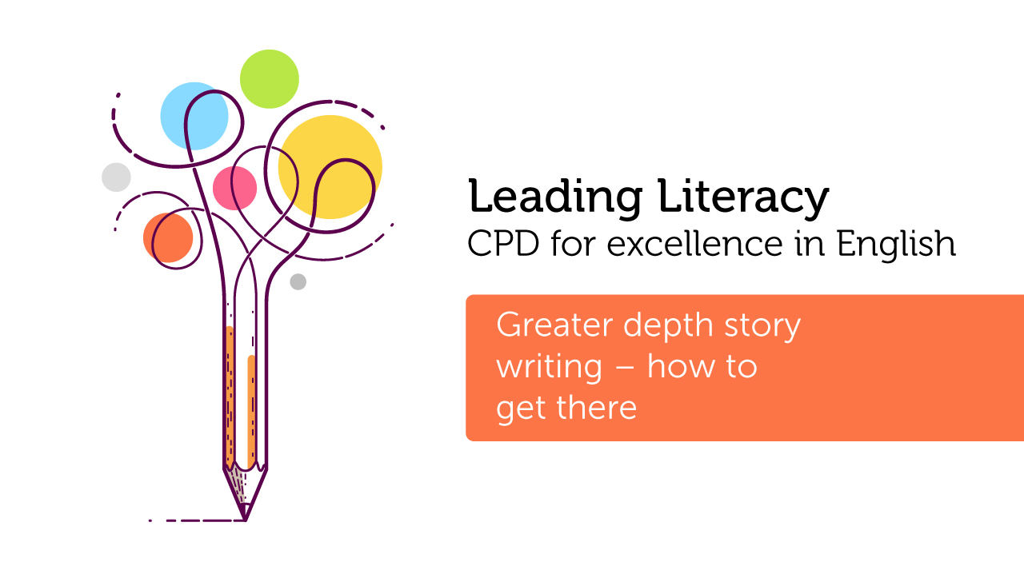

Course creators: Christine Chen and Lindsay Pickton: www.primaryeducationadvisors.co.uk

Slide 2
Greater Depth
KS1
The pupil can, after discussion with the teacher:
write effectively and coherently for different purposes, drawing on their reading to inform the vocabulary and grammar of their writing
KS2
Write effectively for a range of purposes and audiences, selecting the appropriate form and drawing independently on what they have read as models for their own writing
This is what GD writers do already.
Let’s show everyone how to do it!
Notes:
New TAF

Slide 3
Jack and the Beanstalk
Swapping cow for beans
Angry mother
Climbing and stealing
Chased by giant
Chopping down the beanstalk (with mum’s help)

Slide 4
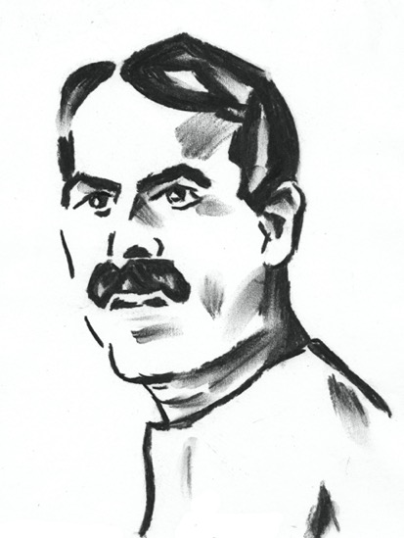
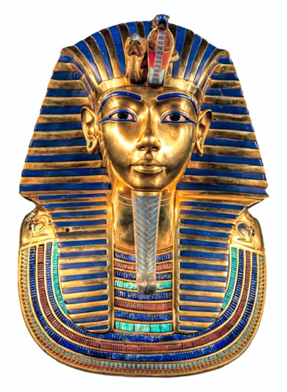

Slide 5
Jack and the Beanstalk
Cross-curricular version starring the young Howard Carter
Swapping cow for beans
Angry mother
Climbing and stealing
Chased by giant
Chopping down the beanstalk (with mum’s help)
Swapping the _______ for a mysterious map
Angry professor
Searching, digging and stealing
Chased by The Mummy
Ending the curse (with professor’s help)

Slide 6
Jack and the Beanstalk
Howard Carter and the Mysterious Map
Swapping the _______ for a mysterious map
Angry professor
Searching, digging and stealing
Chased by The Mummy
Ending the curse (with professor’s help)
Chased by The Mummy _______
Swapping the _______ for a mysterious map
Angry professor
Searching, digging and stealing _______
Ending the curse (with professor’s help)

Slide 7

Shared Planning:
If we scaffold the content, they can concentrate on the skills of writing

Slide 8
Excellent models for language
(vocabulary and sentence structure)
The best writers are the avid readers.
Language is acquired through imitation.
What are we giving them to imitate?

Slide 9
Greater Depth
KS1
The pupil can, after discussion with the teacher:
write effectively and coherently for different purposes, drawing on their reading to inform the vocabulary and grammar of their writing
KS2
Write effectively for a range of purposes and audiences, selecting the appropriate form and drawing independently on what they have read as models for their own writing
This is what GD writers do already.
Let’s show everyone how to do it!
Notes:
New TAF

Slide 10
Shared writing
with help from a model
…because GD writers have heads full of models!

Slide 11
The Fox and the Billy Goat
Fox was daydreaming as he trotted along. He was thinking of all the plump little hens he’d caught last night, waiting for him in his nice warm den.
Stories from Aesop Usborne
The young archaeologist was whistling as he strode back from the bazaar.
He was imagining the gleam of golden relics he’d read about, waiting for him in the hidden tomb.

Slide 12
Drawing on their reading as models for writing
Synthesis
Selecting appropriate models of language, and combining with the content to create a desired effect
Notes:
Greater depth writers do this because they have been immersed in reading; where their lovely terms of reading come from

Slide 13


Slide 14

His feet padded along the balcony, slinking silently past the closed doors of the other flats. No one glimpsed his shadow flickering across the curtain or noticed the uneven rhythm of his steps.
-Gillian Cross
Its feet scraped across the flagstones, moving menacingly towards the flickering torch of the distracted archaeologist.
Only the rats noticed its sinister shape stalking between the relics, disturbed by the ragged rhythm of its rasping breaths.
-Chris and Linz

Slide 15
Baby Elephant
Susan Hellard
Although Ephra was the smallest baby elephant in the herd, she had the biggest ears. The trouble was, she didn’t use them. She never listened.

Slide 16

The Iron Man
Ted Hughes
The Iron Man came to the top of the cliff.
The wind sang through his iron fingers.
Never before had the iron man seen the sea.
He swayed in the strong wind
that pressed against his back.
Ted Hughes

Slide 17
Rapunzel
Sarah Gibb
Suddenly they came to a clearing, and there in the middle was a tall tower with no door; just a few windows at the very top.
…
To Rapunzel’s amazement, although the tower was as slender as a tree, inside there was room after beautiful room, lit by thousands of delicate lamps, which glowed as bright as day.

Slide 18
Talk About Short
Kevin Crossley-Holland
He was alone, and in the dark; and when he reached out for the matches, the matches were put into his hand.

Slide 19
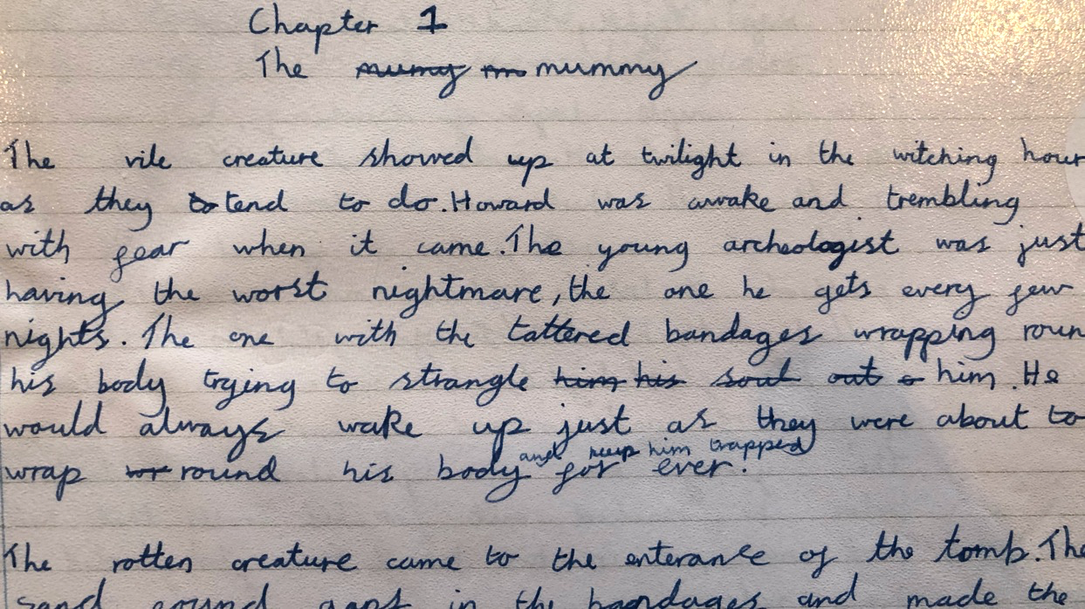
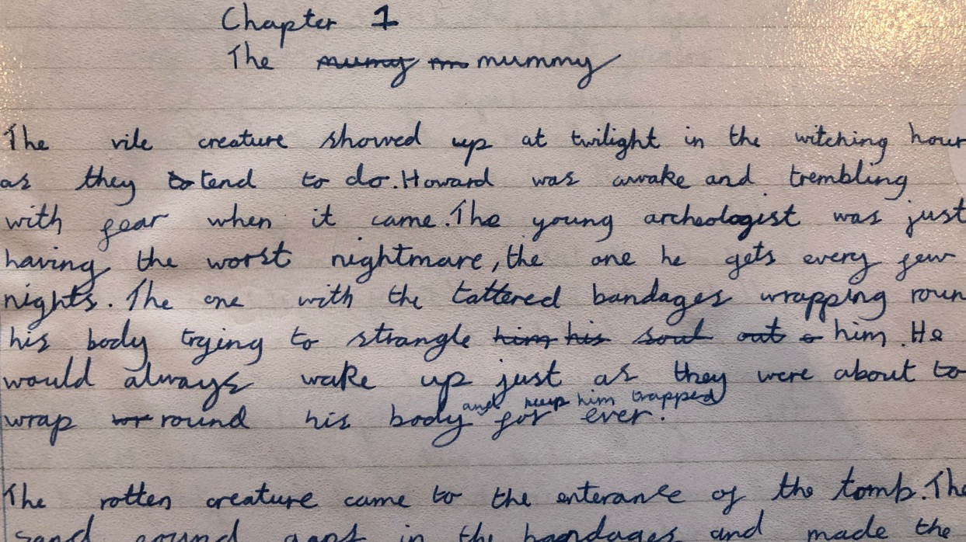

Slide 20
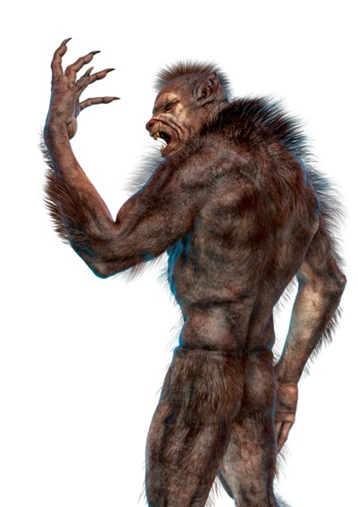
The monster showed up just after midnight. As they do. Conor was awake when it came. He’d had a nightmare. Well, not a nightmare. The nightmare. The one he’d been having a lot lately. The one with the darkness and the wind and the screaming. The one with the hands slipping from his grasp, no matter how hard he tried to hold on.

Slide 21
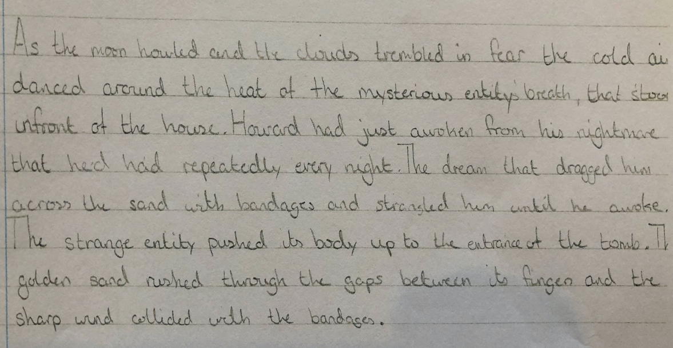

Slide 22
The Hound of the Baskervilles
Arthur Conan Doyle
Blindly we ran through the gloom, blundering against boulders, forcing our way through gorse bushes, panting up hills and rushing down slopes, heading always in the direction whence those dreadful sounds had come.

Slide 23
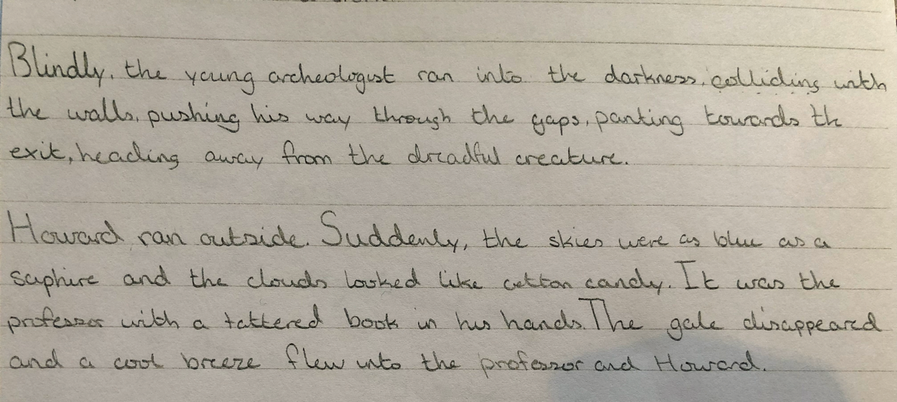

Slide 24
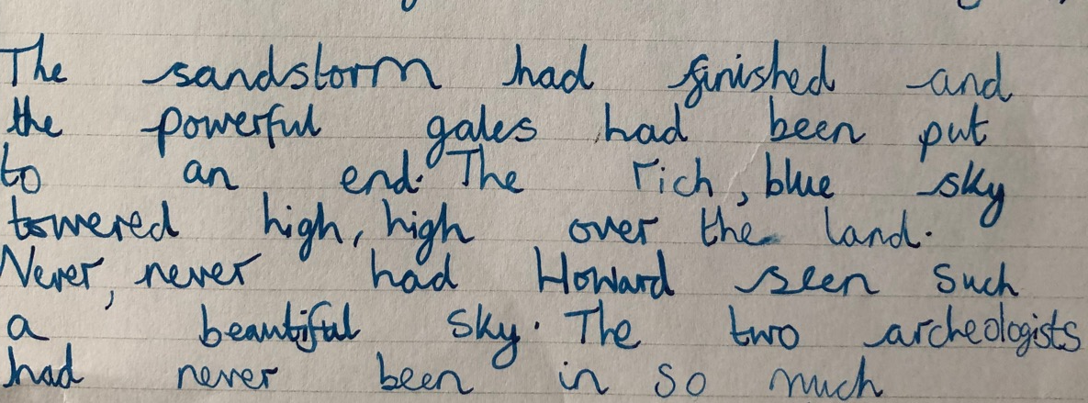

Slide 25
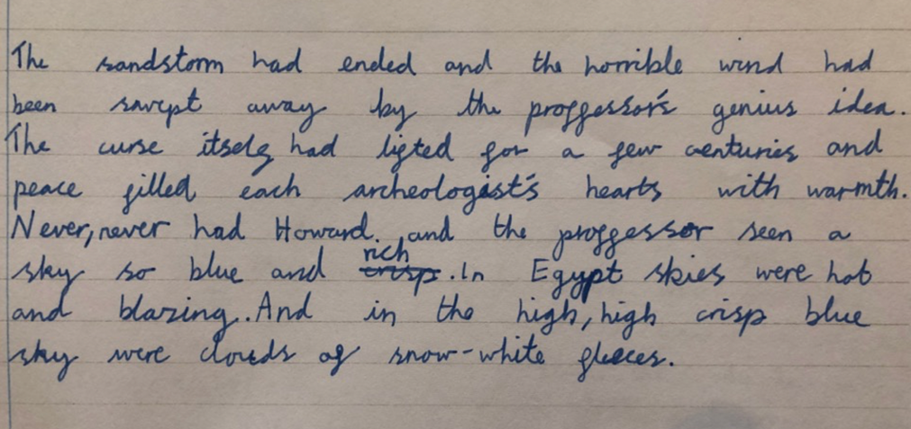

Slide 26
The Secret Garden
The rainstorm had ended and the grey mist and clouds had been swept away in the night by the wind. The wind itself had ceased and a brilliant, deep blue sky arched high over the moorland. Never, never had Mary dreamed of a sky so blue. In India skies were hot and blazing; this was of a deep cool blue which almost seemed to sparkle like the waters of some lovely bottomless lake, and here and there, high, high in the arched blueness floated small clouds of snow-white fleece.

Slide 27
We are going to be crafting…
  Tension / Suspense
  Character entrance (good/ bad)
  Dialogue that shows character
  Dialogue that moves the story on quickly
  Fast pace, eg action
  ENDINGS including reflection
  Time shift/Place shift
  A sense of place (rather than a description of setting)
  A feeling of relief
  …etc…
So keep an eye out for / hunt down / be aware of/ collect AMAZING examples!

Slide 28
Alternative Versions
“Making it your own”
THINK….. Tell me/ tell each other/ note down…
How else could we express this?
How else could we start this sentence?
What needs to be different in your version?
How could we change the order of these sentences?
What other language devices might work to develop the mood?
(adverbials, similes, personification, exaggeration or understatement, etc)

Slide 29
Thank you!
Course creators: Christine Chen and Lindsay Pickton: www.primaryeducationadvisors.co.uk

