Slide 1


Course creators: Christine Chen
and Lindsay Pickton:
www.primaryeducationadvisors.co.uk

Slide 2
Formative Assessment
Enjoy and immerse:
Model text
Capture and organise:
New content
}
_
_
_
_
_
Collaborative composition
(including both shared writing and children’s writing)
Independent application

Slide 3
Formative Assessment
Enjoy & immerse: Cinderella
Capture & organise:
Charlie and the Try-Out
}
Collaborative composition
APPLY

Slide 4
Formative Assessment
Enjoy & immerse: Cinderella
Capture & organise:
Charlie and the Try-Out
}
Collaborative composition
APPLY

Slide 5
Formative Assessment
Enjoy & immerse: Cinderella
Capture & organise:
Charlie and the Try-Out
}
_____
}
Each of these lessons has the same structure:
VGP focus
Shared writing
Children apply
Collaborative composition
Charlie and the Try-Out
APPLY

Slide 6

Collaborative composition lesson suggested structure:
1. Play with the language focus
2. Collaborative Composition:
  Model application of the language focus in writing
  Children begin to apply the language focus orally and perhaps on mini whiteboards
3. Children write, applying the language focus in their versions of the same story
Mini-plenaries throughout, checking the language focus
Repeat for all sections/chapters of the collaborative composition

Slide 7
Collaborative composition
Charlie and the Try-Out - Chapter 1
1. Play with adverbials for when and why
2. Collaborative Composition:
  Model application of when and because in writing
  Children begin to apply when and because orally and perhaps on mini whiteboards
3. Children write, applying when and because in their versions of the same story
Mini-plenaries throughout, checking when and why adverbials

Slide 8
Collaborative composition lesson
Charlie and the Try-Out – Chapter 2
1. Play with dialogue that shows character
2. Collaborative Composition:
  Model application of dialogue that shows character in writing
  Children begin to apply dialogue that shows character orally and perhaps on mini whiteboards
3. Children write, applying dialogue that shows character in their versions of the same story
Mini-plenaries throughout, checking dialogue that shows character

Slide 9
Collaborative composition lesson
Charlie and the Try-Out – Chapter 3
1. Play with adverbials for how and where
2. Collaborative Composition:
  Model application of adverbials for how and where in writing
  Children begin to apply adverbials for how and where orally and perhaps on mini whiteboards
3. Children write, applying adverbials for how and where in their versions of the same story
Mini-plenaries throughout, checking adverbials for how and where

Slide 10
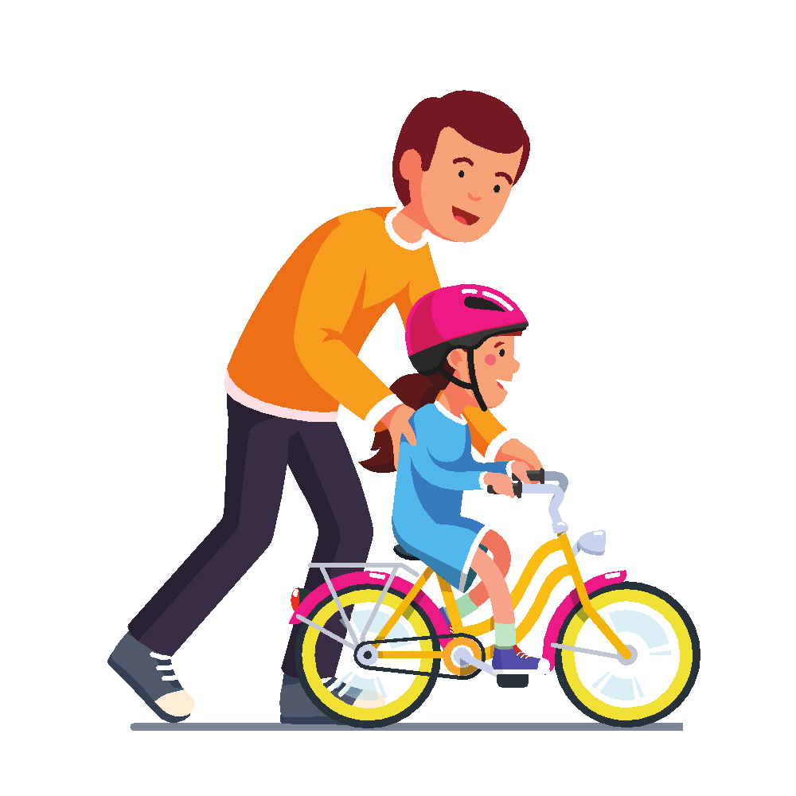

Slide 11
One recipe for the gradual release into indepedence
1. Have the first sentence pre-written and on display. It’s great if that sentence exemplifies the language focus
2. Model write the next sentence, articulating thinking about word choices – especially around application of the focus
  3. Take contributions in a small way at first: “what word/ phrase would work here to describe…”
  4. Move them into finishing a sentence you have started
  5. Then tell them what the next sentence should be about, and what VGP skill in particular you want them to apply; take oral contributions
  6. Repeat the last step, but ask them to write the sentence (eg on mini-whiteboards)
Repeat for all sections/chapters of the collaborative composition

Slide 12
From whole-class to exercise books: managing the transition
1. Ensure that they are not challenged with both content and new skills: if you want to see applied skills, make sure the content is familiar
2. Check pencils/ pens are ready to write before the lesson begins
  3. Consider ways of getting the title and date down before the teaching begins
  4. Ban all forms of eraser unless it is a final draft
  5. “Yes you may … , once you’ve written __ sentences.”
  6. Leave the shared writing on display…for __ minutes
  7. “Whisper your first sentence to your partner before going back to your desk.” “Who’s written a great first sentence they’re prepared to share?”

Slide 13
Access and Deepening:
Challenge and support during whole class shared writing
1. Cut-aways: use ongoing assessment (orally and mini-whiteboards) to assess understanding of the focus skill, and release children to the ir own writing accordingly.
2. Trail-blazers: children you know can already use today’s focus skill get on with their writing independently, but they must use that skill; (10) mins, they will show their work to the class; as the class move on to their own writing, you hang on to the trail-blazers and teach them what they need next.
  3. AfL-led: following a reminder of the focus skill/s, every child gets on independently, while you move briskly around, assessing relative achievement. Then you pull identified children to you for (10) mins shared writing at the appropriate level; and then another group at a different level, and maybe even a third group.

Slide 14
National Curriculum
Pupils should understand, through being shown these,
the skills and processes that are essential for writing:
thinking aloud to explore and collect ideas,
drafting, and re-reading to check their meaning is clear,
including doing so as the writing develops.
Pupils should be taught to
monitor whether their own writing makes sense
in the same way that they monitor their reading…

Slide 15
Thank you!
Christine Chen and Lindsay Pickton: www.primaryeducationadvisors.co.uk

