Slide 1
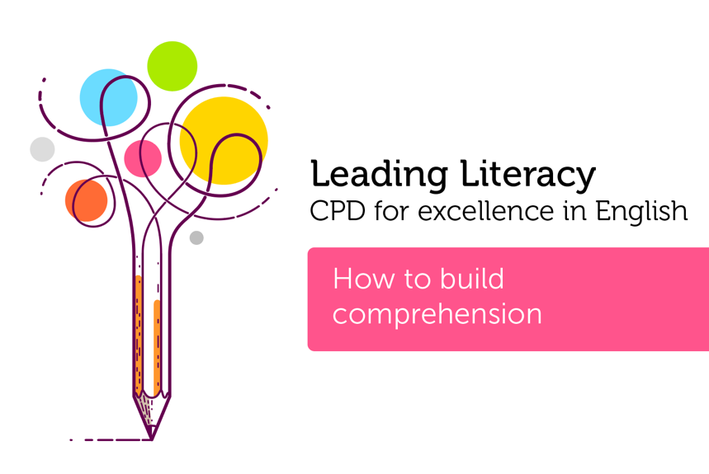

Course creator: James Clements
@MrJClements

Slide 2
The simple view of reading
Language comprehension processes
good
Word recognition
processes
good
Word recognition
processes
poor
poor
Language comprehension processes
Primary Framework for literacy and mathematics
Primary National Strategy – Crown copyright 2006

Slide 3
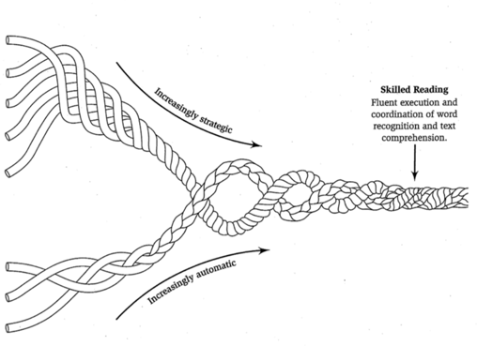
Scarborough’s ‘Reading Rope’
Language comprehension
Background knowledge
(facts, concepts, etc.)
Vocabulary
(breadth, precision, links, etc)
Language structures
(syntax, semantics, etc)
Verbal reasoning
(inference, metaphor, etc)
Literacy knowledge
(print concepts, genres, etc)
Skilled reading
Fluent execution and coordination of word recognition and text comprehension
Word recognition
Phonological awareness
(syllables, phonemes, etc)
Decoding
(alphabetic principle, spelling-sound correspondences)
Sight recognition
(of familiar words)
Scarborough, H. (2001) Connecting early language and literacy to later reading (dis)abilities: Evidence, theory and practice.
In Neuman, S.B., and Dickinson, D.K. (Eds.) Handbook of Early Literacy (pp.97-110) New York: Guilford Press

Slide 4
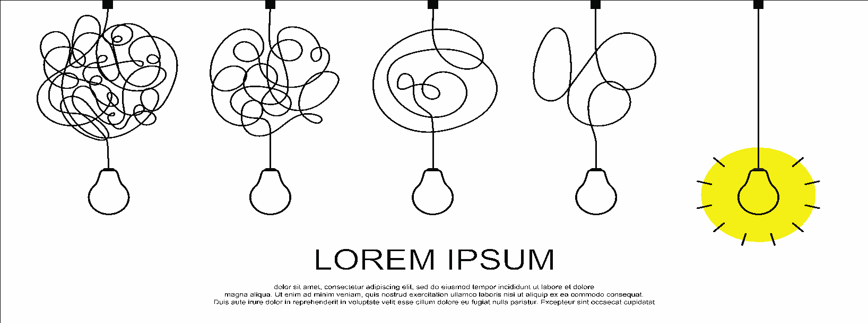
Comprehension relies on…
Background knowledge
(facts, concepts, experience)
Vocabulary
Language structures
(syntax, grammar, semantics)
Verbal reasoning (inference, metaphors)
Literacy knowledge
(genres, text types, print concepts)

Slide 5
He clasps the crag with crooked hands;
Close to the sun in lonely lands,
Ring'd with the azure world, he stands.
The wrinkled sea beneath him crawls;
He watches from his mountain walls,
And like a thunderbolt he falls

Slide 6
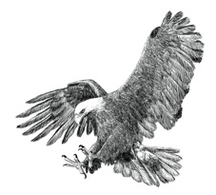
The Eagle
He clasps the crag with crooked hands;
Close to the sun in lonely lands,
Ring'd with the azure world, he stands.
The wrinkled sea beneath him crawls;
He watches from his mountain walls,
And like a thunderbolt he falls
Alfred, Lord Tennyson

Slide 7
Comprehension relies on…
Background knowledge
(facts, concepts, experience)
Vocabulary
Language structures
(syntax, grammar, semantics)
Verbal reasoning (inference, metaphors)
Literacy knowledge
(genres, text types, print concepts)

Slide 8
The Eagle
He clasps the crag with crooked hands;
Close to the sun in lonely lands,
Ring'd with the azure world, he stands.
The wrinkled sea beneath him crawls;
He watches from his mountain walls,
And like a thunderbolt he falls

Slide 9
The Eagle
He clasps the crag with crooked hands;
Close to the sun in lonely lands,
Ring'd with the azure world, he stands.
The wrinkled sea beneath him crawls;
He watches from his mountain walls,
And like a thunderbolt he falls
Alfred, Lord Tennyson

Slide 10
The Eagle
He clasps the crag with crooked hands;
Close to the sun in lonely lands,
Ring'd with the azure world, he stands.
The wrinkled sea beneath him crawls;
He watches from his mountain walls,
And like a thunderbolt he falls
Alfred, Lord Tennyson

Slide 11
The Eagle
He clasps the crag with crooked hands;
Close to the sun in lonely lands,
Ring'd with the azure world, he stands.
The wrinkled sea beneath him crawls;
He watches from his mountain walls,
And like a thunderbolt he falls
Alfred, Lord Tennyson

Slide 12
Comprehension relies on…
Background knowledge
(facts, concepts, experience)
Vocabulary
Language structures
(syntax, grammar, semantics)
Verbal reasoning (inference, metaphors)
Literacy knowledge
(genres, text types, print concepts)
To be successful, we may need to embrace the messiness of comprehension

Slide 13
How can a text based curriculum support comprehension?
  Exposure to texts - quantity, quality and range
  Exposure to language and talk
  Modelling comprehension building through
thinking aloud
questioning
discussion and book talk

Slide 14
Key questions
  Do we have a shared model for thinking about comprehension across our school?
  Does our curriculum provide time and space to develop children’s comprehension?
  How do we balance the demands of assessment with more authentic ways of teaching reading?
  Do the texts we read and study provide opportunities for children to develop their comprehension?

Slide 15

Thank you!
Course creator: James Clements
@MrJClements

