Slide 1
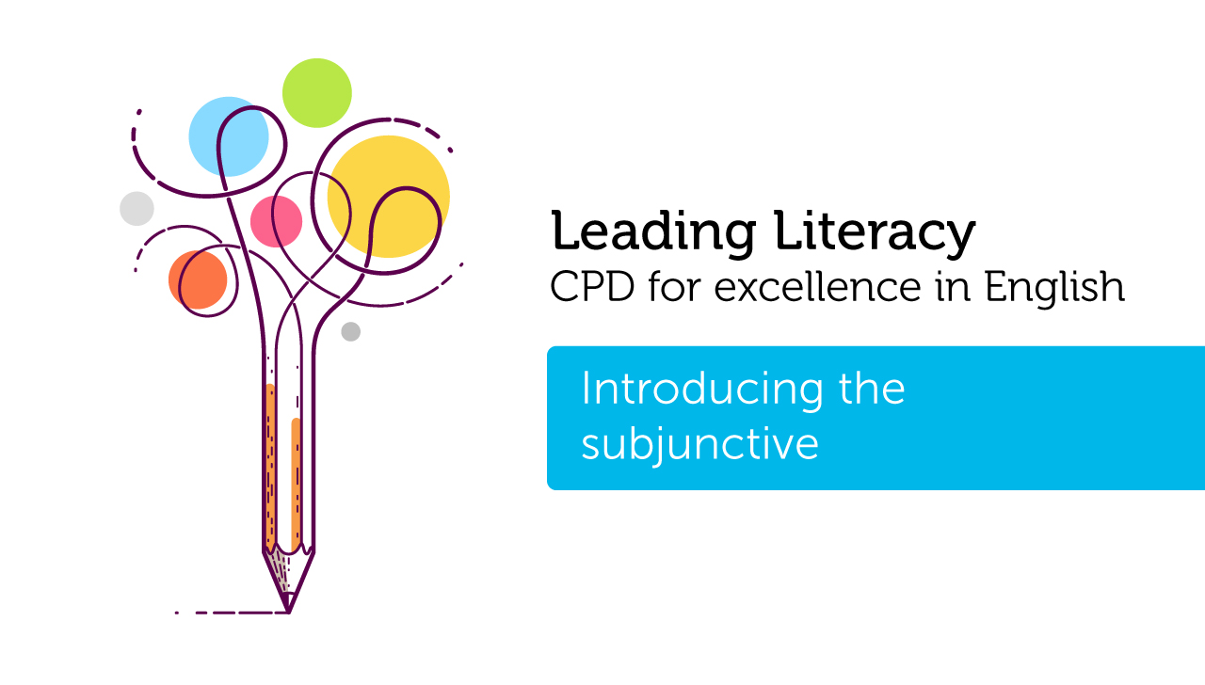

Course creator:
Rachel Clarke: primaryenglished.co.uk
Notes:
Hello and welcome
My name and role
Stopping video to complete tasks etc.

Slide 2
The subjunctive is a verb form used in very formal Standard English.
It is used to express:
dreams, possibilities and aspirations
importance and commands
Notes:
Subjunctive form is one of the hardest areas to teach in the primary years. There are two main ways that it is used and in this presentation we are going to look at each.

Slide 3
Expressing dreams, possibilities & aspirations
If I were a millionaire, I would buy you a sports car.
If I was a millionaire, I would buy you a sports car.
Notes:
It’s highly likely that in your everyday speech, you may well say the second sentence – If I was a millionaire. And strictly speaking, you wouldn’t be wrong. I’d certainly not split hairs over it and would completely understand your meaning.
However, the situation is hypothetical. I’m not a millionaire, and am highly unlikely to become one, so whilst the sentiment of the sentence is all very warming. It’s not likely to happen. When using very formal Standard English this type of sentence is dealt with by using the subjunctive.
In the case of dreams, possibilities and aspirations, the subjunctive is formed by using the verb ‘to be’ in its ‘were’ form instead of its ‘was’ form.
The subjunctive appears in the national curriculum as a Year 6 objective. It’s extremely tricky and understanding how to form it depends on pulling together lots of prior knowledge.
First off, is recognising different forms of the verb ‘to be’.

Slide 4
The verb ‘to be’
Which of the following words are forms of the verb ‘to be’?
am, are, be, being, been, is, was, were
Notes:
Stop the video to complete this task. Can be done on own, in pairs or groups. I will reveal the answer on the next slide.

Slide 5
The verb ‘to be’
am, are, be, being, been, is, was, were
Notes:
Bit of a trick questions. All forms of the verb ‘to be’.
The infinitive form of this verb is ‘to be’ – we’ll talk about the infinitive later in the presentation.

Slide 6
Which sentences use the subjunctive?
I were going to town.
I could travel to the moon if I were an astronaut.
If I were a grown-up, I’d go to the cinema every day.
James and I were riding our bikes.
Sam were doing his homework.
Notes:
Another chance to stop the video and consider each of the sentences. Which sentences use the subjunctive.

Slide 7
Which sentences use the subjunctive?
I were going to town. (incorrect)
I could travel to the moon if I were an astronaut. (subjunctive)
If I were a grown-up, I’d go to the cinema every day. (subjunctive)
James and I were riding our bikes. (plural past tense)
Sam were doing his homework. (incorrect)
Notes:
Another chance to stop the video and consider each of the sentences. Which sentences use the subjunctive.

Slide 8
What else can we see in these sentences?
I could travel to the moon if I were an astronaut.
If I were a grown-up, I’d go to the cinema every day.
The use of ‘if’ to indicate a conditional statement.
If clauses are subordinate. When they come at the front of a sentence they are marked with a comma.

Slide 9
What else can we see in these sentences?
The use of a modal verb indicating uncertainty.
I could travel to the moon if I were an astronaut.
If I were a grown-up, I’d go to the cinema every day.
Modal verbs in contracted forms.
Notes:
Explain that modals can also include negatives such as wouldn’t, couldn’t etc.

Slide 10
Applying the subjunctive in authentic texts
Discursive writing, e.g.
If people were to stop hunting whales… If you were to consider the following points…
To promote the features of a place or product in persuasive texts, e.g.
If you were lucky enough to visit the rain forest, you would see…

Slide 11
Expressing importance & giving commands
We ask that children be able to recite their times tables.
We ask that children are able to recite their times tables.
It is recommended that he stay indoors until he is better.
It is recommended that he stays indoors until he is better.
Notes:
This form of the subjunctive is extremely useful for when we want to write very formal texts with a voice of authority. As with the previous form of the subjunctive, it requires children to apply previous grammatical learning.
The two sentences in black use the subjunctive. The other examples still use Standard English but in a far less formal register.

Slide 12
Expressing importance & giving commands
Verb simplified to its infinitive form.
We ask that children be able to recite their times tables.
It is recommended that he stay indoors until he is better.
Verb simplified to its infinitive form

Slide 13
The infinitive
The infinitive is the base form of a verb e.g. to walk, to dance, to be, to go etc.
When we use the command and importance form of the subjunctive, we use these base forms of verbs but without the ‘to’. E.g .walk, dance, be, go etc.
Notes:
Talk about split infinitive here. The Star Trek example to boldly go… explain that this is a convention rather than a hard and fast rule.

Slide 14
Verbs are more than ‘doing words’
Children will come unstuck forming the infinitive if they only recognise verbs as ‘doing words’ e.g. dance, walk
They need to recognise that the infinitive of am, are, being, been, is, was, were is ‘to be’
And, that the infinitive of had, has, having and is ‘to have’
Verbs are doing, being and having words.

Slide 15
Expressing importance & giving commands
‘That’ is used to link the subjunctive clause to the main clause in the sentence.
We ask that children be able to recite their times tables.
It is recommended that he stay indoors until he is better.
‘That’ is used to link the subjunctive clause to the main clause in the sentence.

Slide 16
Writing using the subjunctive form
Rewrite these sentences using the subjunctive form
  It is important that children are at school for 9.00.
  We advise that your child brings sunscreen on the trip to the beach.
  We ask that each child has a notebook and pencil.
Notes:
Can you explain to a colleague what you have done and why?

Slide 17
Writing using the subjunctive form
Rewrite these sentences using the subjunctive form
  It is important that children are at school for 9.00.
  It is important that children be at school for 9.00.
  We advise that your child brings sunscreen on the trip to the beach.
  We advise that your child bring sunscreen on the trip to the beach.
  We ask that each child has a notebook and pencil.
  We ask that each child have a notebook and pencil.
Notes:
You’ve used the infinitive form of verbs in order to form the subjunctive.

Slide 18
Applying the subjunctive in authentic texts
Highly formal letters from people in authority and in letters of complaint, e.g.
Dear parents please ensure that all homework be completed in blue ink…
I request that the item be returned to me…
Formal requests to visitors, such as those at a tourist attraction:
We ask that all visitors refrain from eating in the… Whilst on the premises, we ask that visitors keep to the paths… For the comfort of all our guests, we ask that guests maintain quiet between the hours of…

Slide 19
Essential prior knowledge
An understanding of verbs as doing, being and having words
Recognition of modal verbs that indicate possibility
Recognising the infinitive form of verbs
Understand the effect of the subordinating conjunctions ‘if’ and ‘that’ on the rest of the sentence
Appreciate that there are different levels of formality in writing

Slide 20
Thank you!
RachelClarke: primaryenglished.co.uk

