Slide 1
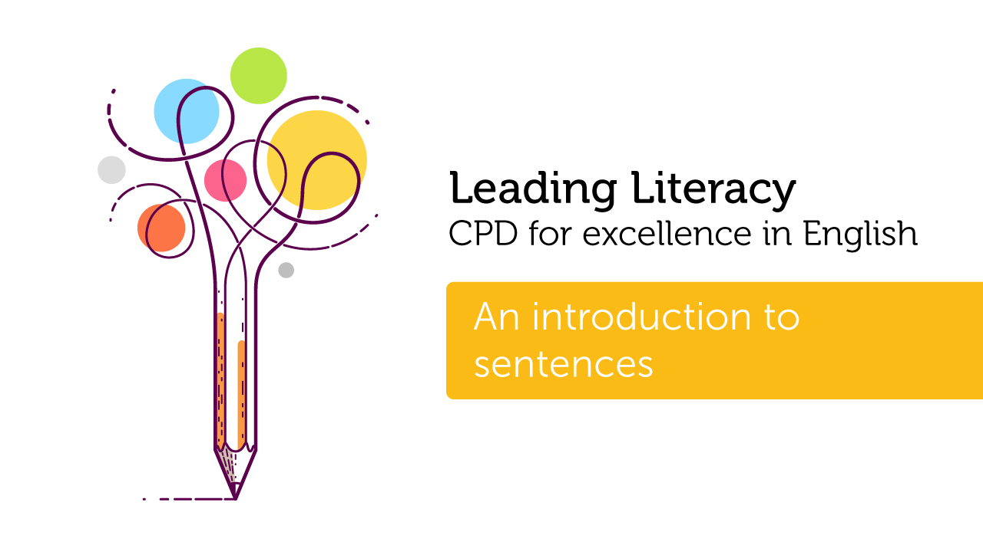

Course creator: Rachel Clarke: https://primaryenglished.co.uk

Slide 2

What is a
sentence?
Notes:
Something that begins with a capital letter and ends with a full stop, exclamation mark or question mark.
A collection of words separated by finger spaces
A group of words that contains a verb
A group of words that has a subject and verb and sometimes an object (something that the verb is being done to).
‹#›

Slide 3
Sentences
A sentence is a group of words that make sense on their own.
This is a dog.
Sentences start with a capital letter.
Sentences have a verb.
Sentences end with a full stop, a question mark or an exclamation mark.

Slide 4
Sentences
This sentence has one clause.
A clause is a group of words that contain a verb and make sense on their own.
This is a dog.
verb

Slide 5
Sentences
This sentence has two clauses.
Each clause has a verb.
The clauses are joined by a conjunction.
This is a dog and it has big paws.
clause 1
conjunction
clause 2

Slide 6
Sentences
The subject of a sentence is the person or thing undertaking the verb in the sentence.
The dog chewed the bone.
subject

Slide 7
Sentences
The subject of a sentence is the person or thing undertaking the verb in the sentence.
Sentences have a verb.
The dog chewed the bone.
subject
verb

Slide 8
Sentences
The subject of a sentence is the person or thing undertaking the verb in the sentence.
Sentences have a verb.
Some sentences also have a object (the person or thing the verb is being acted on by the verb).
The dog chewed the bone.
subject
verb
object

Slide 9
Subject, verb, object
Can you identify the subject, verb and object (if there is one) in each of these sentences?
The cat licked its kittens.
Sarah mowed the lawn.
The dog slept.

Slide 10
Subject, verb, object
Can you identify the subject, verb and object (if there is one) in each of these sentences?
The cat licked its kittens.
Sarah mowed the lawn.
The dog slept.

Slide 11
Four sentence types
Statements tells you something. They end with a full stop.
Question asks you something. They end with a question mark.
Command tells you to do something. They can end with a full stop or an exclamation mark.
Exclamations show surprise or strong feelings about something. They end with an exclamation mark. Exclamations often start with the words ‘how’ or ‘what’.

Slide 12
Four sentence types
I like dogs.
Would you like a dog?
Statements tells you something. They end with a full stop.
Question asks you something. They end with a question mark.
Look at the dog.
Command tells you to do something. They can end with a full stop or an exclamation mark.
What a lovely dog, that is!
Exclamations show surprise or strong feelings about something. They end with an exclamation mark. Exclamations often start with the words ‘how’ or ‘what’.

Slide 13
Can you identify the sentence types?
What a lovely hat that is! | What are you having for dinner tonight?
Sit down, please. | That is a lovely hat.
First, stir the mixture carefully. | Have you heard the news?

Slide 14
Can you identify the sentence types?
What a lovely hat that is! | What are you having for dinner tonight?
Sit down, please. | That is a lovely hat.
First, stir the mixture carefully. | Have you heard the news?

Slide 15
To summarise
  A sentence is a group of words that make sense on their own.
  Sentences contain a subject, a verb and sometimes an object.
  There are four sentence types: statements, questions, commands and exclamations.

Slide 16
Thank you!
Course creator: Rachel Clarke: https://primaryenglished.co.uk

