Slide 1
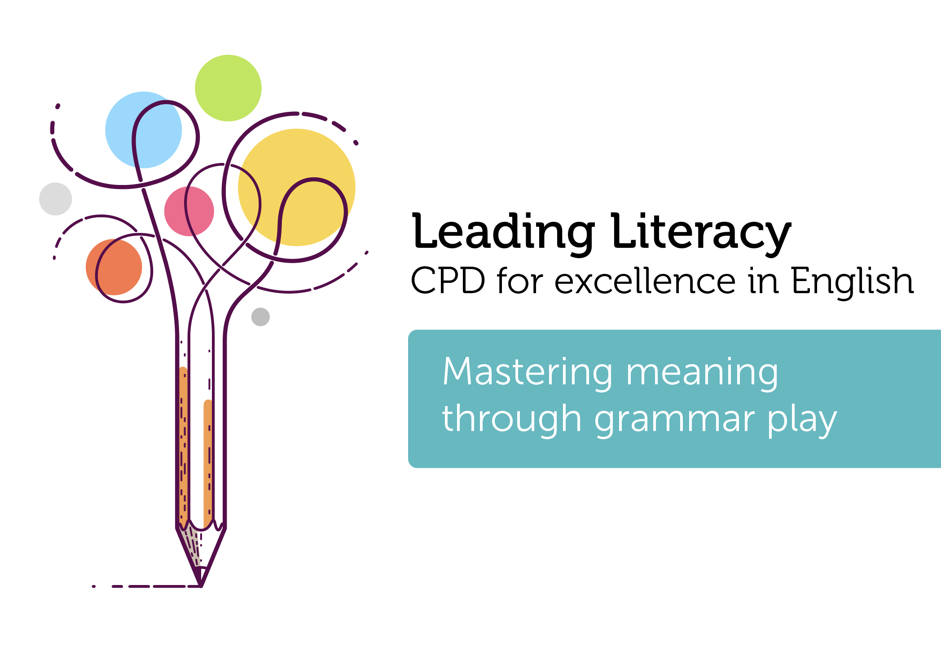

Course creators: Christine Chen and
Lindsay Pickton: www.primaryeducationadvisors.co.uk

Slide 2


Slide 3
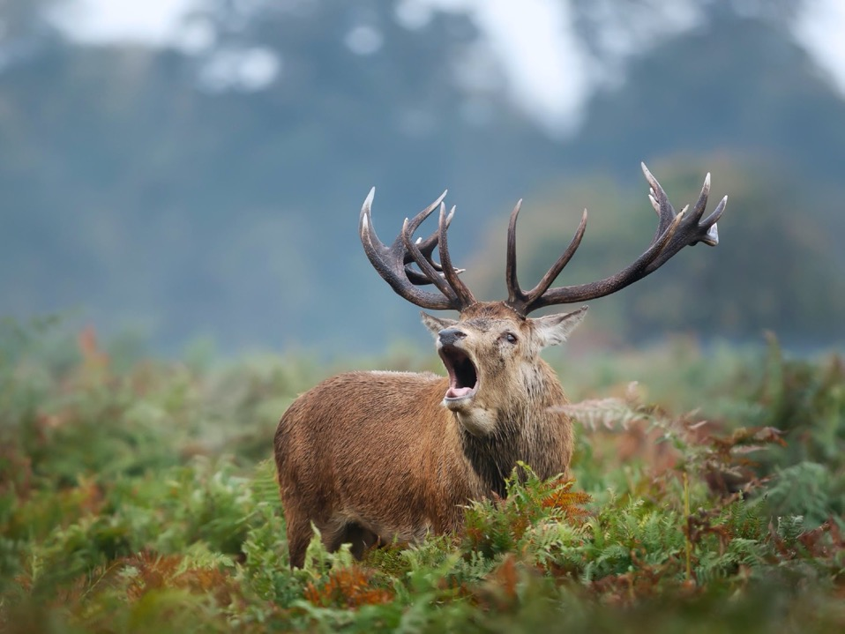

Slide 4


Slide 5
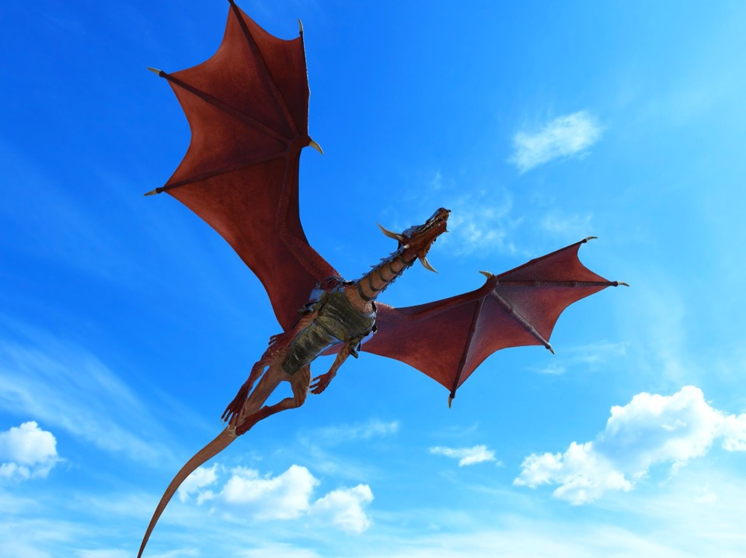

Slide 6
I leapt onto the mighty dragon.
Pronoun
Verb
Preposition
Determiner
Adjective
Noun
1.
2.
3.
4.
5.
6.

Slide 7
I leapt onto the mighty dragon.
Subject
Verb
Preposition
Determiner
Adjective
Object
1.
2.
3.
4.
5.
6.

Slide 8
Then, they crowded around the magician.
Verb
Noun
Preposition
Determiner
Adjective
Pronoun
1.
2.
3.
4.
5.
6.

Slide 9
She strode across the crowded hall.
Verb
Noun
Adjective
Determiner
Preposition
Pronoun
1.
2.
3.
4.
5.
6.

Slide 10
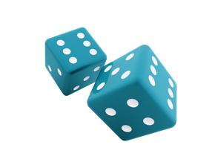
She walked to the old building.
Creepy
Joyful
Relieved
Shocking
Exciting
Magical
Subject
Verb
Preposition
Determiner
Adjective
Object
1.
1.
2.
2.
3.
3.
4.
4.
5.
5.
6.
6.

Slide 11
He walked up the stairs.
Spooky
Joyful
Shocking
Magical
Funny
Exciting
Change subject
Change verb
Change determiner
Add adverb for when
Add adverb/adverbial for how
Expand the noun phrase
1.
1.
2.
2.
3.
3.
4.
4.
5.
5.
6.
6.

Slide 12

Using images to play
with grammar

Slide 13

Expand the noun phrase:
He stared at the ……………………….. bear.

Slide 14

Expand the noun phrase:
He stared at the ……………………….. bear.

Slide 15
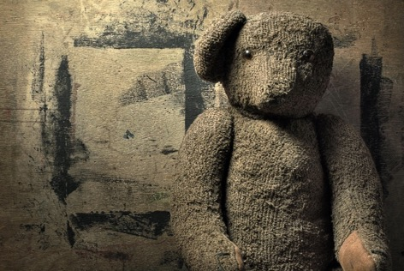
Expand the noun phrase:
He stared at the ……………………….. bear.

Slide 16

The teacher reached the staffroom first.
Which teacher?!

Slide 17
Thumbs up
Thumbs down

Slide 18

Sense of a sentence

Slide 19
I or Me?
Right or wrong?
My friends and I were playing football.
The coach spoke to my team and I.
Me and my mum went to the shop.
The dog barked at Chris and me.

Slide 20
I or Me?
Right or wrong?
My friends and I were playing football.
The coach spoke to my team and I.
Me and my mum went to the shop.
The dog barked at Chris and me.

Slide 21
To be or not to be?
I is playing
I be playing
We be playing
We is playing
We was playing
I am playing
We are playing
We were playing

Slide 22
Grammar
is language
is clarity and precision
is description and creativity
is empowering

Slide 23
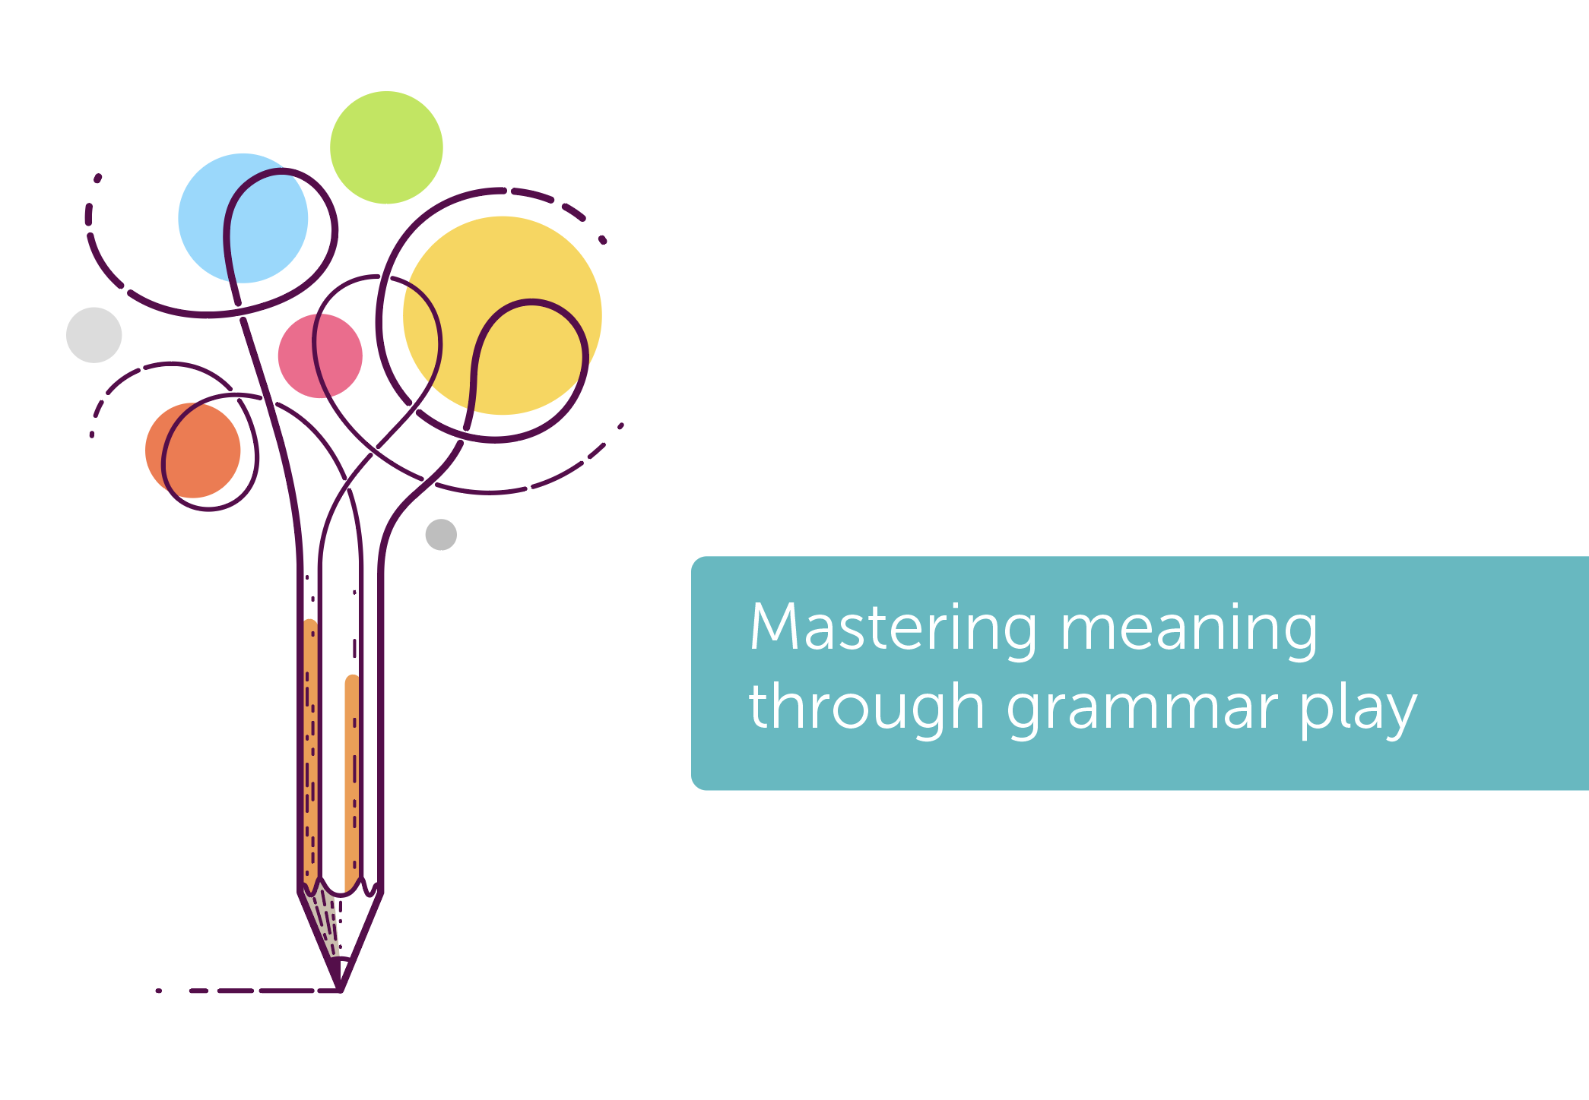
Thank you!
Christine Chen and Lindsay Pickton: www.primaryeducationadvisors.co.uk

