Slide 1
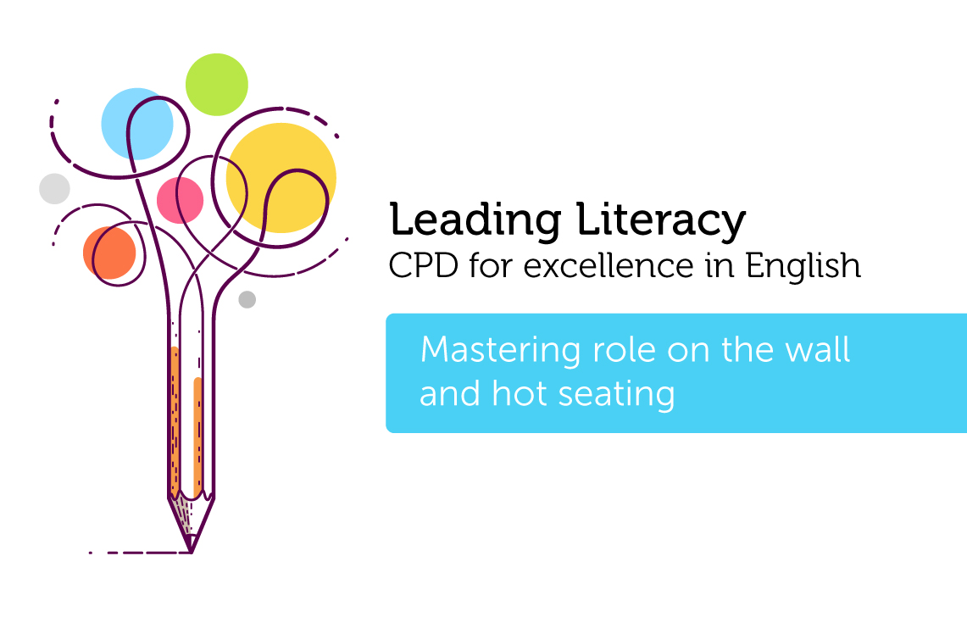

Course creator: Ruth Baker-Leask

Slide 2
What to expect…
Role on the wall and hot seating are strategies commonly used in primary classrooms; however, though both are fun and popular activities, the full potential of these techniques is often overlooked.
During this session we will explore how to:
      make role on the wall purposeful, deepening children’s understanding of how characters change as a plot advances.
        use hot seating as an effective tool during most reading lessons and discussions.

Slide 3
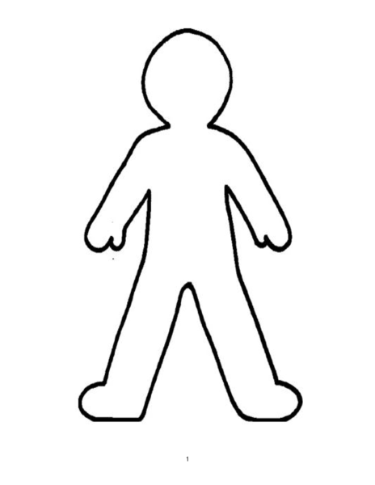
What is role on the wall?
Role on the wall is a strategy that supports children in thinking and talking about the key characters in stories.
Using a large outline of a chosen character, the children record the character’s thoughts and feelings on the inside of the outline and the character’s appearance, as well as how they are viewed by others, on the outside of the outline.
This technique is most useful when repeated at different points during a story. This enables children to notice, discuss and evaluate the emotional changes a character experiences as the plot of a story unfolds.
Although this is not strictly a drama technique, children find that thinking and acting in role comes more easily when they have explored a character in depth.

Slide 4
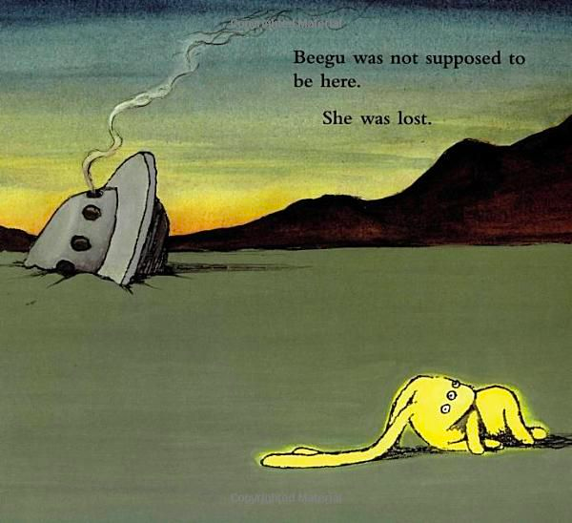
Beegu. Red Fox, 2004. Illustrations Alexis Deacon

Slide 5
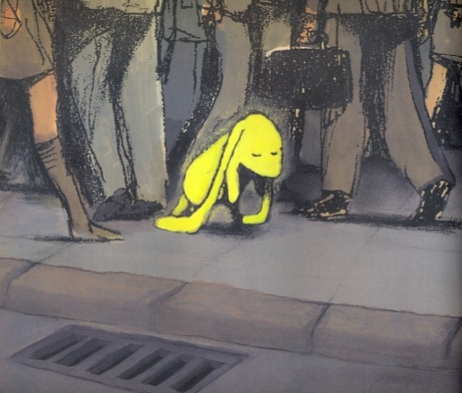
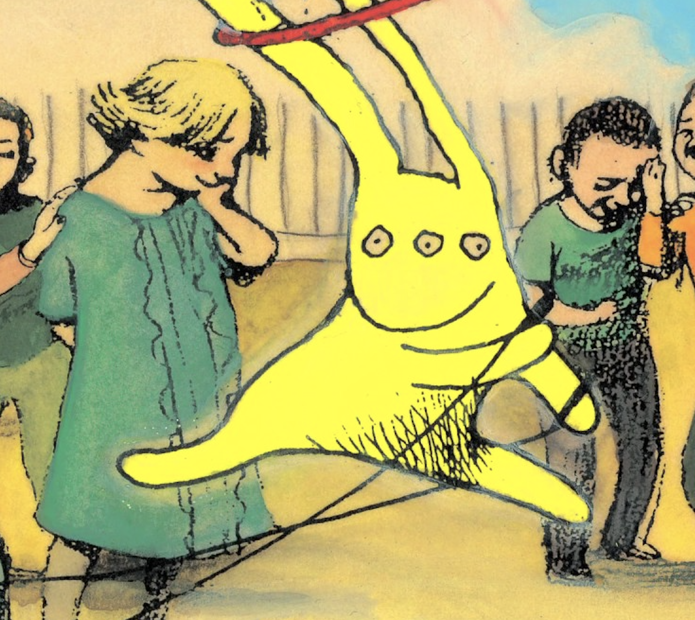
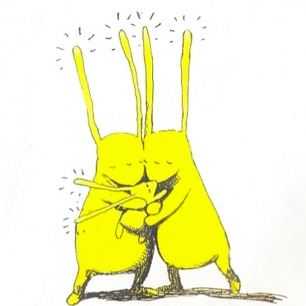
Beegu by Alexis Deacon
Beegu. Red Fox, 2004. Illustrations Alexis Deacon

Slide 6
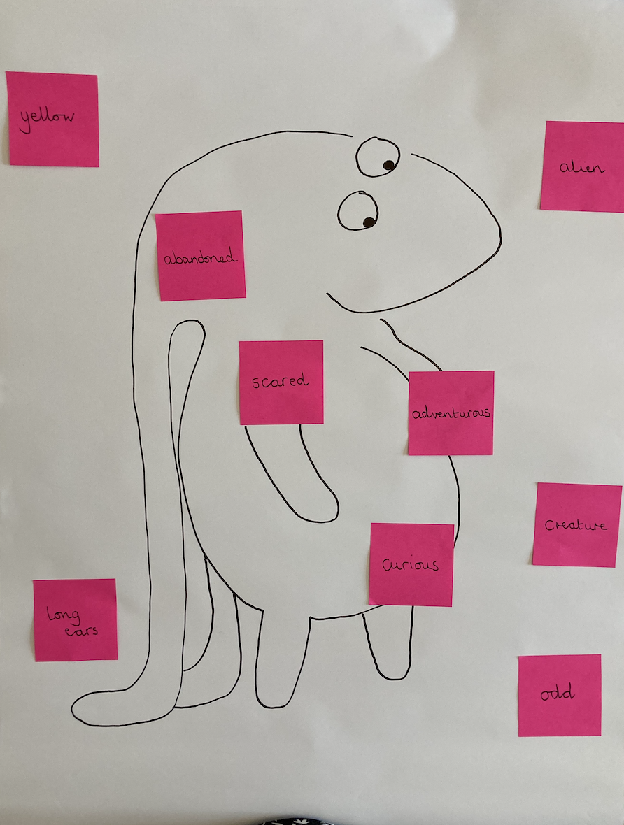
Beegu. Red Fox, 2004. Illustrations Alexis Deacon

Slide 7
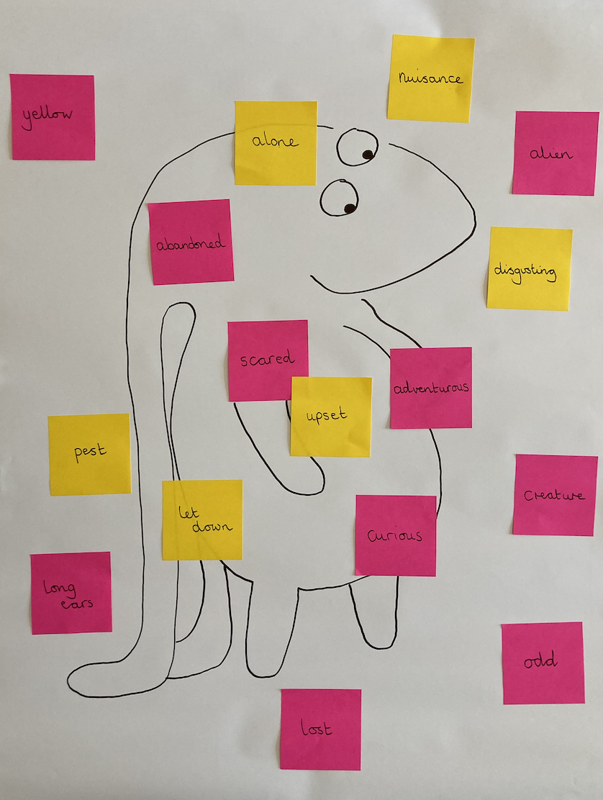
Beegu. Red Fox, 2004. Illustrations Alexis Deacon

Slide 8
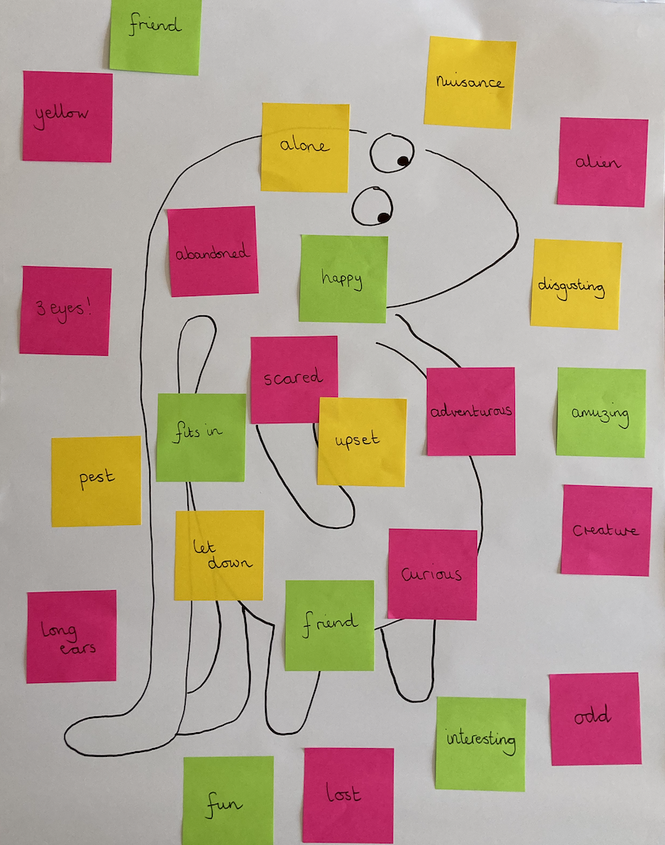
Beegu. Red Fox, 2004. Illustrations Alexis Deacon

Slide 9
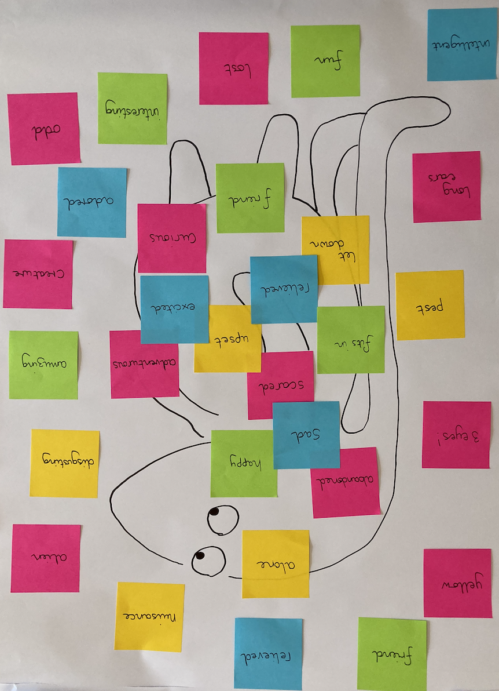
Beegu. Red Fox, 2004. Illustrations Alexis Deacon

Slide 10
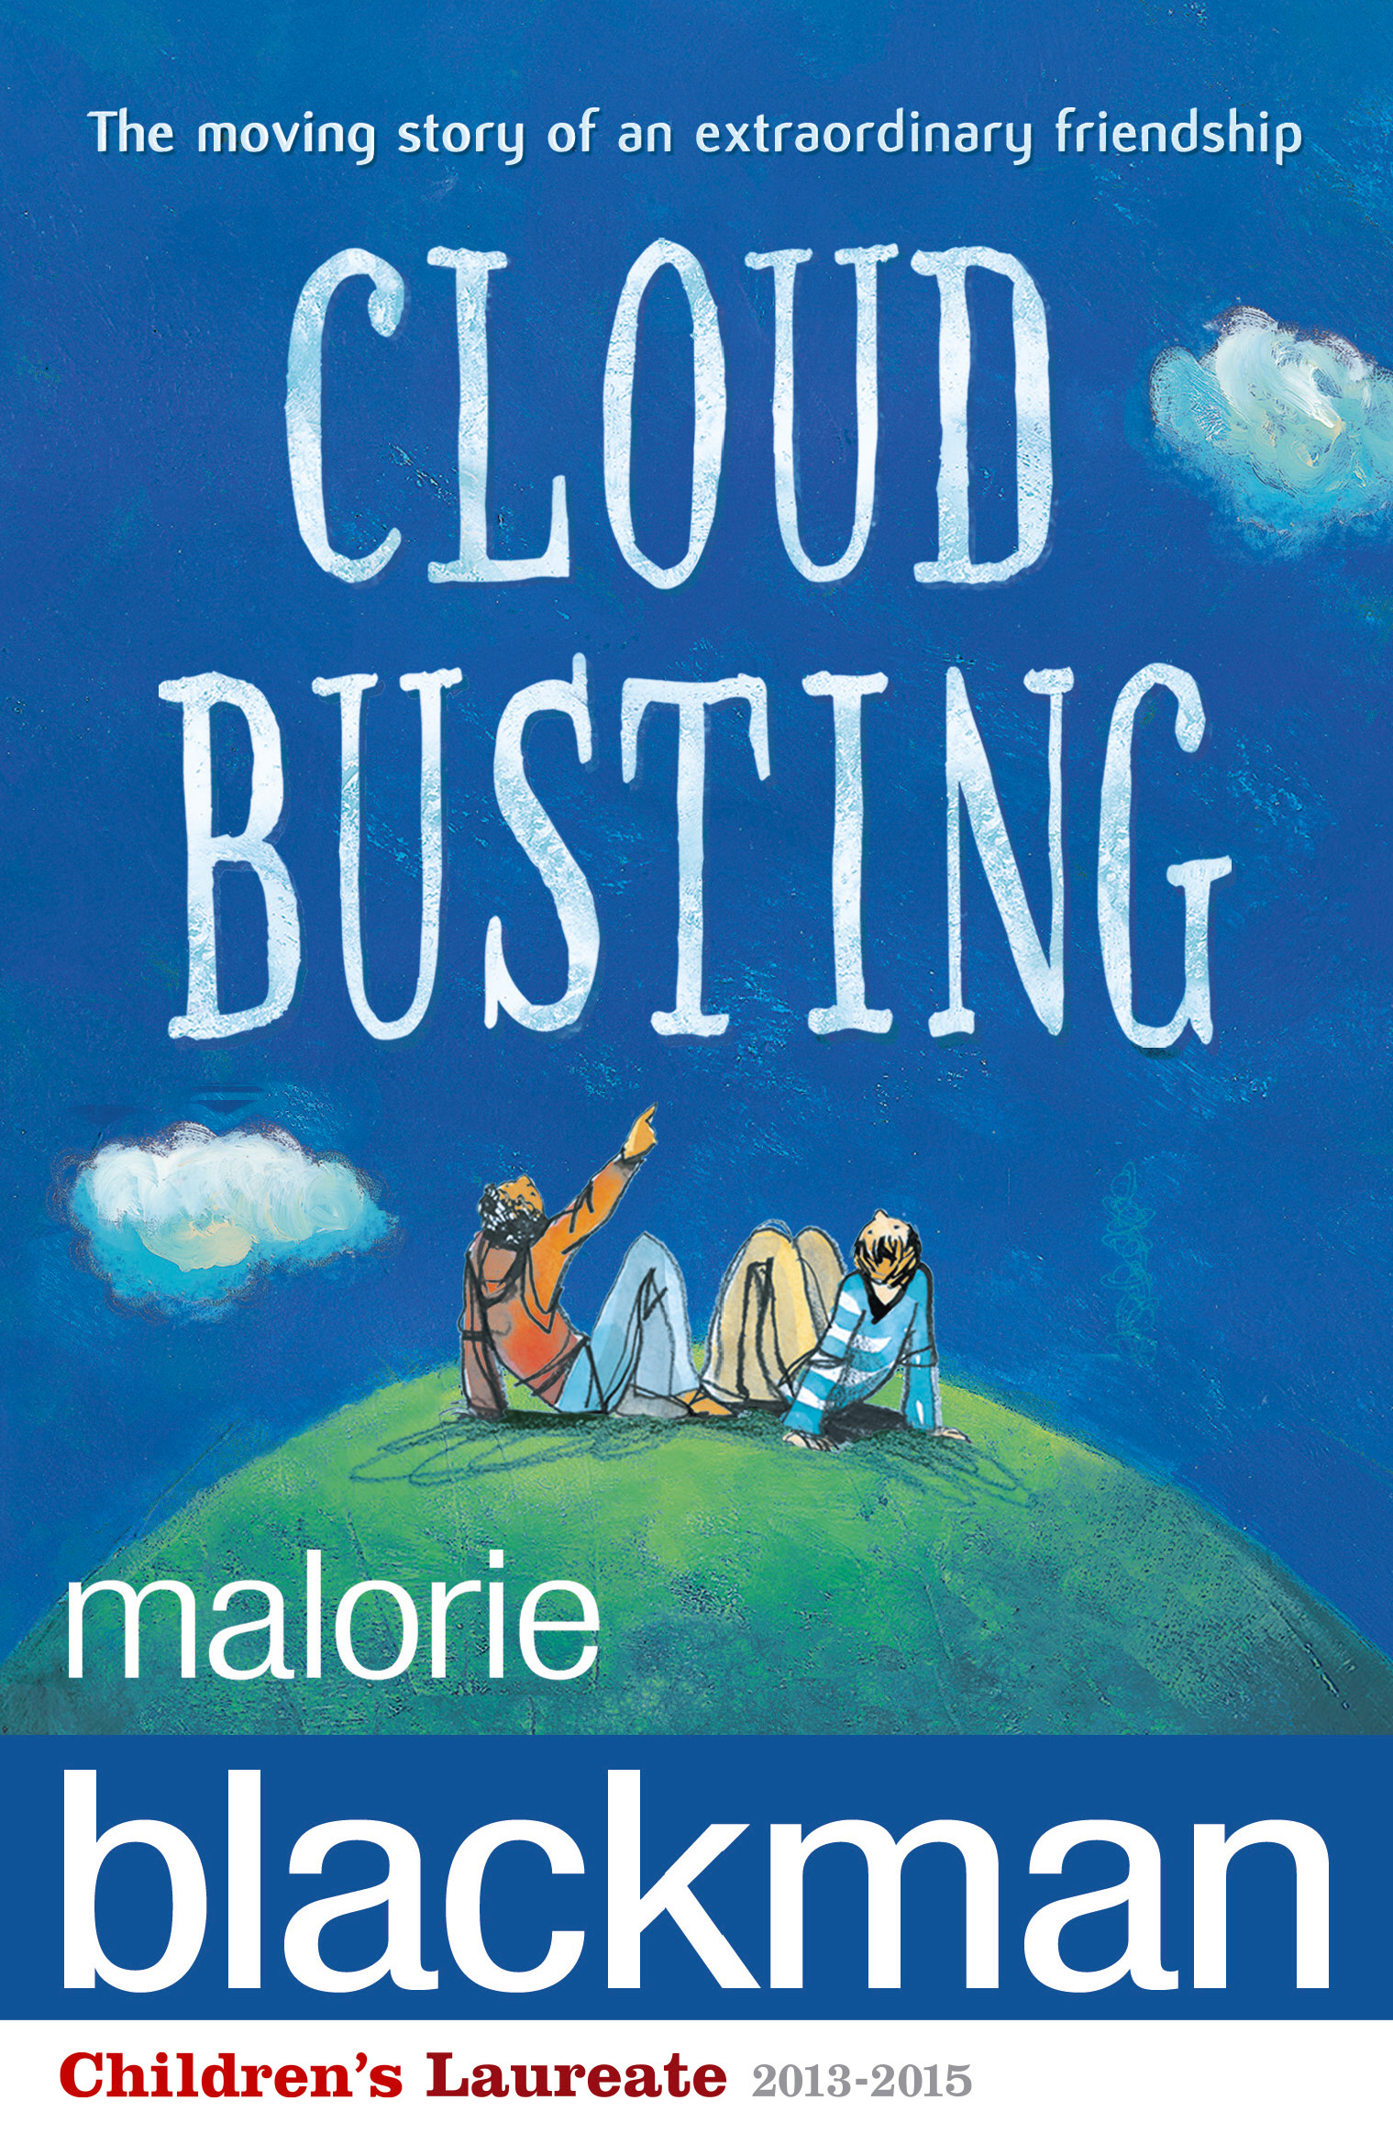

Slide 11
Cloud Busting by Malorie Blackman
What’s in a name? Not much.
That’s what the class idiot said
After Davey's name
Was changed to Fuzzy Feet
Davey was the new boy,
Full of uncertain smiles
And anxious eyes
And not much else.
Pages 15 and 16
He was one of them now.
The same as Alex,
Pete, Barry. He talked
About football and sport
He played computer games
And read the occasional book.
But any music he didn’t like
Was a waste of energy.
Page 147

Slide 12
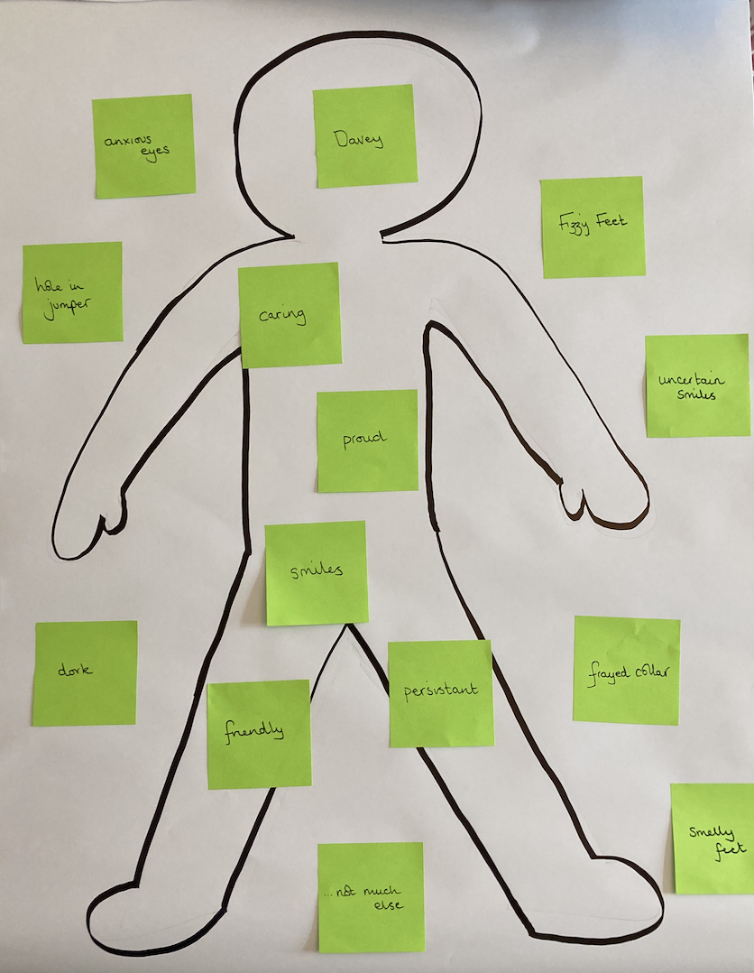
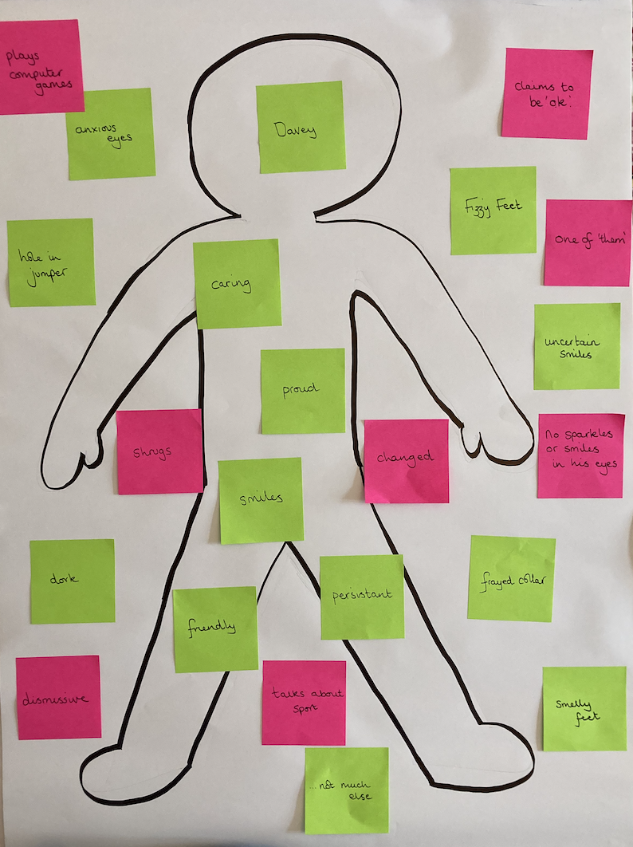

Slide 13

What is hot seating?
Hot seating is a drama strategy commonly used in primary classrooms to explore character.
The teacher or a child takes on the role of a familiar story character to whom the class then ask questions about their actions, feelings and motivations at key parts of the story.
This activity works best when the children have spent some time getting to know the characters in a story (role on the wall).

Slide 14
Hot seating: some words of advice
  Make sure there is a clear purpose to the questions e.g. Find out how Beegu is getting on back on her home planet (Beegu). Find out how Davey feels when Sam visits him in hospital (Cloud Busting).
  Give the children time to discuss and formulate useful, well-phrased questions. When appropriate, provide children with question stems to support their thinking. Model questions that are analytical rather than literal:
    Why did you…?
    What would you have done if…?
    Is that the only reason you…?
    How do you feel about…?
    Did you really feel…or…?

Slide 15
Hot seating: some words of advice
  Ask the children to ask their questions in role as another character from the story e.g. You are Davey’s teacher and you have noticed something is wrong. What questions would you ask? (Cloud Busting).
  Don’t always make hot seating an event. It can be short and snappy and integrated into book talk.

Slide 16
Benefits of drama in understanding narrative
Drama can support children to:
  engage with texts they might otherwise find ‘difficult’
  reflect on the text as a whole, giving a well-informed, personal response
  understand plot and action
  understand the setting (time and place) and how this influences action
  predict and discuss future actions and their consequences
  recognise themes and subtext
  understand and discuss mood atmosphere
  understand characters’ traits and infer their feelings, motives and intentions
  explore the language used by characters to express thoughts and feelings
  feel more confident when answering inference questions

Slide 17
Thank you!
Course creator: Ruth Baker-Leask

