Slide 1
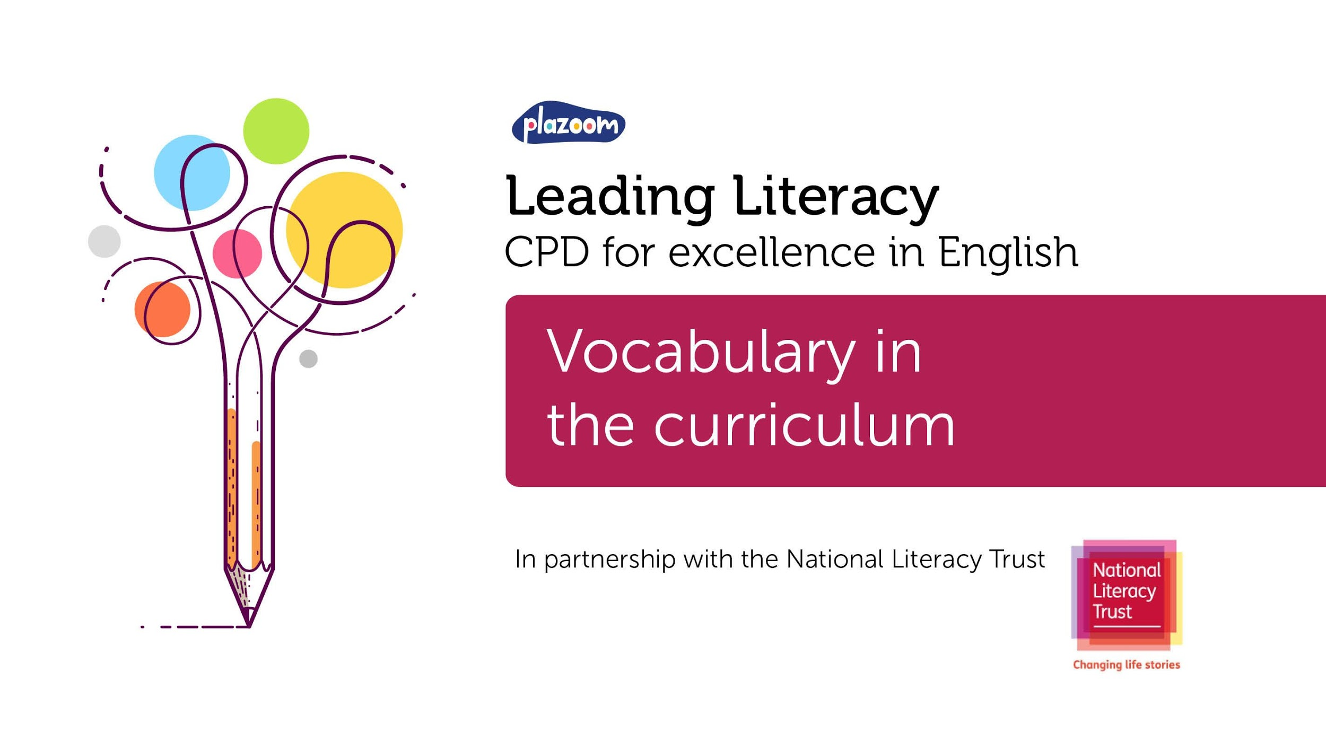
Leading Literacy
CPD for Excellence in English
Vocabulary in the curriculum
In partnership with the National Literacy Trust

Slide 2



Session 4: Vocabulary in the curriculum
The purpose of this, the fourth of eight CPD sessions, is:
To explore the National Curriculum expectations with regards to teaching vocabulary, including subjects other than English.

Slide 3
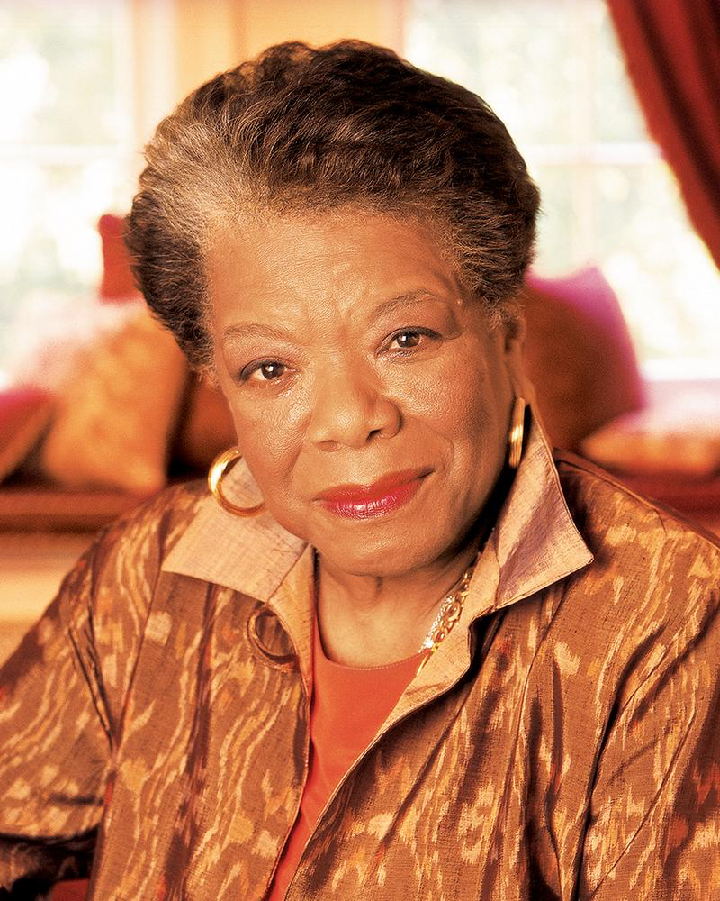
Maya Angelou
“Words mean more than what is set down on paper. It takes the human voice to infuse them with deeper shades of meaning"

Slide 4
Vocabulary in the English curriculum (primary)
Opportunities for teachers to enhance pupils’ vocabulary arise naturally from their reading and writing.
They should also teach pupils how to work out and clarify the meanings of unknown words and words with more than one meaning.
Teachers should teach pupils the vocabulary they need to discuss their reading, writing and spoken language. It is important that pupils learn the correct grammatical terms in English and that these terms are integrated within teaching.
Reading widely and often increases pupils’ vocabulary because they encounter words they would rarely hear or use in everyday speech.

Slide 5
Vocabulary in the English National Curriculum (KS3)
Pupils’ acquisition and command of vocabulary are key to their learning and progress across the whole curriculum. Teachers should therefore develop vocabulary actively, building systematically on pupils’ current knowledge. They should increase pupils’ store of words in general.
In addition, it is vital for pupils’ comprehension that they understand the meanings of words they meet in their reading across all subjects, and older pupils should be taught the meaning of instruction verbs that they may meet in examination questions. It is particularly important to induct pupils into the language which defines each subject in its own right, such as accurate mathematical and scientific language.

Slide 6

Ofsted 2019
If we want to give all children opportunity, a good place to start is through reading to them frequently, introducing new vocabulary and meaning within contexts that stimulate their thinking. Subsequently, it is important to teach them a range of curriculum subjects that will provide a wide vocabulary and a rich understanding of the meaning of the words encountered.
(Sean Harford, OFSTED school inspection update, Jan 2019)
In reaching an evaluation against the ‘quality of education’ judgement, inspectors will consider whether…stories, poems, rhymes and non-fiction are chosen for reading to develop pupils’ vocabulary, language comprehension and love of reading.
(OFSTED, School inspection handbook, 2019)

Slide 7
Low frequency words, often subject specialist or technical vocabulary, e.g. ‘condensation’, ‘metamorphosis’, ‘evaporation’
Tier 3
Medium frequency words for academic language, e.g. ‘coincidence’, ‘industrious’, ‘function’.
Tier 2
High Frequency vocabulary in everyday use, e.g. ‘desk’, ‘weather’, ‘book’
Tier 1

Slide 8



Making progress
Progression in the teaching of vocabulary depends on the pitch and variety of the texts presented to children (tier 2 words).

Slide 9
Language progression
Not Now Bernard
The monster ate the dinner. Then it watched the television.
Sweep
But before Ed knew it, the something had grown, gathered pace, and swept him off down a path.
Felix After the Rain
Something dark had appeared in the suitcase when Grandma died. Something hurtful had hidden inside when his friends made fun of him. Something bothersome had burrowed its way in when his dad told him off.

Slide 10
Making progress
Progression in the teaching of vocabulary depends on the complexity of the concepts and knowledge children are learning (tier 3 words).
Geography
KS1
The names of the seven continents and five oceans
The names of the four countries and capital cities of the United Kingdom and its surrounding seas,
Cliff, coast, forest, hill, mountain, sea, ocean, river, soil, valley, vegetation, season, weather, city, town, village, factory, farm, house, office, port, harbour and shop
KS2
Topographical features, land-use, latitude, longitude, hemisphere, climate, biomes, vegetation, settlement, minerals

Slide 11
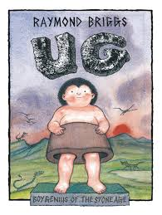
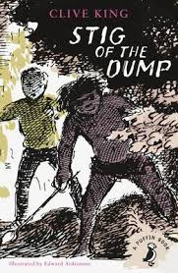
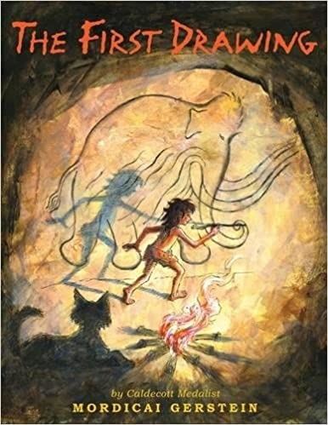
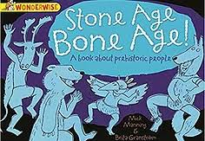
The Stig trap
Pupils should be taught about changes in Britain from the Stone Age to the Iron Age

Slide 12


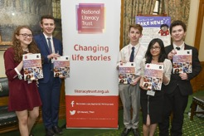
The National Literacy Trust gives children and young people from disadvantaged communities the literacy skills to succeed in life
They support schools and early years settings through their programmes, training, CPD and membership
They bring together local partners to transform family literacy in the UK’s poorest communities
They campaign to make literacy a priority for politicians, businesses
and parents
All their work is underpinned by their pioneering research and analysis

