Slide 1
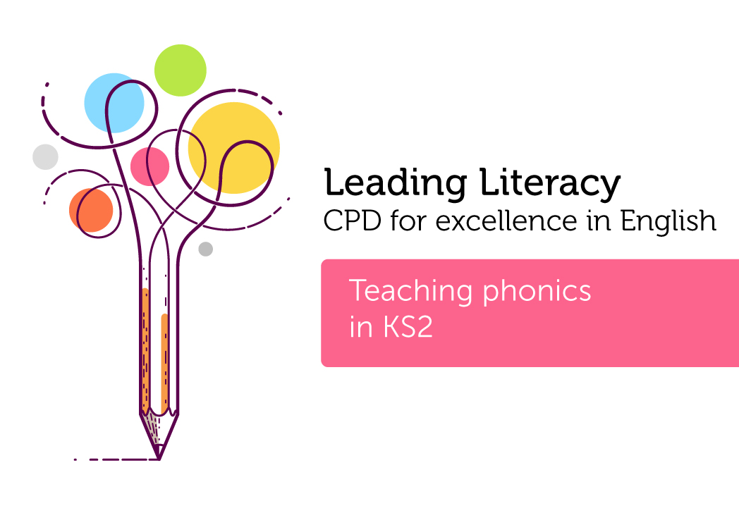

Course creator: Shareen Wilkinson
@ShareenAdvice

Slide 2
What is phonics?
Knowledge
44 phonemes (sounds)
40 graphemes (letters)
Skills
- Blending
- Segmenting
Notes:
44 ish
- 44 phonemes (speech sounds)
- 140graphemes – ways of writing phonemes
Phoneme – smallest unit of speech sound
Grapheme – a written representation of a phoneme
Digraph – two letters that make one sound ch ck th ng
Adjacent consonants– two or more consonants next to each other in a word – stop list – CAN PROVE TRICKY

Slide 3

Blending
The phonemes s-a-t
into the word sat
Notes:
Merging (or synthesising)
Image from pixabay.com

Slide 4

Segmenting
mat
m-a-t
Notes:
Image from Pixabay.com

Slide 5
Articulating phonemes
S
R
M
D
T
H
Notes:
Crisp sounds
Image from pixabay.com

Slide 6
Terminology is important…
Terminology no longer used | Current terminology
Magic ‘e’ | Split digraph (a-e) snake
Blends | Adjacent consonants st br tr
Notes:
Consonant clusters
Blend sounds together.
These are not digraphs.

Slide 7

The purpose of Phase 1
Explore and experiment with sounds and words
Distinguish between different sounds in the environment and phonemes
Learn to orally blend and segment sounds in words
Notes:
Phase 1 shouldn’t really come to an end. These skills should be worked on throughout Primary School.

Slide 8
The purpose of Phase 2
(Up to six weeks – see p.50 of Letters and Sounds for suggested timetable)
Learn 19 phonemes and know the graphemes that represent them
Move on from orally blending and segmenting to blending and segmenting letters to read and spell (maybe with magnetic letters) VC and CVC words
Introduce two syllable words, simple captions and some tricky HFW

Slide 9
Phase 2 letter progression
Learn 19 phonemes and know the graphemes that represent them.
Set 1: s a t p
Set 2: I n m d
Set 3: g o c k
Set 4: ck e u r
Set 5: h b f,ff l,ll ss

Slide 10
The 25 phonemes taught in Phase 3
Letters:
Set 6: j v w x
Set 7: y z,zz qu
Consonant digraphs:
ch sh th ng
Vowel digraphs:
ai ee igh
oa oo ar
or ur ow
oi er
ure ear air

Slide 11
The purpose of Phase 4
Can blend adjacent consonants in words and apply this skill when reading unfamiliar texts, (CCVC, CVCC, CCVCC).
step list clap grasp strap
Can segment adjacent consonants in words and apply this in spelling.
Notes:
Adjacent consonants
Children with speech and language difficulties find this stage tricky. Persevere – they will get there.
Adjacent consonants are no longer taught as blends as this can be a barrier to learning. Not everybody knows this yet.
Spread the word to other people
Watch out for old resources (and some new ones)
Train children to think about mouth movements
Beware – Adjacent consonants are not digraphs. They make two distinct sounds.

Slide 12
New graphemes for reading
ay day
ou out
ie tie
ea eat
oy boy
ir girl
ue blue
aw saw
wh when
ph photo
ew new
oe toe
au Paul
a-e make
e-e these
i-e like
o-e home
u-e rule

Slide 13
Alternative pronunciations
i fin, find
o hot, cold
c cat, cent
g got, giant
u but, put (south)
ow cow, blow
ie tie, field
ea, eat, bread
er farmer, her
a hat, what
y yes, by, very
ch chin, school, chef
ou out, shoulder, could, you

Slide 14
Phonics assessment
The pond
In a smelly pond
Dark and deep
Swam a tiny fish
Who started to weep
I am sad and lonely
He told a frog
Who was asleep and dreaming
On a big brown log
On a beach is where
He wished to be
He wanted to surf and sail
On the cool blue sea
But in that pool
He had to stay
Under the pondweed
He did float about each day
Evidence of Phase 4 (adjacent consonants)
In a smelly pond
Dark and deep
Swam a tiny fish
Who started to weep
I am sad and lonely
He told a frog
Who was asleep and dreaming
On a big brown log
On a beach is where
He wished to be
He wanted to surf and sail
On the cool blue sea
But in that pool
He had to stay
Under the pondweed
He did float about each day
Evidence of Phase 5 (alternative spellings of long vowel phonemes)
In a smelly pond
Dark and deep
Swam a tiny fish
Who started to weep
I am sad and lonely
He told a frog
Who was asleep and dreaming
On a big brown log
On a beach is where
He wished to be
He wanted to surf and sail
On the cool blue sea
But in that pool
He had to stay
Under the pondweed
He did float about each day
Notes:
Teach children the poem orally
each day for a week (don't let
them see it written down)
• Dictate it for them and ask them
to write it down
• Look for evidence of each
phase

Slide 15
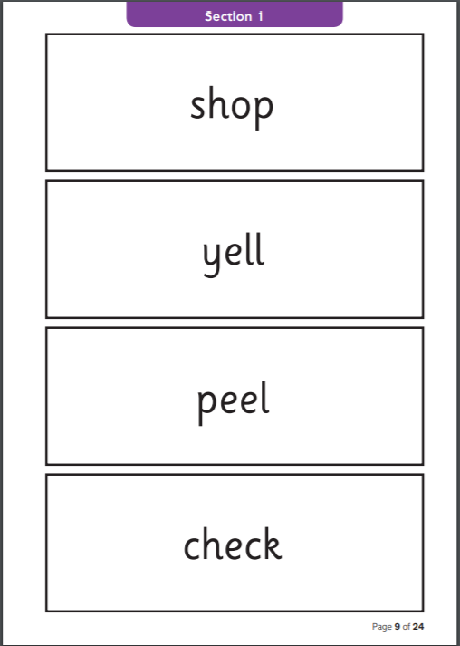
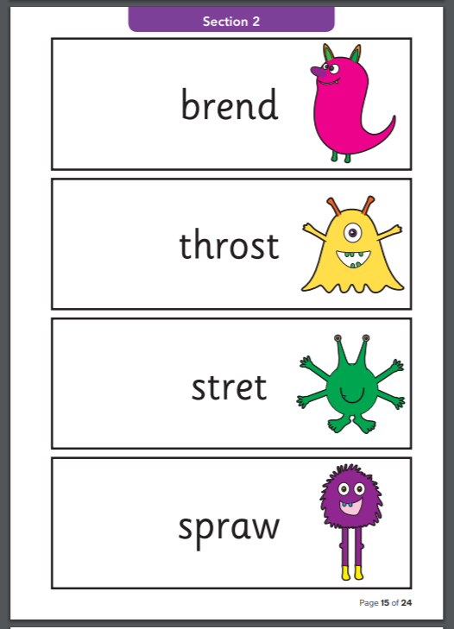
Phonics Screening Check materials
Notes:
32 is normally the threshold.
Phase 5 reading.

Slide 16
Possible questions inspectors could ask pupils…
Have you read any other books/poems by this author?
Have you read books like this one by someone else? Which ones?
What sorts of books do you enjoy the most/least?
Who is your favourite author? Why do you like her/his books? What would you say to recommend them to other people?
Do you enjoy reading?
Does the school have the sorts of books that you would like to read? If not, what sorts would you like more of?
How do you find out about new books or authors that you might want to read?
How well do you think you’re getting on as a reader?
Source: Get them Reading - Distance learning materials for inspecting reading July 2014, No. 110122
Notes:
How is reading prioritised in your school?
Possible evidence:
Phonics screening check data (last 3 years)
Reading improvement plans
Discussions with senior leaders (head teacher)

Slide 17
Possible questions inspectors could ask pupils…
What do you think would improve your reading even more?
What advice does your teacher give you about your reading?
Does anyone check what books you are reading? Do you get help/advice with what sorts of books to read?
How many books have you read on your own this term/since you have been in this class?
Do you read every day: at school? at home? If not, why not?
How many books do you think you read in a week? Who checks how many you read? Do you write down the titles so that you know what you’ve read?
How long do you think it will take you to finish this book?
Source: Get them Reading - Distance learning materials for inspecting reading July 2014, No. 110122
Notes:
How is reading prioritised in your school?
Possible evidence:
Phonics screening check data (last 3 years)
Reading improvement plans
Discussions with senior leaders (head teacher)

Slide 18
Questions inspectors could ask pupils…
Decoding
What do you do if you get stuck on a word?
  [Return to a word that the child hesitated on and see how s/he tackles it.]
What part of the word would you look at first?
  [Check that the child starts at the beginning.]
Can you show me what you do?
What sound does this letter make? And this one? And this one?
  [Point from left to right through the word, not randomly, making sure that you are not covering up the letter.]
What word is that when we put those sounds together?
Say the word for me.
Can you tell me what this word is?
  [Check the child’s fluent reading of common exception words, as they appear in the text, e.g. Year 1: said, were, friend, here; Year 2: door, floor, people, busy, could.]
Get them Reading - Distance learning materials for inspecting reading July 2014, No. 110122

Slide 19
Systematic, synthetic programmes
Do you ensure that the elements of word reading and spelling are taught well across the school?
What does your reading, phonics and writing curriculum look like?
How do you ensure that pupils continue to make progress in reading in key stage 2?
How well do staff know their chosen systematic synthetic phonics programme?
Are staff consistent with their approach to teaching phonics?
Notes:
Possible evidence:
Discussion with teachers and leaders
Systematic, synthetic phonics programme

Slide 20
Approved DfE phonics programmes
Floppy’s Phonics Sounds and Letters
Jolly Phonics
Letterland Phonics (revised edition)
Letters and Sounds
Phonics Bug
Read Write Inc
Sound Discovery
Sounds-Write

Slide 21
Structure of a phonics lesson
Part of lesson
Revisit
Teach
Practise
Apply
Type of activity
Previous day’s learning and recent grapheme-phoneme correspondences taught
New grapheme-phoneme correspondence - visual search for position in words, blending skills for reading words, segmenting words for spelling letter formation
Counting phonemes and spelling words, magnetic boards and letters, mini-whiteboards, etc.
Ensure children have opportunities to hear/say/read/write the phoneme/grapheme
Notes:
presents high quality systematic, synthetic phonic work as the prime approach to decoding print, i.e. a phonics ‘first and fast’ approach
enables children to start learning phonic knowledge and skills using a systematic, synthetic programme by the age of five, with the expectation that they will be fluent readers having secured word recognition skills by the end of key stage one
is designed for the teaching of discrete, daily sessions progressing from simple to more complex phonic knowledge and skills and covering the major grapheme/phoneme correspondences enables children’s progress to be assessed
uses a multi-sensory approach so that children learn variously from simultaneous visual, auditory and kinaesthetic activities which are designed to secure essential phonic knowledge and skills
demonstrates that phonemes should be blended, in order, from left to right, ‘all through the word’ for reading
demonstrates how words can be segmented into their constituent phonemes for spelling and that this is the reverse of blending phonemes to read words
ensures that children apply phonic knowledge and skills as their first approach to reading and spelling even if a word is not completely phonically regular
ensures that children are taught high frequency words that do not conform completely to grapheme/phoneme correspondence rules
provides fidelity to the teaching framework for the duration of the programme, to ensure that these irregular words are fully learnt
ensures that, as pupils move through the early stages of acquiring phonics, they are invited to practise by reading texts which are entirely decodable for them, so that they experience success and learn to rely on phonemic strategies.

Slide 22
Primary CLLD Phonics at Key Stage 2 (2009)
Practise
The specific knowledge and skills to be covered in the ‘Practise’ section each day will build on the focus of the ‘Teach’ section, so that children have the opportunity to practise new/recent skills and knowledge immediately.
Select from/adapt
Use ‘Fans’ and ‘Quickwrite’ activities to practise recognising and recalling newly learned GPCs.
Use ‘sound-talk’ to practise oral blending and segmenting.
Use ‘What’s in the box?’, ‘Matching words and pictures’ and ‘Buried treasure’ to practise blending phonemes to read words.
Use ‘Phoneme frame’ and ‘Quickwrite words’ to practise segmenting phonemes to spell words.
Practise rapid reading of decodable high-frequency words, using a timer.
Sound hunt: using an egg timer and a page of text, the children could hunt words in a specific time – words beginning with the focus phoneme, ending with the focus phoneme, or words where the focus phoneme is in the middle.
Source: http://www.lancsngfl.ac.uk/curriculum/english/download/file/clld_phonics_ks2_01058%5b1%5d.pdf
Notes:
Free resource
Copy a lesson example

Slide 23
Primary CLLD Phonics at Key Stage 2 (2009)
Apply
To demonstrate how phonic knowledge and skills are applied in reading, use a prepared, fully decodable caption, that includes high-frequency words where possible, to read with the children.
To demonstrate how phonic knowledge and skills are applied in spelling, compose a fully decodable caption, including a high-frequency word if possible, as shared writing.
The ‘Apply’ part of the sequence is critical, as it enables children to apply their knowledge and skills at the point of learning.
Assess
Encourage the children briefly to reflect on what they have learned and practised in the session, and remind them to use it when they are reading and writing back in class. Make a note of any significant difficulties or successes observed during the session
Source: http://www.lancsngfl.ac.uk/curriculum/english/download/file/clld_phonics_ks2_01058%5b1%5d.pdf
Notes:
Free resource
Copy a lesson example

Slide 24

Pupils should complete phase 4 by the end of reception

Slide 25
Key questions for discussion
Do you have an expert in the teaching of reading at your school? Are you aware of the teaching of early reading if you are not in EYFS or KS1?
Do staff have a consistent approach to describing different sounds?
Are teachers ensuring they have identified reading gaps in phonics knowledge and / or comprehension?
Do pupils have knowledge of different subjects?
Does the curriculum prepare pupils with the vocabulary and knowledge to access rich texts, rather than being prepared for SATs?
What CPD is in place to support teachers with the teaching of reading?

Slide 26
Thank you!
Course creator: Shareen Wilkinson
@ShareenAdvice

