Slide 1
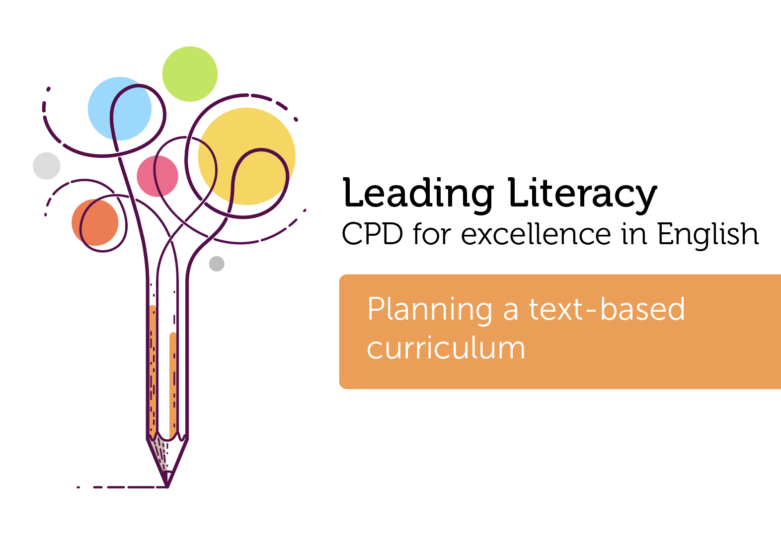

Course creator: James Clements
@MrJClements

Slide 2
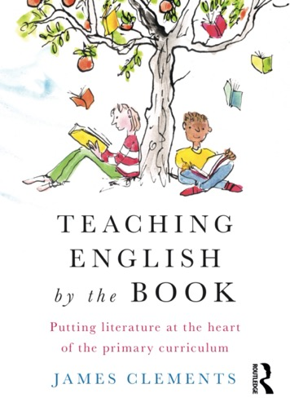

Slide 3
How might we structure the English curriculum?
  Genres
  Working backwards from assessment
  Experiences
  Books and texts

Slide 4
Why a text-based curriculum?
A model for language
Vocabulary
Language structures
New ideas and experiences
Writing development

Slide 5
Why a text-based curriculum?
A model for language
Vocabulary
Language structures
New ideas and experiences
Writing development
Joy, entertainment and interest?

Slide 6
Some key questions
  Who decides which texts make it onto the curriculum?
  How much time do we plan for?
  Which books might we choose?

Slide 7
Who decides what texts make it onto the curriculum?
  Teachers?
  School leaders?
  Children?
  A combination?

Slide 8
Books in the classroom
  English lessons
  Whole-class shared reading
  Small group guided reading
  Reading aloud to children
  Listening to children read aloud
  Independent reading

Slide 9
Who decides what texts make it onto the curriculum?
  Teachers?
  School leaders?
  Children?
  A combination?

Slide 10

How much time do we plan for?
  A full curriculum?
  A core curriculum?
  A spine of texts?
  Satellite books?
  What else might we want
  to use to drive our curriculum?

Slide 11
Key questions
  How do we ensure a balance between flexibility and choice and children’s entitlement?
  What might the implications be on teachers’ time and workload?
  What might the opportunity cost of a text-based curriculum be?
  How do keep our text-based curriculum up-to-date?
  How do we make judgements about the quality, quantity and range of literature children encounter?

Slide 12
Thank you!
Course creator: James Clements
@MrJClements

