Slide 2
Session 1: Helping children discover a love of words
The purpose of this, the first of eight CPD sessions, is:
To explore how to engage children in vocabulary learning, developing their fascination for words and their meanings, and investigating the importance of word play.

Slide 3
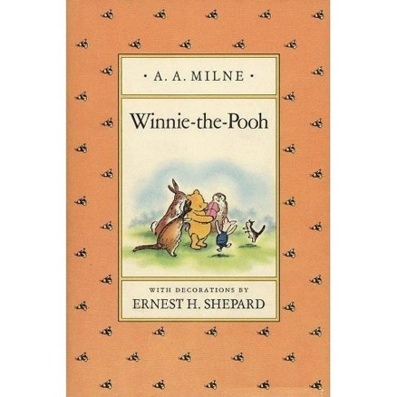
A A Milne
“Pooh, how do you spell love?’
'You don't spell love Piglet, you feel it.”
‹#›

Slide 4
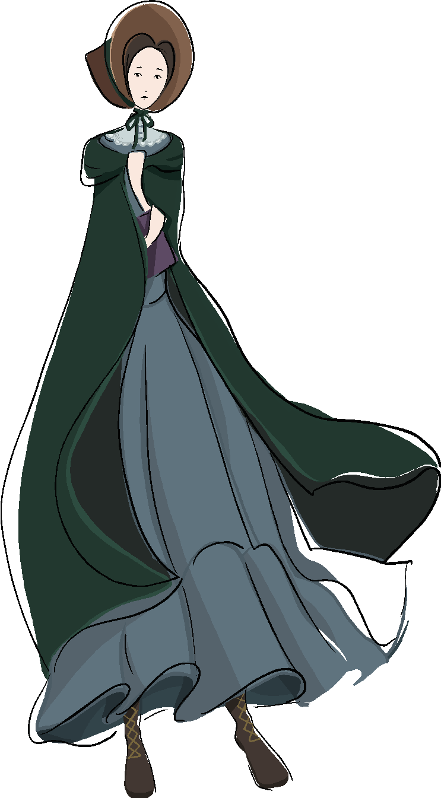
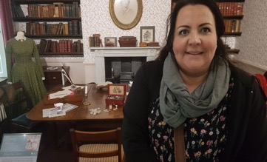
Words are personal
“Prejudices, it is well known, are most difficult to eradicate from the heart whose soil has never been loosened or fertilized by education: they grow there, firm as weeds among stones.”
Charlotte Brontë, Jayne Eyre

Slide 5
Receptive and expressive vocabulary
Receptive Vocabulary: all the words a person has read, understands and may have responded to, but are not used by that person when they speak and write.
Expressive Vocabulary: the words, language and expressions a person uses when talking and writing

Slide 6
What’s your favourite word?
postprandial
paronomasia
lexiphanic

Slide 7
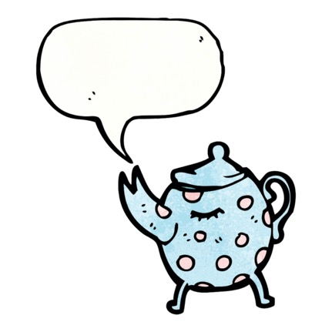
On the Ning Nang Nong, by Spike Milligan
On the Ning Nang Nong Where the Cows go Bong! and the monkeys all say BOO! There's a Nong Nang Ning Where the trees go Ping! And the teapots jibber jabber joo. On the Nong Ning Nang All the mice go Clang And you just can't catch 'em when they do! So its Ning Nang Nong Cows go Bong! Nong Nang Ning Trees go ping Nong Ning Nang The mice go Clang What a noisy place to belong is the Ning Nang Ning Nang Nong!!

Slide 8
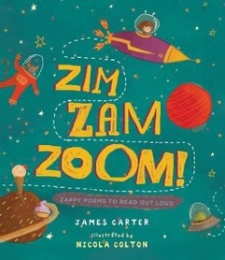
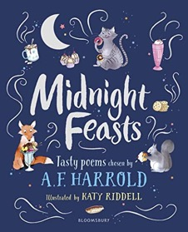
Poems, rhymes and riddles

Slide 9
Enjoying puns
As an aspiring British citizen, will Meghan Markle be required to sit the complete citizenship test, including the written questions on the role of the monarchy? Or will Britannia waive the rules?
Austen Lynch
Garstang, Lancashire
From The Guardian letters page

Slide 10
Santa's helpers are subordinate clauses.
In democracy your vote counts. In feudalism your count votes.
Atheism: the only non-prophet organisation.

Slide 11
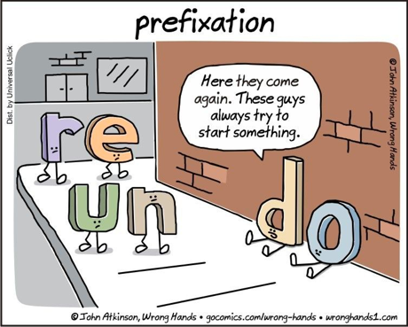
Word appreciation

Slide 12
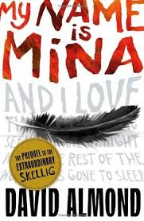
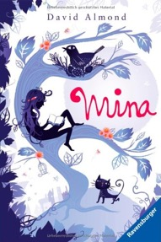
Building a love of words
“Words should wander and meander. They should fly like owls and flicker like bats and slip like cats. They should murmur and scream and dance and sing.”
My Name is Mina by David Almond

Slide 13
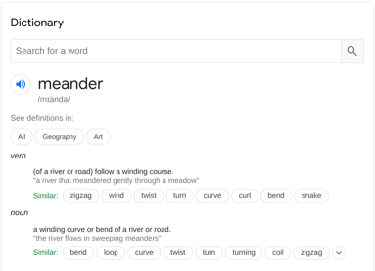
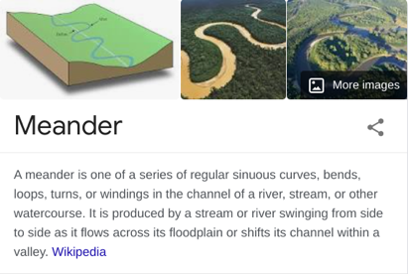

Slide 14
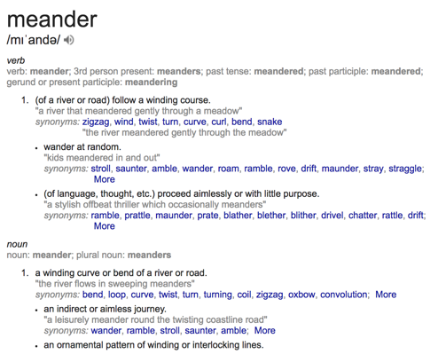

Slide 15
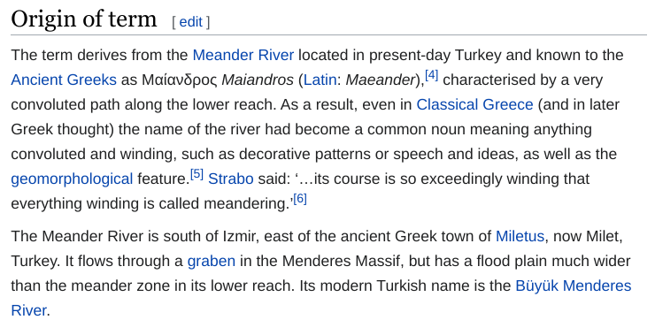
Meander

Slide 16
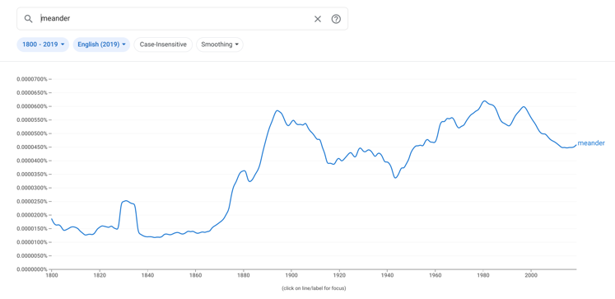
Meander

Slide 17
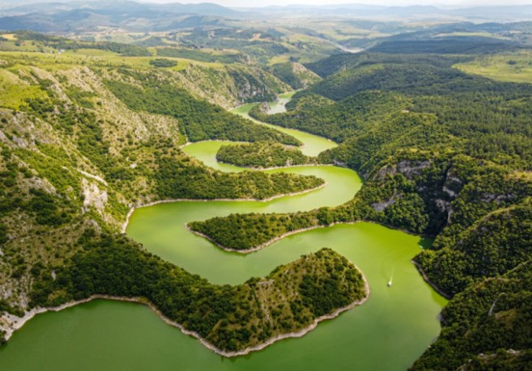
Meander

Slide 18
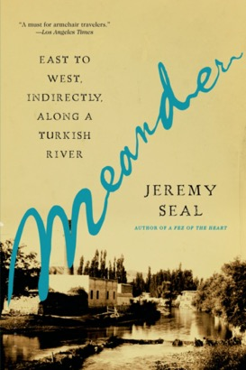
Meander

Slide 19
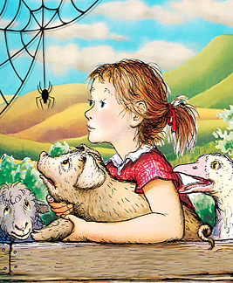
“It’s time I made an egg sac and filled it with eggs.”
“I didn’t know you could lay eggs,” said Wilbur in amazement.
“Oh sure,” said the spider, “I’m very versatile.”
“What does versatile mean? Full of eggs?” asked Wilbur.
“Certainly not,” said Charlotte. Charlotte’s Web, by E. B. White

Slide 20
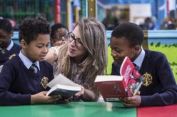
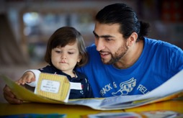
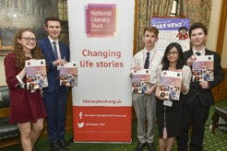
The National Literacy Trust gives children and young people from disadvantaged communities the literacy skills to succeed in life
They support schools and early years settings through their programmes, training, CPD and membership
They bring together local partners to transform family literacy in the UK’s poorest communities
They campaign to make literacy a priority for politicians, businesses and parents
All their work is underpinned by their pioneering research and analysis

