Slide 1


Slide 2



Session 2: Closing the word gap - what we can learn from research
The purpose of this, the second of eight CPD sessions, is:
To explore the research that underpins what we know about vocabulary development and how it influences children’s academic success.

Slide 3
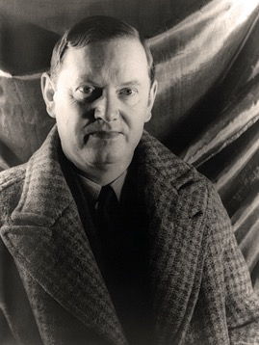
Evelyn Waugh
"One forgets words as one forgets names. One’s vocabulary needs constant fertilizing or it will die..."

Slide 4
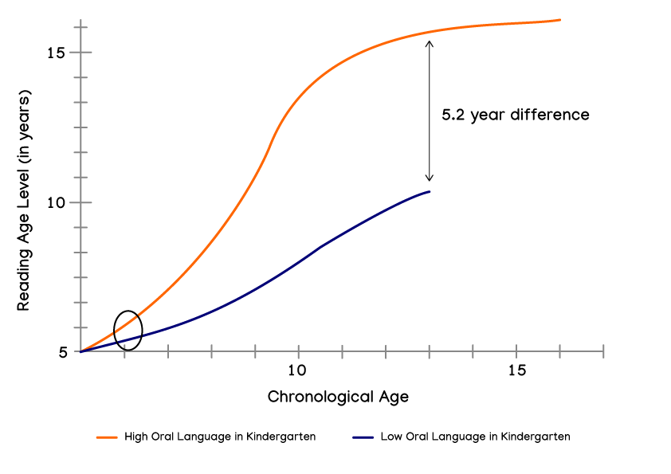
Research evidence
The effects of weaknesses in oral language on reading comprehension growth
(Hirsch, 1996)

Slide 5
A timeline of evidence
1977 - Becker identifies poor vocabulary knowledge as the primary cause of academic failure for disadvantaged students.
1977 - Becker also finds that children’s declining reading comprehension, compared to more able peers from age eight onwards, largely results from a lack of vocabulary knowledge.
1986 - Stanovich finds students with limited vocabularies read less and thus learn fewer words (the Matthew effect).
1990 - Chall et al explore how disadvantaged students show declining reading comprehension as their limited vocabulary comes to constrain what they can understand from texts

Slide 6

A timeline of evidence
2003 - Hart and Risley find that, from birth to 48 months, parents in professional families speak 32 million more words to their children than parents in welfare families.
2017 - A report from the DfE evidences that a child who is not at the expected standard in language at the age of five is 11 times less likely to achieve the expected level in maths at age 11.
2017 - Law et al show that children with language difficulties at age five are four times more likely to have reading difficulties in adulthood, three times as likely to have mental health problems, and twice as likely to be unemployed.

Slide 7
Vocabulary size
There are numerous estimates about vocabulary size. Some count all words, others count word ‘families’ or ‘root words’. Children in the highest quartile enter school with an average estimated receptive vocabulary of 7100 root words. In contrast, children from the lowest quartile have an average receptive vocabulary size of 3000 root words.
Biemiller, 2003
Milton and Treffers-Daller (2013) revisited the link between vocabulary size and academic achievement and concluded that native speakers’ vocabulary size on entering university in the UK is much smaller than usually reported - being an average of 10,000 word families.

Slide 8
Helping pupils consider the depth of their own knowledge is part of developing good vocabulary.
Word | Do not know the word | Have seen or heard the word - not quite sure of meaning | Know something about it and can relate it to a situation | Know it well, can explain it and use it in multiple contexts
Obfuscate
Excoriate
Exponential
From Bringing Words to Life (2013)
From Bringing Words to Life 2013

Slide 9
What works and what doesn’t?
There is a strong reciprocal relationship between word knowledge and reading comprehension.
(National Reading Panel 2000, Biemiller 2003)
Children who read more will come across a greater number of words and get more practice at decoding words and have greater opportunities to enhance their knowledge of morphology and spelling than less avid readers.
(Cain and Oakhill 2011)
Learning new words is a cumulative task that takes place gradually over time.
(Nagy and Scott 2000 )
Teaching definitions by themselves are unlikely to enhance comprehension.
(Baumann, Kame'enuu,& Ash, 2003)

Slide 10
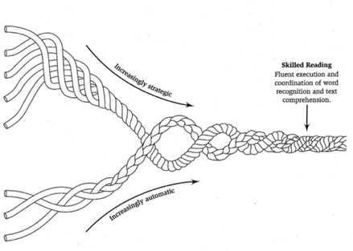
The reading rope
Skilled reading
Fluent execution and coordination of word recognition and text comprehension
Language comprehension
Background knowledge
(facts, concepts, etc.)
Vocabulary
(breadth, precision, links, etc)
Language structures
(syntax, semantics, etc)
Verbal reasoning
(inference, metaphor, etc)
Literacy knowledge
(print concepts, genres, etc)
Word recognition
Phonological awareness
(syllables, phonemes, etc)
Decoding
(alphabetic principle, spelling-sound correspondences)
Sight recognition
(of familiar words)
Scarborough, H. (2001) Connecting early language and literacy to later reading (dis)abilities: Evidence, theory and practice.
In Neuman, S.B., and Dickinson, D.K. (Eds.) Handbook of Early Literacy (pp.97-110) New York: Guilford Press

Slide 11
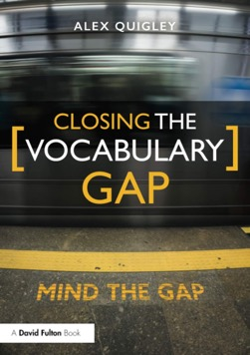
Closing the vocabulary gap
By explicitly teaching a mere 300 to 400 words a year we can foster an annual growth of around 3000 to 4000 words.
With a bigger, harder curriculum, in any subject, we begin with the words.
Vocabulary teaching can be incidental, disorganised and limited, when it needs to be organised, cumulative and rich.
(Quigley, 2018)

Slide 12



The National Literacy Trust gives children and young people from disadvantaged communities the literacy skills to succeed in life
They support schools and early years settings through their programmes, training, CPD and membership
They bring together local partners to transform family literacy in the UK’s poorest communities
They campaign to make literacy a priority for politicians, businesses
and parents
All their work is underpinned by their pioneering research and analysis

