Slide 2
Session 3: word knowledge – the history and morphology of words
The purpose of this, the third of eight CPD sessions, is:
To explore the subject knowledge that underpins our understanding of words and the way they work, relating this to practical classroom approaches to vocabulary development.

Slide 3
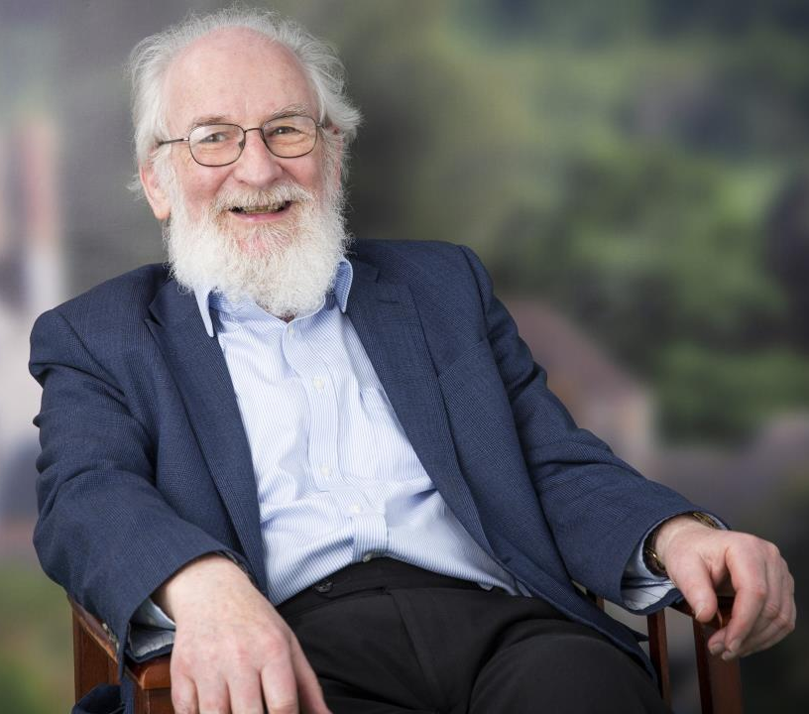
David Crystal
“Vocabulary is a matter of word-building as well as word-using”

Slide 4
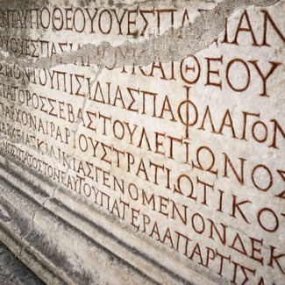
The origins of the English language
• There are over 1,000,000 words (half of which are commonly used)
• We have 26 letters, which have to form 40+ sounds
• Our words have complex and varied origins, the main ones being:
Germanic - from the Anglo Saxons Romance - Latin words from France and, in the 16th century, Spanish and Portuguese Greek - the language of areas of ancient knowledge
• 60% of the words we use come from Greek and Latin origins, which increases to 90% of the technical language children need to learn
• Despite all this variation, we have many words, with different origins, which sound the same but are spelt differently. The joy of the homophone!

Slide 5
Have you heard the word?
Word | I do not know the word | I have heard the word but can’t remember its meaning | I can use the word in the right way when I am talking | I can give a definition of this word / phrase or use it in writing (write it below)
Orthography
Morphology
Etymology
Collocation

Slide 6
Morphemes
A morpheme is a unit of meaning
A phoneme is a unit of sound
A grapheme is a unit of writing (representing one sound)
-ing
sh

Slide 7
Morphology
A morpheme is defined as the smallest unit of meaning in a word.
In a word such as independently, the morphemes are said to be:
in - depend - ent - ly
depend is the root (or base) word and the other morphemes are, in this case, affixes.
A prefix comes before the root and suffix comes after it.
Free morphemes – morphemes that can stand alone as meaningful words (e.g. independent-)
Bound morphemes – morphemes that can only be attached to another part of a word (cannot stand alone); affixes are bound morphemes (e.g. -ly)

Slide 8
Morphemes
Prefix
Base/root
Suffix
dis
ab
appear
duc(t)
ance
tion

Slide 9
Word building
Prefix
Base/root
Suffix
un
re
pre
no
lonely
black
happy
empty
thing
tidy
ness
tion
ing
ate

Slide 10
Use concept maps to explore new words
What is it?
A result, effect or an action; something important or relevant
Example The current teacher recruitment crisis is a consequence of ever increasing teacher workload.
Can you find any morphemes and what do they mean?
con / sequ /ence
consequence
What is its etymology?
From the Latin ‘con’ meaning ‘with’ and ‘sequi’ meaning ‘to follow’
Stahl & Kapinus

Slide 11
Use concept maps to explore new words (younger children)
What is it?
Having been opened and / or spread out
Example The butterfly carefully unfolded its wings
Can you find any morphemes and what do they mean?
un / fold /ed
unfolded
What is its etymology?
fold (verb), fold (noun), folding, folded, unfold, refold
Stahl & Kapinus

Slide 12
Latin and Greek root words
When exploring new vocabulary, look closely at the morphology of the words
Pay particular attention to words with their origins in Latin and Greek
If children are learning from lists or sets of technical or academic words, teach the relevant roots
mit/miss
How many words can you think of?
emit
permit
remit
commit
submit
admit
transmission
emission
mission
missive
permissive
missile
missionary
admission
intermission

Slide 13
Numeric prefixes
Meaning | Greek | Latin | Examples
1 | mono | uni | monotone, monoxide, unicorn, unicycle
2 | di | bi, duo | dioxide, binoculars, bicycle, duet
3 | tri | tri | triangle, tricycle, triplicate, tripod
4 | tetra | quad (quart) | tetrahedron, quadrilateral, quarter
5 | pent | quint | pentagon, quintuplets, quintet
6 | hex | sext | hexagon, sextet
8 | octo | octo | octopus, October, octagon, octave
10 | deca | deci | decade, decagon, decimal, December,
100 | (hecto) | cent | century, centurion, cents, percentage
1000 | kilo | mille | kilometre, kilobyte, millennium, millilitre
half | hemi | semi | hemisphere, semicolon, semicircle
many | poly | multi | polygon, monopoly, multiply,

Slide 14
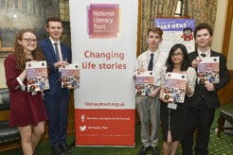
We give children and young people from disadvantaged
communities the literacy skills to succeed in life
We support schools and early years settings through our programmes, training, CPD and membership
We bring together local partners to transform family literacy in the UK’s poorest communities
We campaign to make literacy a priority for politicians, businesses and parents
All their our is underpinned by their pioneering research and analysis
Notes:
This is the slide and script which could go at the end of every presentation.
SCRIPT
Our charity is dedicated to improving the reading, writing, speaking and listening skills of those who need it most, giving them the best possible chance of success in school, work and life. We run Literacy Hubs and campaigns in communities where low levels of literacy and social mobility are seriously impacting people’s lives. We support schools and early years settings to deliver outstanding literacy provision, and we campaign to make literacy a priority for politicians, businesses and parents. Our research and analysis make us the leading authority on literacy and drive our interventions. Literacy is a vital element of action against poverty and our work changes life stories.

