Slide 1


Slide 2



Session 6: Effective teaching approaches
The purpose of this, the sixth of eight CPD sessions, is:
To better understand the difference between the direct and indirect teaching of vocabulary and explore some of the effective strategies we can apply to both approaches.

Slide 3

Bill Bryson
“English is full of booby traps for the unwary foreigner. Any language where the unassuming word ‘fly’ signifies an annoying insect, a means of travel, and a critical part of a gentleman's apparel is clearly asking to be mangled.”

Slide 4
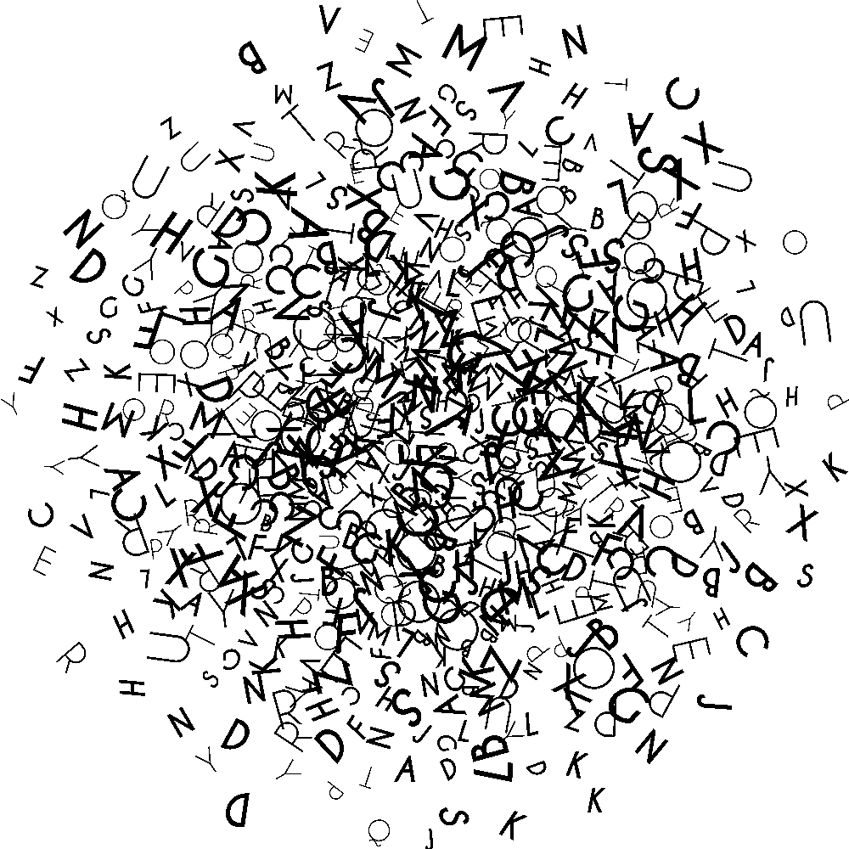
Effective vocabulary learning
Most vocabulary researchers argue that vocabulary learning is a combination of:
learning words from context through extensive reading;
providing direct instruction of vocabulary words;
developing word-learning strategies;
building word-recognition fluency;
developing word appreciation (and motivation) on students’ parts.
(Graves 2000, Nation 2001, Stahl & Nagy 2006)

Slide 5
Teaching approaches
Indirect instruction
Using wider reading to grow vocabulary ‘naturally’
Paying attention to context to work out meaning using background knowledge or prior knowledge
Direct instruction
Pre-teaching vocabulary
Demonstrating morphology and word building knowledge
Checking understanding through use in context

Slide 6


Indirect instruction
Lucy looked and saw that Aslan had just breathed on the feet of the stone giant.
“It's all right!” shouted Aslan ______. “Once the feet are put right, all the rest of him will follow.”
Present children with vocabulary that might be suitable for a given context. Encourage them to order the language for precision and effect, exploring the power of language choices.
How might this have been said? What difference would it make to the meaning?

Slide 7
Close reading: shades of meaning
quietly | proudly | joyously | cheerily
calmly | briskly | abruptly | jubilantly
Where would you place the words on this continuum?
Least appropriate
Most appropriate

Slide 8

Activating prior knowledge - KS1

Slide 9
Close reading - KS1
This hat is not mine. I just
it.

Slide 10
Close reading - KS1
This hat is not mine. I just stole it.

Slide 11


Slide 12
Zone of relevance

Slide 13
What does it mean to ‘know’ a word
I am really familiar with it. I know what it means, can define and explain.
I can use it in writing in different contexts
Some idea of what it means, get the gist when I hear it, but don’t really use it
I pretty much know what it means and might try it out in my speech in one context
I am familiar with it and I can use it without thinking in my speech in more than one context
Heard it but don’t really know what it means
Never heard of it

Slide 14


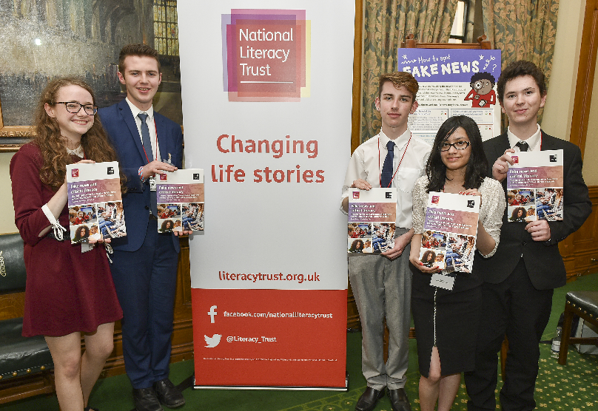
The National Literacy Trust gives children and young people from disadvantaged communities the literacy skills to succeed in life
They support schools and early years settings through their programmes, training, CPD and membership
They bring together local partners to transform family literacy in the UK’s poorest communities
They campaign to make literacy a priority for politicians, businesses
and parents
All their work is underpinned by their pioneering research and analysis

