Slide 1


Slide 2



Session 7: Effective teaching approaches – part 2
The purpose of this, the seventh of eight CPD sessions, is:
To explore the different categories of words we must consider when planning vocabulary instruction, and relating this to the ways in which they can be taught.

Slide 3
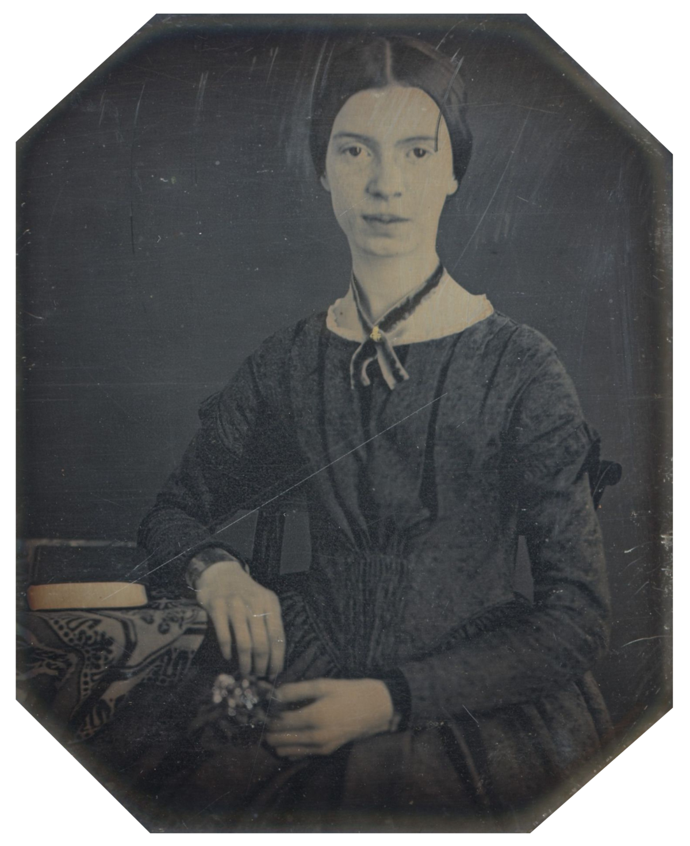
Emily Dickinson
“I know nothing in the world that has as much power as a word. Sometimes I write one, and I look at it, until it begins to shine.”

Slide 4
Teaching approaches
Indirect instruction
Using wider reading to grow vocabulary ‘naturally’
Paying attention to context to work out meaning using background knowledge or prior knowledge
Direct instruction
Pre-teaching vocabulary
Demonstrating morphology and word building knowledge
Checking understanding through use in context

Slide 5
What does it mean to ‘know’ a word
I am really familiar with it. I know what it means, can define and explain.
I can use it in writing in different contexts
Some idea of what it means, get the gist when I hear it, but don’t really use it
I pretty much know what it means and might try it out in my speech in one context
I am familiar with it and I can use it without thinking in my speech in more than one context
Heard it but don’t really know what it means
Never heard of it

Slide 6
A basic teaching sequence
Beck, McKeown and Kucan (2013) suggest a basic format suitable for young vocabulary learners but it’s easily adaptable for older pupils.
1. Read the text
2. Contextualize the target word within the text
3. Have the pupils say the word out loud
4. Provide a student-friendly explanation of the word
5. Present examples of the word used in contexts
different from the immediate context
6. Engage the pupils with a range of activities that
get them to interact with the word
7. Pupils repeat the word out loud

Slide 7

Paronomasia
Paronomasia is prevalent in print media and advertising as a way of making words and ideas memorable.
For example:
"Every bubble's passed its fizzical"
- slogan for Corona soft drink
Curl Up and Dye
- the name of a hair salon
Word origin
via Latin from Greek from ‘para-’ meaning resembling and ‘onoma’ meaning a name

Slide 8
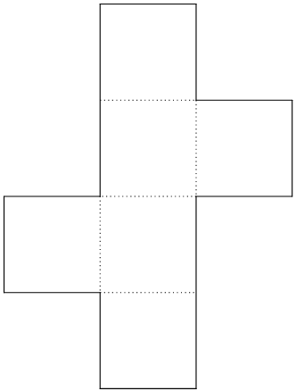
Using four square vocabulary
Pupils take a piece of paper and fold it into four squares
Top left: dictate the word to be taught
Then describe the word and model it in context.
Top right: pupils discuss & write a definition of the concept
Bottom right: pupils draw a diagram
Bottom left: pupils use the word in context
Congruent | Having the same shape and same size
A cube has six congruent faces

Slide 9
Word webs
Signature
Signatory
Consign
Consignment
Consigned
Resign
Resignation
Resigning
Resigned
Sign
Design
Designer
Designing
Designed
Designation
Designate
Redesign
Assign
Assignment
Assignation
Reassign
Signal
Signalling

Slide 10


Specific usage
How many meanings can you find for the root word ‘bank’?
How might you use it in a sentence?

Slide 11
Word association
Involve pupils in a variety of engaging activities as soon as possible to help pupils process and embed meanings. Activities should be short, lively and engaging.
Take the words provisions, invocation, foundations
- Which word goes with religion?
- Which word goes with house?
- Which word goes with meal?
Pupils must choose and then give an explanation to the association. Note these are not synonyms but associations.

Slide 12
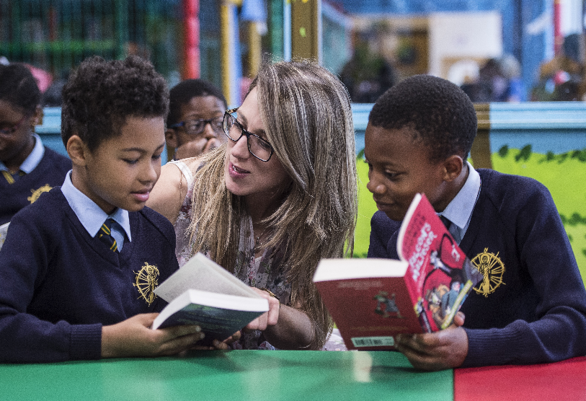
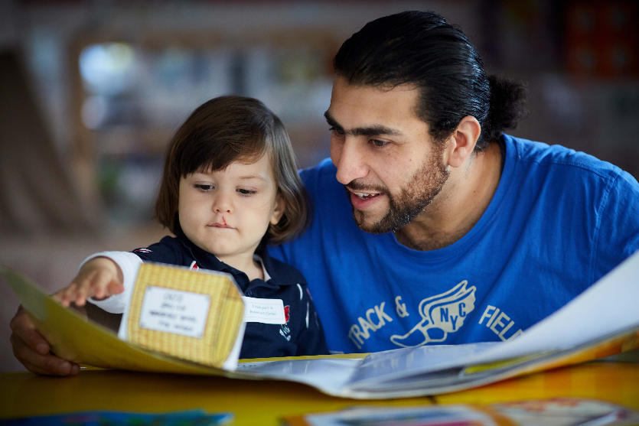
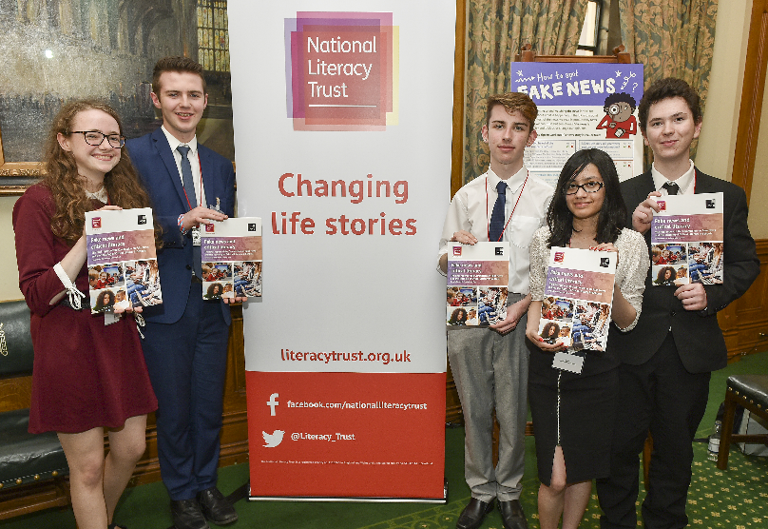
The National Literacy Trust gives children and young people from disadvantaged communities the literacy skills to succeed in life
They support schools and early years settings through their programmes, training, CPD and membership
They bring together local partners to transform family literacy in the UK’s poorest communities
They campaign to make literacy a priority for politicians, businesses
and parents
All their work is underpinned by their pioneering research and analysis

