Slide 1
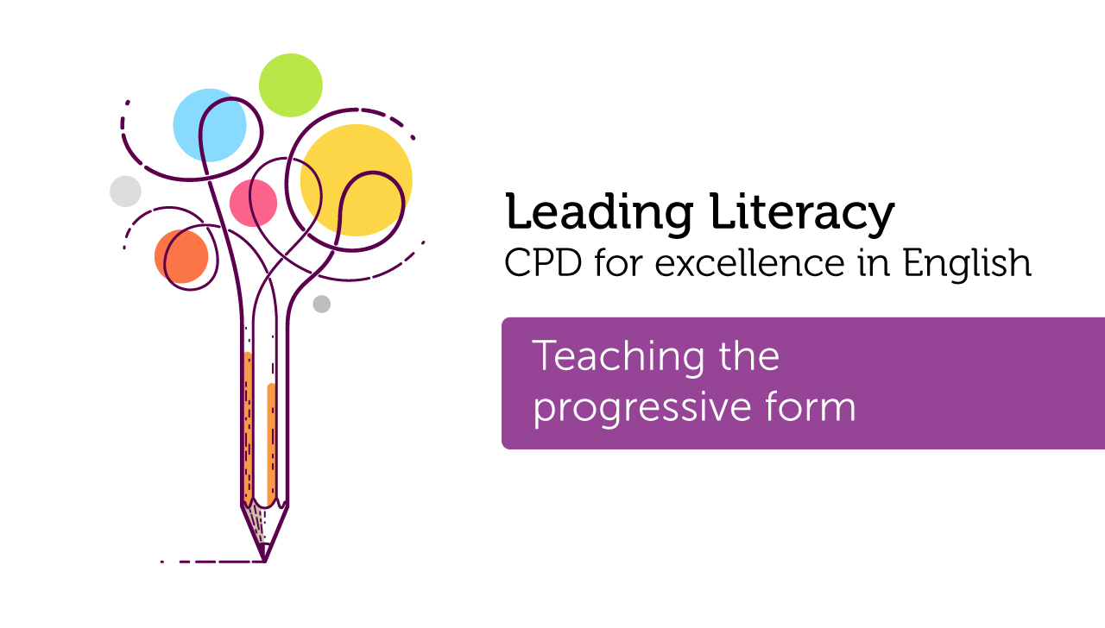

Course creator:
Rachel Clarke: primaryenglished.co.uk

Slide 2
Introducing the progressive form
The progressive is a verb form that describes events in progress.
There are two important things we need to understand in order to teach the progressive form:
verbs & tense

Slide 3
Verbs
All full sentences contain at least one verb.
Can you identify the verbs in each of these sentences?
  I have black hair.
  Ravi plays the guitar.
  Demi is a doctor.

Slide 4
Verbs
All full sentences contain at least one verb.
Can you identify the verbs in each of these sentences?
  I have black hair.
  Ravi plays the guitar.
  Demi is a doctor.
Verbs are doing, being and having words.

Slide 5
Being verbs
Which of the following are being verbs:
am, are, be, being, been, is, was, were

Slide 6
Being verbs
Which of the following are being verbs:
am, are, be, being, been, is, was, were

Slide 7
Being verbs
Being verbs can be the main verb in a sentence, e.g.
  The sofa is red.
  The children are tired.
  The sun was very bright.
  My boots were dirty.
They can also be used as auxiliary or ‘helper’ verbs - more about this later.

Slide 8
Present tense
Every verb in a sentence has a tense. It shows when something happens.
The present tense tells us that something happens now. It usually has no ending, or it ends with the suffix –s.
The dog sniffs its dinner.
If the verb ends in –s, -ss, -x, -sh or –ch, the suffix –es is used instead e.g. passes, mixes, watches etc.
Present tense verb

Slide 9
Past tense
The past tense tells us that something happened earlier. It usually ends with the suffix –ed (the past participle).
The dog sniffed its dinner.
Some verbs change completely in the past tense.
buy → bought eat → ate
drink → drank think → thought
past tense verb

Slide 10
The progressive form
In the progressive form, being verbs are combined with doing verbs to show that an action is ongoing.
subject + to be + present participle = progressive
the dog + is + eating = present progressive
the dog + was + eating = past progressive

Slide 11
Present progressive tense
The present progressive tense tells us that something is still happening now. It is on-going. It is a present tense.
It is made up of two verbs. The first verb is am, is or are (forms of ‘to be’).
The second verb ends with the suffix –ing (the present participle)
I am enjoying this pizza.
first verb
second verb

Slide 12
Past progressive tense
The past progressive tense tells us that something was happening. It was not finished or was still happening when something else happened. It is a past tense.
It is made up of two verbs. The first verb is was or were (forms of ‘to be’).
The second verb ends with the suffix –ing.
I was playing football.
first verb
second verb

Slide 13
Identifying tense
Can you identify the tense of each sentence?
  The boy chases the dog.
  The boy chased the dog.
  The boy is chasing the dog.
  The boy was chasing the dog.
  The boy and the dog are playing chase.
  The boy and the dog were playing chase.
  I am enjoying this story about the boy and the dog.

Slide 14
Identifying tense
Can you identify the tense of each sentence?
  The boy chases the dog. (simple present)
  The boy chased the dog. (simple present)
  The boy is chasing the dog. (present progressive)
  The boy was chasing the dog. (past progressive)
  The boy and the dog are playing chase. (present progressive)
  The boy and the dog were playing chase. (past progressive)
  I am enjoying this story about the boy and the dog. (present progressive)

Slide 15
Changing tense
Can you transform the tense of these sentences from present progressive to past progressive?
  The children are playing football on the field.
  The teacher is watching them play.
  The children are playing very skilfully.

Slide 16
Changing tense
Can you transform the tense of these sentences from present progressive to past progressive?
  The children are playing football on the field.
  The children were playing football on the field.
  The teacher is watching them play.
  The teacher was watching them play.
  The children are playing very skilfully.
  The children were playing very skilfully.

Slide 17
To summarise
  The progressive form describes events in progress.
  Understanding the progressive form requires children to understand that verbs can be being words as well as doing words.
  To understand the progressive form, children need to be able to recognise tense in sentences.

Slide 18
Thank you!
Course creator:
Rachel Clarke: primaryenglished.co.uk

