Slide 1
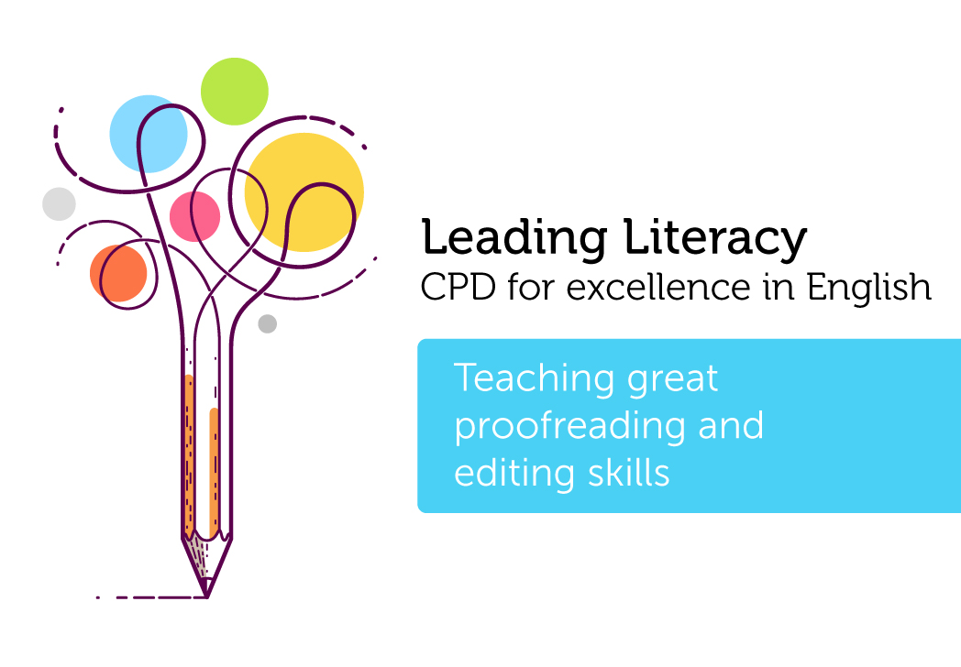

Course creator: Shareen Wilkinson
@ShareenAdvice
Notes:
Introduce yourself
Shareen Mayers
Experienced primary teacher – 15 years
Lead for primary English – successful and high performing LA, covering 42 primary schools
DfE range of projects and review groups
Author and series editor for leading publishers
Adviser to charities and various organisations, e.g. author of national children’s book week materials
@ShareenMayers on board.
Handouts:
Sutton Writing Descriptors
National Curriculum – Grammar Appendix

Slide 2















Key aspects of teaching reading and writing
Read
Comprehension
Analyse
Plan
Reading &
Writing Journey
Draft
Write
Evaluate
and edit
Proofread
Read Aloud
Notes:
Writing to entertain, persuade can be added to the end.

Slide 3
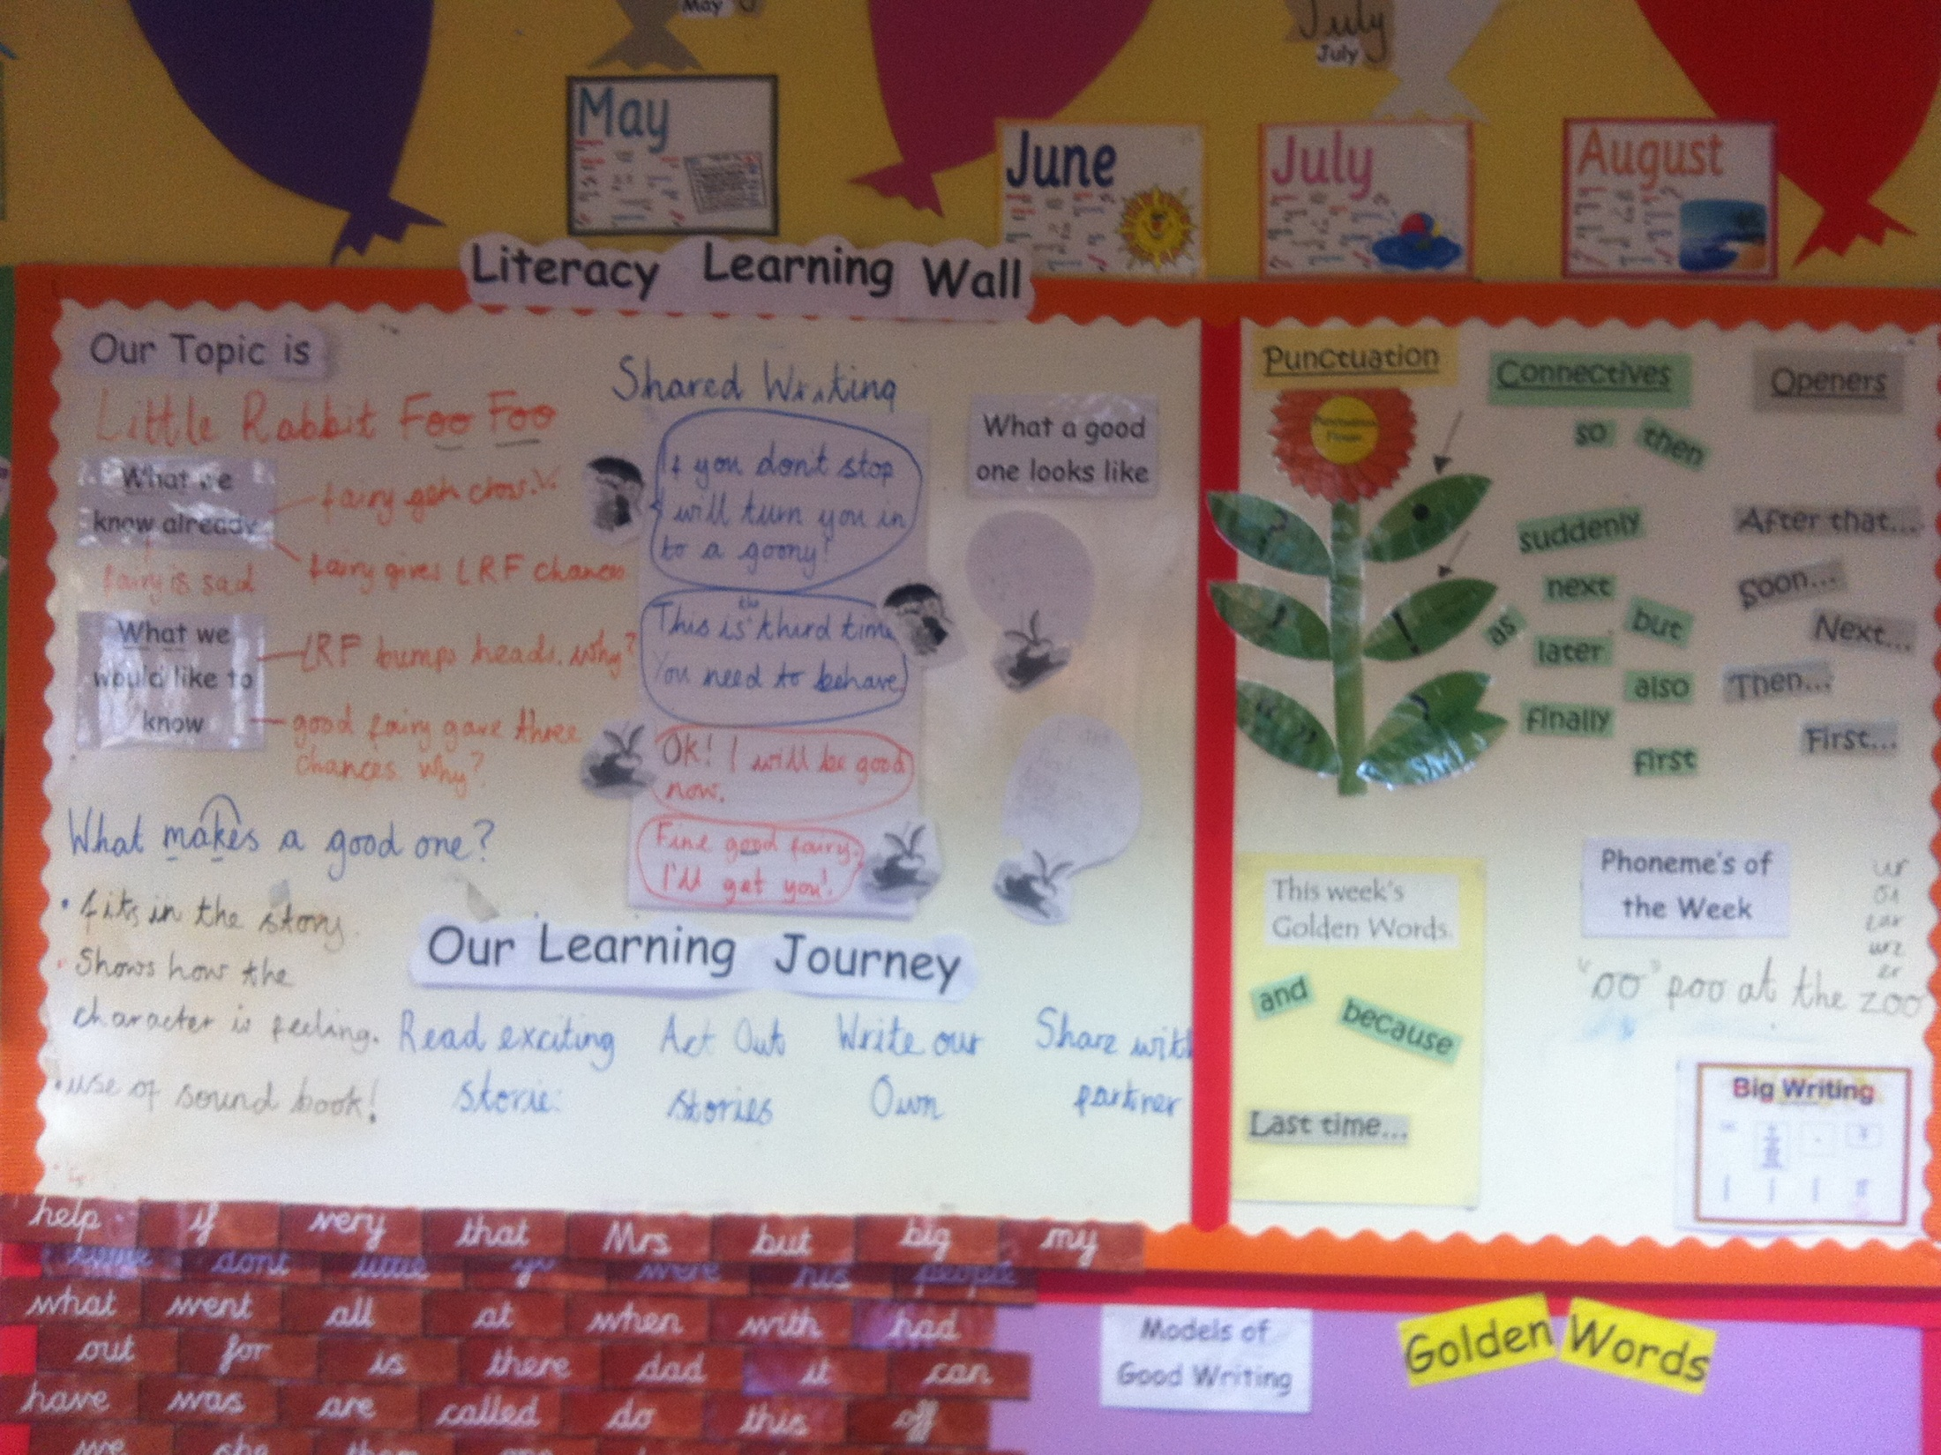
Year 1 Kings Oak Primary, Kingston
Phonemes of the week

Slide 4
Editing and proofreading in the English programmes of study
Year 1
Re-read what they have written to check it makes sense
Discuss what they have written with the teacher or other pupils
Year 2
Make simple additions, revisions and corrections to their own writing by:
Evaluating their writing with the teacher and other pupils
Re-reading to check that their writing makes sense and that verbs to indicate time are used correctly and consistently, including verbs in the continuous form
Proofread to check for errors in spelling, grammar and punctuation

Slide 5
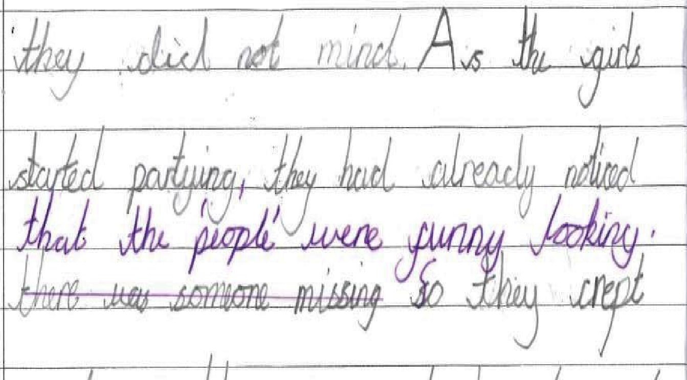
Additions
Notes:
DfE – National Moderator Training Materials

Slide 6
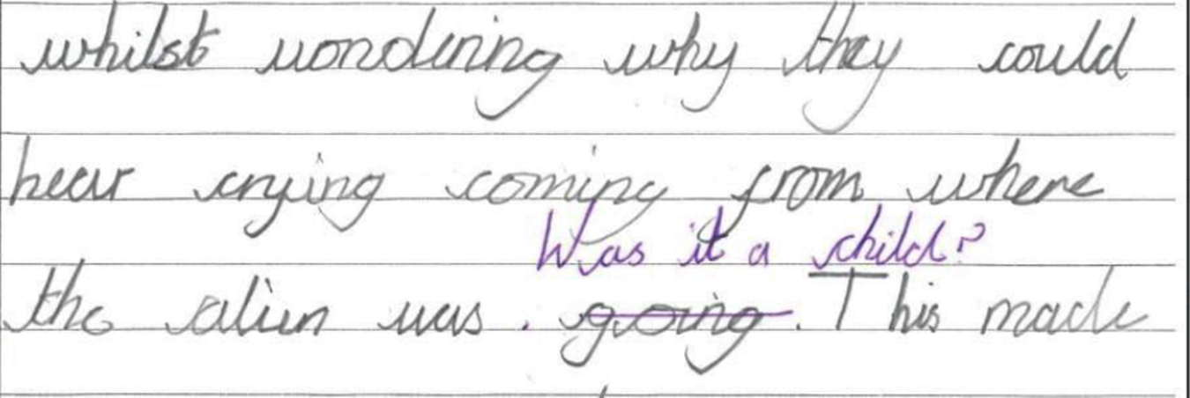
Revisions

Slide 7
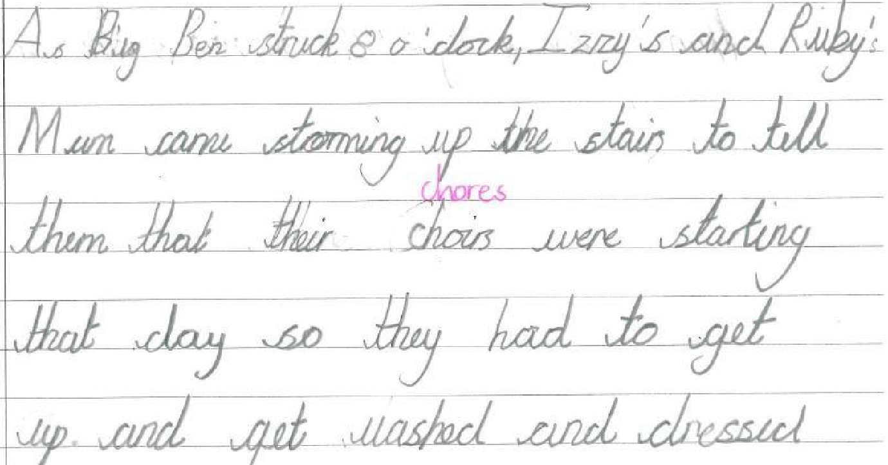
Corrections

Slide 8
Editing and proofreading in the
English programmes of study
Years 3 and 4
Evaluate and edit by:
Assessing the effectiveness of their own and other’s writing and suggesting improvements
Proposing changes to grammar and vocabulary to improve consistency, including the accurate use of pronouns in sentences
Proof-read for spelling and punctuation errors
Years 5 and 6
Evaluate and edit by:
Proposing changes to vocabulary and grammar, to enhance effects and clarify meaning
Ensuring the consistent and correct use of tense throughout the piece
Ensuring correct subject and verb agreement when using singular and plural, distinguishing between language of speech and writing and choosing appropriate register
Proof-read for spelling and punctuation errors

Slide 9
Proofread for spelling and punctuation errors
E.g. Year 5
Checklist:
Brackets
Dashes
Commas
Verb prefixes
Application of spelling, e.g. –ough letter strings, silent letters and unstressed vowels
Notes:
Look over the spelling expectations and link this to proofreading.

Slide 10

Make your own viewfinder

Slide 11
Key focus on audience and purpose
To recount: letter, diary, journal, newspaper report, timeline, science experiment, historical recount, autobiography, log, magazine article | To inform: information leaflet, magazine article, non-fiction book, letter, group presentation, tourist guide, reference book, speech, newspaper | To argue/discuss: newspaper, leaflet with advice, write up of a debate, blog, speech
To explain: encyclopaedia entry, question and answer article, write up science experiment, non-fiction book, technical manual Describe: observation, speech, analysis | To persuade: adverts, travel brochure, letter, newspaper article, poster, book blurb, catalogue, flyer, pamphlet from pressure group, speech | To instruct/explain: recipe, list of rules, route-finder, poster, directions, instructions on packaging, non-fiction book
To entertain: Narrative: traditional tale, short story, role-play, adventure, fable, fantasy, science fiction, cartoon, play-script, myth/legend, mystery, stories with dilemmas, historical Poetry: story, song, jingle, lyric verse, limerick, Haiku, sonnet, ballard, epic Some purposes may be a mixture of two things

Slide 12
Steps to proofreading and editing
Step 1 – Read, comprehend, analyse
Begin by using a quality persuasive text as the stimulus for all writing. Unpick the key features and learn from its grammar, vocabulary and punctuation used for effect. This is also a good time to teach comprehension skills, asking questions about the content.
Source: https://www.teachwire.net/news/how-to-help-children-develop-brilliant-proof-reading-skills

Slide 13
Step 2 – Plan, draft, write, edit and proofread
Using the stimulus text, pupils should plan, draft or write a persuasive advert, making notes of the key features of persuading, e.g. using facts and figures, groups of three (e.g. fun, fit and fabulous) and rhetorical questions. Model explicitly how to edit, improve and proofread pupils’ work, using an example created as a class.

Slide 14
Step 3 – Apply to a range of writing with the same purposes
Once pupils have had the time to be explicitly taught a particular purpose and have edited and proofread the grammar and punctuation for their year group, give them opportunities to apply this knowledge to a few more pieces with the umbrella purpose of persuasion.
They can then write a persuasive speech or poster but this time they should evaluate and edit their work independently. Having a focus on the purpose for writing means that pupils can apply their editing and proofreading skills in a different context, without having to re-teach the purpose and ensuring independent application.

Slide 15
Gradual release
Teacher Responsibility
Focused Instruction
“I do it”
Guided Instruction
“We do it”
Collaborative Learning
“You do it together”
Independent Learning
“You do it alone”
Student Responsibility
From Better learning through structured teaching: A framework for the gradual release of responsibility(p. 4), by D. Fisher and N. Frey, 2008, Alexandria, VA: ASCD. Copyright 2008 by ASCD.
Notes:
Important to model first.

Slide 16

Writing Revolution -
Proofreading and editing
Proofreading symbols
Revise and edit checklist

Slide 17
Rosenshine’s principles in action -
Using scaffolds
‘Scaffolds include modelling of the first steps by the teacher…’
‘In some of the studies, students were given a checklist to evaluate their work (e.g. does every sentence start with a capital letter?). The teacher then modelled the use of the checklist.’
Sherrington, T. (2019)

Slide 18
Year 1
1. Full stops and capital letters for names and ‘I’
2. Joining words: and
3. Finger spaces
4. Describing words
5. ! , ?
6. Sounding out words
7. Say your sentence out loud

Slide 19
Year 2
1. Capital letters and full stops, exclamation marks and question marks
2. Spaces between words
3. Joining words using: when, if, that, because, or, and, but, so
4. Apostrophes used for missing letters (e.g. can’t, couldn’t)
5. Expanded noun phrases: my beautiful purse, the blue butterfly with colourful wings
6. Write statements, commands, exclamations and questions
7. Adverbs of time, e.g. first, next, second
8. Adverbs, e.g. slowly, quickly, cautiously
9. Joined handwriting and correct spellings

Slide 20
Year 3
1. Capital letters and full stops. Punctuation: ! ? “ “ , ’
2. Commas in a list
3. ‘a’ and ‘an’ used correctly
4. Conjunctions using: while, before, after, because, although, if
5. Range of adverbs, e.g. then, soon, next, therefore
6. Prepositions, e.g. before, after, during, in
7. Verbs, e.g. has gone / have been
8. Paragraphs (change of time, place, person)
9. Joined handwriting and correct spellings

Slide 21
Year 4
1. Capital letters and full stops. Punctuation: ! ? “ “ , ’
2. Paragraphs (topic sentence and supporting details)
3. Pronouns and nouns, e.g. he, she, we, Sally
4. Range of adverbs: then, next, soon, therefore
5. Conjunctions, prepositions and adverbs, e.g. when, after, so, because, soon, next, because of, during, in, before, while
6. Expanded noun phrases (e.g. ‘the teacher’ expanded to ‘the strict teacher with curly hair’)
7. Fronted adverbials with a comma
8. Apostrophes for possession and plural nouns, e.g. the boy’s coat/the boys’ coats
9. Joined handwriting and correct spellings

Slide 22
Year 5
1. Capital letters and full stops. Punctuation: ! ? “ “ , ’
2. Sentences with relative clauses: who, which, what, that. E.g. the table that is made of oak is now black with age
3. Adverbs/adverbials, prepositions and conjunctions
4. Expanded noun phrases and interesting vocabulary
5. Modal verbs, e.g. might, could, should, will, must
6. Paragraphs (topic sentence and supporting details)
7. Pronouns and nouns for cohesion: she, Sally, her
8. Cohesion within and between paragraphs: then, after, although, meanwhile, firstly, had been
9. Joined handwriting and correct spellings

Slide 23
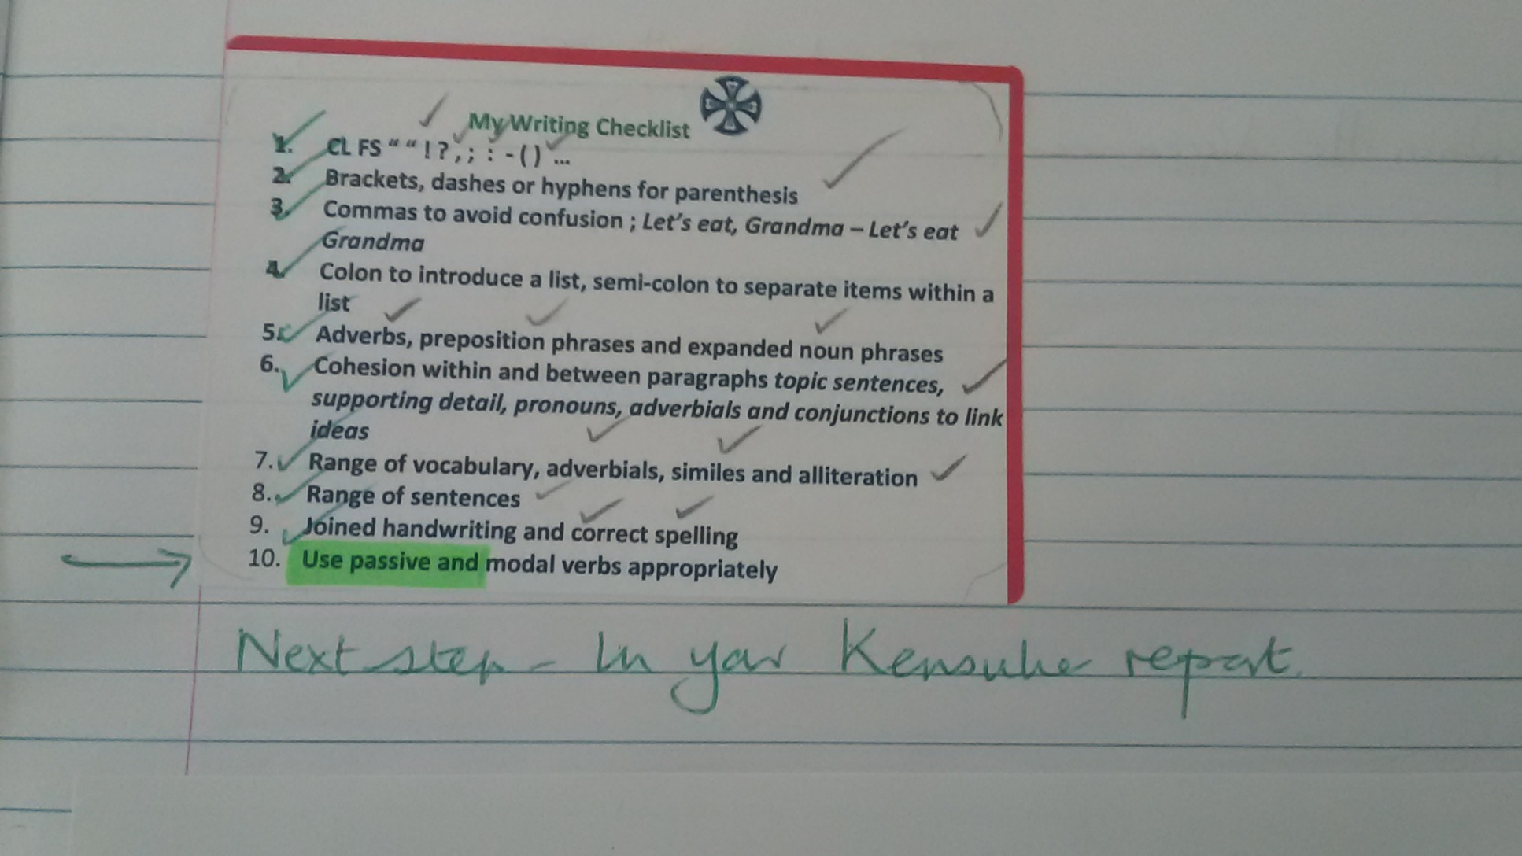
St. Dunstan’s C of E Primary School, Sutton (Year 6)

Slide 24
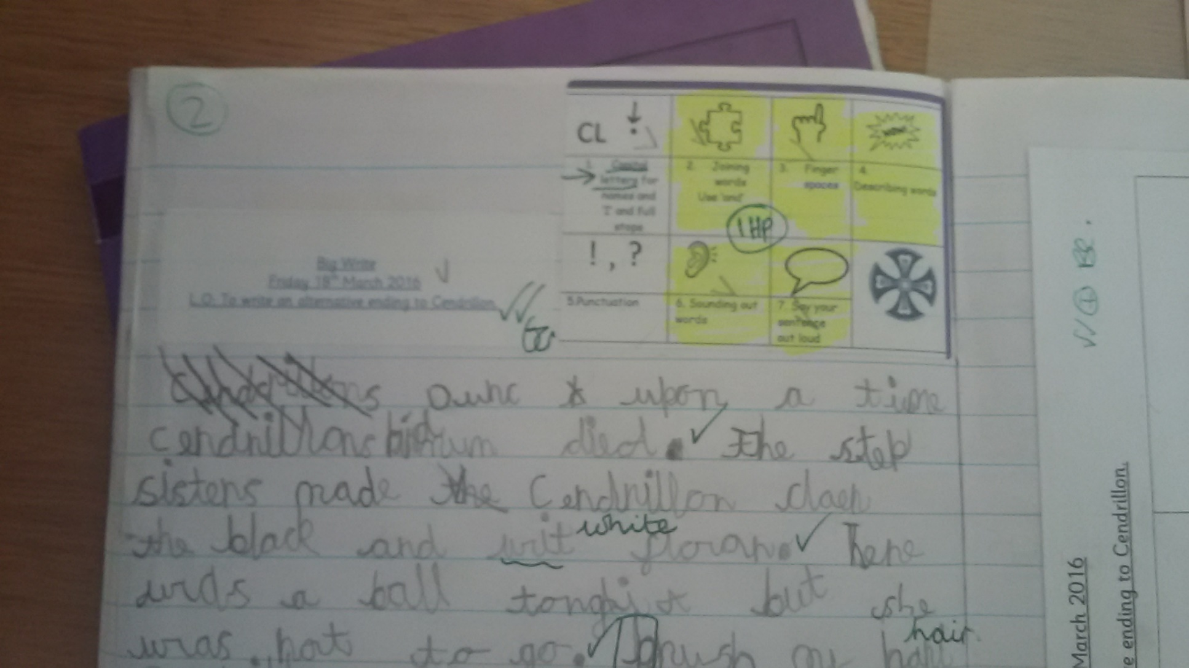
St. Dunstan’s C of E Primary School, Sutton (Year 1)

Slide 25
Thank you!
Course creator: Shareen Wilkinson
@ShareenAdvice
Notes:
Introduce yourself
Shareen Mayers
Experienced primary teacher – 15 years
Lead for primary English – successful and high performing LA, covering 42 primary schools
DfE range of projects and review groups
Author and series editor for leading publishers
Adviser to charities and various organisations, e.g. author of national children’s book week materials
@ShareenMayers on board.
Handouts:
Sutton Writing Descriptors
National Curriculum – Grammar Appendix

