Slide 1


Course creator: James Clements
@MrJClements

Slide 2


Slide 3
What might our planning include?
  Choosing a text (and any supporting texts)
  Learning intention / learning objectives
  Outcomes - written, spoken, thought
  Text structure and language patterns

Slide 4

Making a plan
  Sketch planning
  Lesson structure
  Responsive planning each day
  Extended writing with time to edit based on feedback
  Language teaching embedded based on text

Slide 5




Text-based planning: The Odyssey

Slide 6
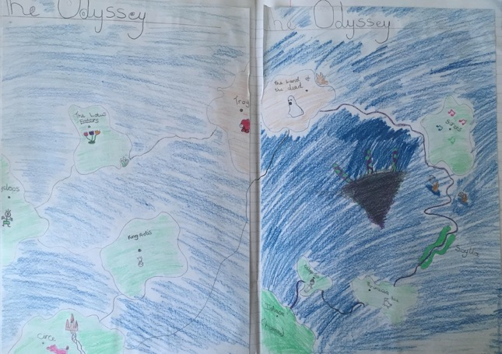
The Odyssey

Slide 7
The Odyssey
Day 1-4: Children read, talk and think about the story
Close reading and analysis
  Whole-class, small-group and individual
Questioning
  Cascades of questions
  Authentic questions
  statements
Booktalk

Slide 8

Aiden Chambers’ Tell Me Beginnings
Was there anything you liked about this text?
Was there anything you disliked about this text?
Was there anything that puzzled you?
Were there any patterns or connections
that you noticed?

Slide 9
The Odyssey
The moment the prow of the boat touched the wine-dark sea, the wind whipped up waves like mountains. A sudden storm raged, vast and terrible.
Odysseus's men were afraid. “This is no normal squall. To set sail would be to forfeit our lives,” shouted Elipnor to nods of agreement.
Did Odysseus hear the protests of his crew over the gale? If he did, he did not acknowledge them. He cast an eye up at the raging skies and stepped onto his ship without a backwards glance.

Slide 10
Aiden Chambers’ Tell Me Beginnings
Was there anything you liked about this text?
Was there anything you disliked about this text?
Was there anything that puzzled you?
Were there any patterns or connections
that you noticed?

Slide 11
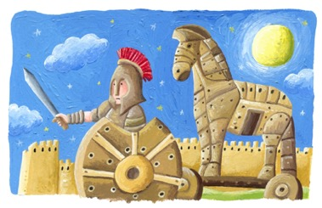
The Odyssey
Day 5: Plan and write a character study of Odysseus
  Is Odysseus a good leader?
Day 6: Edit and improve their character studies
Day 7: Planning their own journeys
  What does Odysseus want?
  What will get in his way?

Slide 12
The Odyssey
Day 8-15: Writing their own Odyssey stories
Modelling and scaffolding based on reading
Overwriting and restricted writing
Shared writing and guided writing
Editing together

Slide 13
The Odyssey
Day 8: Descriptive writing
Similes and metaphors
Personification
Details drawn from sight, sound, scent and touch
Beautiful language
Day 8: Extended writing – adventure one

Slide 14
The Odyssey
Day 10: Some GPS teaching and then edit and improve their adventure
Day 11: Taught section looking at something the class might benefit from and then write draft of adventure two
Day 12: Analysis of text, share some work and then edit and improve adventure two

Slide 15
The Odyssey
Day 13: ‘Showing, not telling’
Day 14: Extended writing of adventure three
Day 15: Share some examples and then edit and improve their adventure
Day 16 onwards: Enjoy the ending and publishing

Slide 16
Key questions
What do I want the children to learn/apply/practise in the session?
What will be the outcome of the session? Does there need to be an outcome at the end or could today’s learning feed into future work?
How will I feed back to children about their work? How will they feed back to me about what they’ve learnt?
How can I ensure that all children are challenged and all children have the chance to achieve in the session?
Are there any additional opportunities for learning or developing additional skills? Oracy? Drama? Working as a team? ICT?

Slide 17
Thank you!
Course creator: James Clements
@MrJClements

