Slide 1
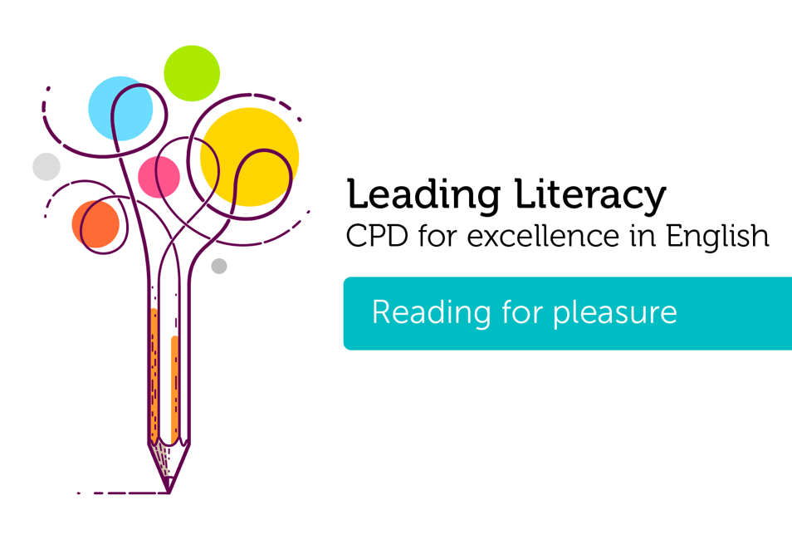
Course creator: James Clements @MrJClements

Slide 2
How can a text-based curriculum support reading for pleasure?
Reading for Pleasure:
‘Reading that we do of our own free will, anticipating the satisfaction that we will get from the act of reading. It also refers to reading that having begun at someone else’s request we continue because we are interested in it.’
(Clark and Rumbold, 2006)

Slide 3
The advantages of being a reader
A correlation between reading engagement and reading attainment (De Naeghel et al., 2012; Morgan and Fuchs, 2007; OECD, 2002, 2010)
Improved general knowledge (Cunningham and Stanovich 1998)
Improved vocabulary development (Sullivan and Brown, 2013)
A link to both improved attainment and more positive attitudes to writing (Clark, 2016; Cremin and Myhill, 2012)
A possible effect on wider academic performance (OECD 2002)
Better performance in tests of spelling and mathematics (Sullivan and Brown, 2013)

Slide 4
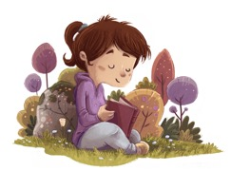
The advantages of being a reader
Develop empathy for others through their engagement with fictional characters (Nikolajeva, 2013)
Support children to develop their awareness and understanding of their emotions and furnish them with a vocabulary to discuss these (Kumschick et al., 2014)
Promote a better understanding of the world (Howard, 2011)
Develop their self and social identities (Moje et al., 2008)

Slide 5
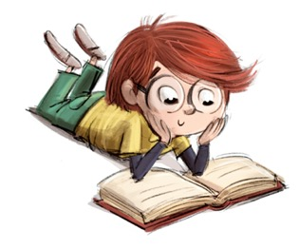
How can a text-based curriculum support reading for pleasure?
Opportunities to read, think and talk about books
Different types of reading for pleasure
Learning to read

Slide 6
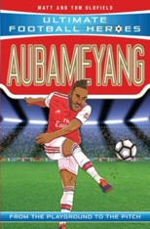
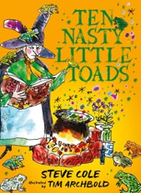

Slide 7
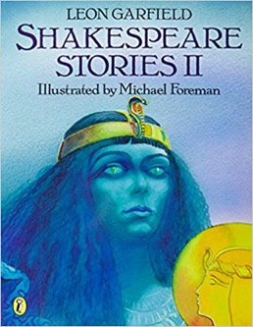
Cowards die many times before their deaths; The valiant never taste of death but once. Of all the wonders that I yet have heard, It seems to me most strange that men should fear; Seeing that death, a necessary end, Will come when it will come.
Julius Caesar, Act II Scene II

Slide 8
How can a text-based curriculum support reading for pleasure?
Opportunities to read, think and talk about books
Different types of reading for pleasure
Learning to read

Slide 9
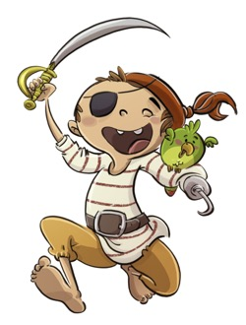
Reading initiatives
Book corners and reading displays
Dressing up days
Prizes and points
DEAR time
How can we make these things authentic?

Slide 10
A curriculum for reading for pleasure
Reading and studying rich and wonderful texts
Time for everyone to talk about books, promote books, and share books
Reading aloud every day - from the EYFS to Y6
Build in regular dedicated independent reading time for every child

Slide 11
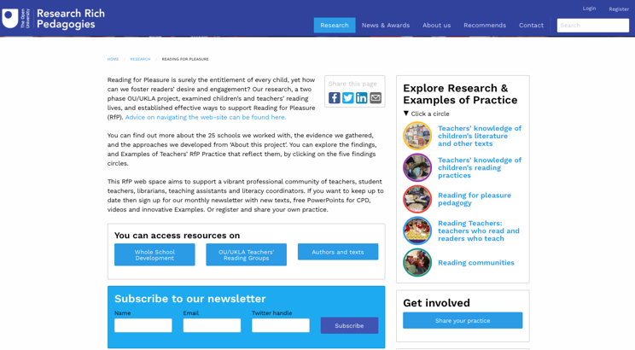
Reading for pleasure

Slide 12
Key questions
How well does our curriculum support reading for pleasure?
How much time do children have to read and be read to?
How does our curriculum balance children’s choice and interests with introducing them to new texts?
Are initiatives we use to support children’s reading
authentic?
inclusive and equitable?
actually about reading?

Slide 13
Thank you!
Course creator: James Clements @MrJClements

