Slide 1


Course creator: James Clements
@MrJClements

Slide 2
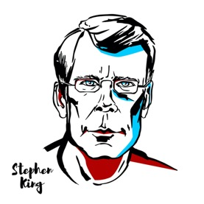
Texts as inspiration
‘If you want to be a writer, you must do two things above all others: read a lot and write a lot. There's no way around these two things that I'm aware of, no shortcut.’
Stephen King

Slide 3
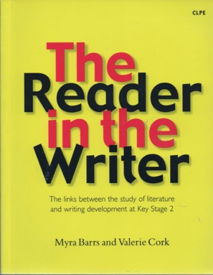
Text to support writing
Traditional tales
Rich and lyrical texts
Emotionally powerful texts

Slide 4
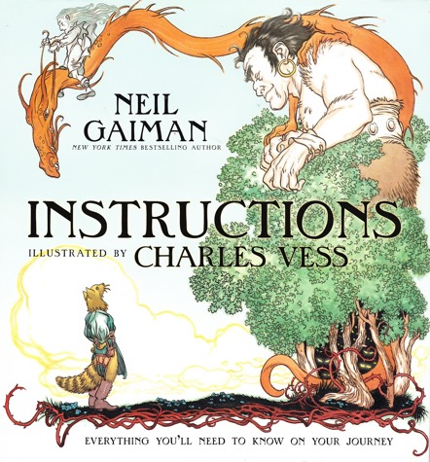
Texts as models

Slide 5
Texts as inspirations
Themes and ideas
Genres and big ideas
Reasons to write…
Familiar characters,
new adventures

Slide 6

Themes and ideas

Slide 7
Story tropes: a fitting ending…
A footballer who stopped to help a player on the opposite team during a match
An evil wizard who has been stealing treasure using a spell that makes him shrink to a tiny size
A girl who took her younger brother’s ice cream
when no one was looking

Slide 8


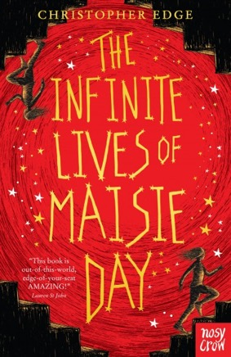
Genres and big ideas

Slide 9
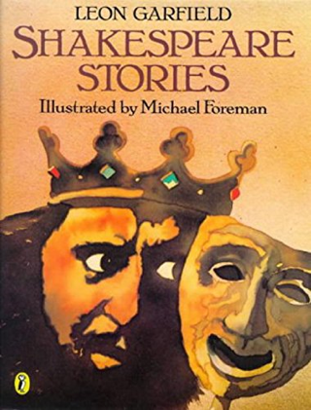
Reasons to write

Slide 10
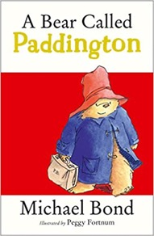

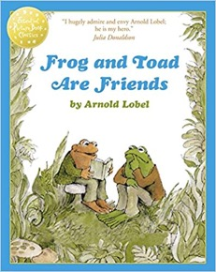

Familiar characters, new adventures

Slide 11

Devising a new adventure
What does your character want?

Slide 12

Devising a new adventure
What does your character want?
What can get in the way?
Do they get what they want?

Slide 13
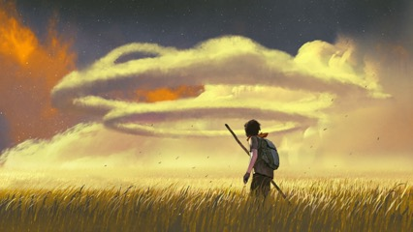
Starting with a character
Who are they?
What are they?
What makes them special?

Slide 14
Starting with a character
Who are they?
What are they?
What makes them special?
Do they have a special power
Do they have a weakness or flaw?

Slide 15
Starting with a character
Who are they?
What are they?
What makes them special?
Do they have a special power
Do they have a weakness or flaw?
An animal?
A person?
A magical creature?
A brand new superhero?
A tiny dinosaur?
A kind-hearted pirate?
An invisible unicorn?

Slide 16
Key questions
  How do we choose texts as inspiration for writing?
  How well do we know the possibilities open to us?
  How do we help children to draw on their reading when they write?
  How do we ensure children’s choice and freedom to write with the demands of the curriculum?

Slide 17
Thank you!
Course creator: James Clements
@MrJClements

