Slide 1


Course creator: James Clements
@MrJClements

Slide 2

Text to support writing
Traditional tales
Rich and lyrical texts
Emotionally powerful texts

Slide 3
Text to support writing
Text-level models
Language-level models

Slide 4
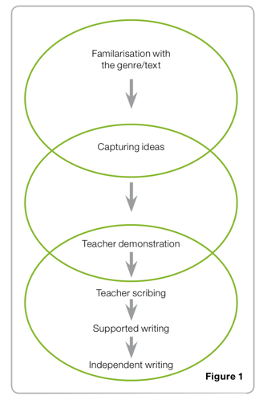
A model for writing
National Primary Strategy
Crown copyright 2007

Slide 5




Texts as models for writing
Narrative structure

Slide 6



Texts as models for writing
Letters and replies

Slide 7





Texts as models for writing
Diaries

Slide 8

Texts as models for writing
Instructional texts

Slide 9

Texts as models for writing
Instructional texts

Slide 10

Language-level models
Two useful techniques:
Overwriting
Restricted writing

Slide 11
Overwriting
The moment the prow of the boat touched the wine-dark sea, the wind whipped up waves like mountains. A sudden storm raged, vast and terrible.
Odysseus's men were afraid. “This is no normal squall. To set sail would be to forfeit our lives,” shouted Elipnor to nods of agreement.
Did Odysseus hear the protests of his crew over the gale? If he did, he did not acknowledge them. He cast an eye up at the raging skies and stepped onto his ship without a backwards glance.

Slide 12
Overwriting
The moment the prow of the boat touched the wine-dark sea, the wind whipped up waves like mountains. A sudden storm raged, vast and terrible.
Odysseus's men were afraid. “This is no normal squall. To set sail would be to forfeit our lives,” shouted Elipnor to nods of agreement.
Did Odysseus hear the protests of his crew over the gale? If he did, he did not acknowledge them. He cast an eye up at the raging skies and stepped onto his ship without a backwards glance.

Slide 13
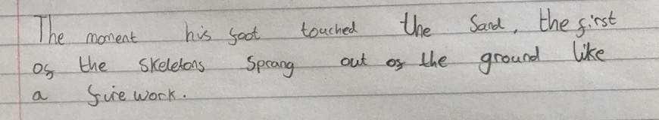
Overwriting

Slide 14

Overwriting: removing the scaffolds
Use the text as a scaffold (independently or shared writing)
Set some abstract challenges from the text (restricted writing)
Independent writing

Slide 15
Overwriting
The moment the prow of the boat touched the wine-dark sea, the wind whipped up waves like mountains. A sudden storm raged, vast and terrible.
Odysseus's men were afraid. “This is no normal squall. To set sail would be to forfeit our lives,” shouted Elipnor to nods of agreement.
Did Odysseus hear the protests of his crew over the gale? If he did, he did not acknowledge them. He cast an eye up at the raging skies and stepped onto his ship without a backwards glance.

Slide 16
Prompts for restricted writing
Can you use an adverbial of time to start your description and show cause and effect?
Can you ask a question and then answer it?
Can you use a simile to describe a moment in the story?

Slide 17
Overwriting: removing the scaffolds
Use the text as a scaffold (independently or shared writing)
Set some abstract challenges from the text (restricted writing)
Independent writing

Slide 18
Texts as models and scaffolds
We should vary the scaffolds so we support different things at different times
There should always be a plan to take a scaffold down

Slide 19
Key questions
  How well do we use texts as models for writing?
  How do we choose the texts we use as models?
  How do we move from models and scaffolds to independence?

Slide 20
Thank you!
Course creator: James Clements
@MrJClements

