Slide 1


Course creator: Shareen Wilkinson
@ShareenAdvice

Slide 2
Different types of sentences
Exclamation
What a wonderful present you gave me!
Command
Pack away your paints now.
Statement
One day, Ali decided to make a toy robot.
Question
Where do lions live?
Notes:
Expectation for the end of year 2 but should be repeated throughout the primary years.
These are also tested at the end of KS2.

Slide 3
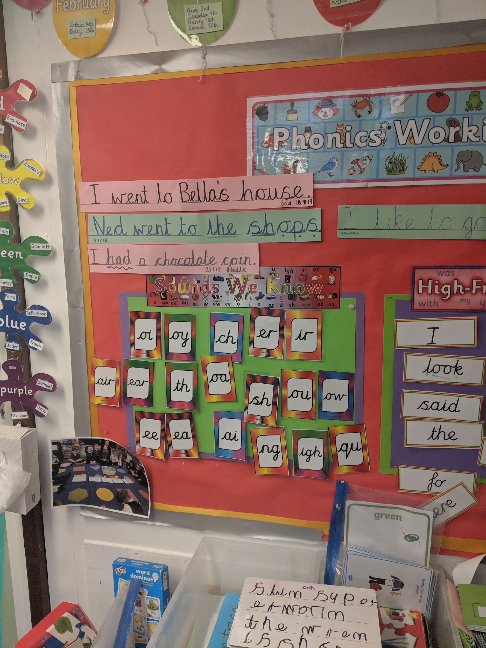
Ottershaw Infant School, Surrey
Notes:
Important to have whole sentences on display rather than odd words.

Slide 4
Explicitly teach the difference between a statement and a phrase
  The boy played tennis.
  Blue sky.
  The rabbit ate a carrot.
  Delicious cake.
Notes:
What makes a sentence? Statement or phrase?
Subject and verb agreement.
According to the DfE!

Slide 5
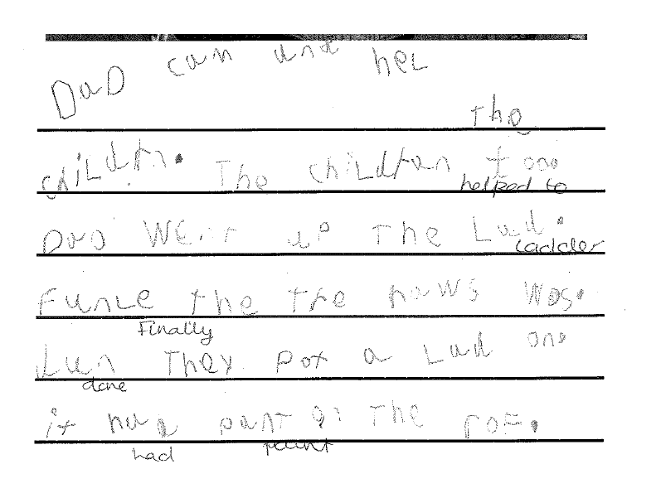
Year 1
Notes:
Barrow Hedges Primary School

Slide 6
1) Circle the full stops that are in the wrong places.
One has been done for you.
My classroom is. quite big. There are some colourful paintings. on the walls. My best friend. Ahmed painted one of them.

Slide 7
Questions
Question tags
She’s really talented, isn’t she?
I am the best writer, aren’t I?
Verb starters (do, have, be) or modal verbs (could, should,
will etc)
Do you have a pencil?
Could you pass me the sauce please?
Wh- words (what, who, whom, whose, where, why, when)
Who was that?
Where did you find them?
Notes:
Question tags are sometimes not classed as true questions but they are in the NC Year 6 as part of informal speech writing.
Outlining the typical syntax.

Slide 8
Explanations
What | Noun/noun phrase | Subject (noun or pronoun) | verb | Exclamation mark
What | big teeth | you | have | !
How | Adjective | Subject (noun or pronoun) | verb | Exclamation mark
How | amazing | he | is | !
N.B: The syntax varies in the examples given because they can include other elements but this gives a rough guide.

Slide 9
Other uses of exclamation marks
Examples of using exclamation marks
  You are my best friend!
  (Statement with an exclamation mark)
  Get out of my house!
  (Command with an exclamation mark)
  Wow!
Notes:
Interjection and sentence fragment

Slide 10
What type of writing can exclamations be applied to?
Letters (How I wish you were here!)
Traditional stories and fairy tales (What big teeth you have!)
Narrative writing (What a lucky escape that was!)
Book reviews (How amazing this is!)
Character description (How shiny she looks!)
Recounts (What a wonderful day we had!)

Slide 11
Commands
Commands give directives and use the imperative form.
Look at me.
Follow the signs.
After the while, stand over there.
Stop right now!
Put down your pencils.
They rarely use the subject as this is implied.
(You) look at me.
(You) follow the signs.
Negative commands
Don’t touch that!
Do not touch.

Slide 12
How can commands be used in writing ?
Instructions (Cut the bread in half)
Requests (Please refrain from touching the display)
Invitations (Do come to my dinner party)
Advice (Think about the answer)
Good wishes (Have a lovely time)
Warnings (Watch out for the crocodiles)

Slide 13
Gateway to writing – Learning about sentences (2009)
Human sentences
Write each word of a sentence, and the full stop, on separate cards. Give each card to a child, and ask the children to sequence the words to make a sentence. All the children then read the sentence together.
Notes:
Human sentences
Write each word of a sentence, and the full stop, on separate cards. Give each card to a child, and ask the children to sequence the words to make a sentence (Letters and Sounds, DCSF 2007, has examples of sentences at each phonic phase). All the children then read the sentence together.
Beginnings and ends
Write out some sentences on cards, and cut each sentence into two parts. The sentences could be taken from a familiar book or from Letters and Sounds. Give each child a card, and ask them to find the other part of their sentence. Each pair should show their sentence and read it to the rest of the group.
Example sentences from Letters and Sounds Phase 3:
I can hear an owl/hoot at night.
Nan is sitting/in the rocking chair.
The farmer gets up/at six in the morning.
Is it a sentence?
Write some sentences and non-sentences on strips of card. For example:
Sam sat on the.
The dog ran up the hill.
The cat and the fish.
Jumps on the bed.
The doll is in the cot.
01038-2009PDF-EN-07 © Crown copyright 2009 2 of 2 The National Strategies  Early Years Gateway to writing – Learning about sentences 01038-2009PDF-EN-07 © Crown copyright 2009
On top of the rock.
I can go to the log hut.
Ask the children to show thumbs up for a sentence and thumbs down for a non-sentence.
Rainbow sentences
In shared writing, write each sentence in a different colour. Some sentence ends should fall in the middle of lines, so children do not think that they need a full stop at the end of each line. A similar activity can be done in shared reading, with different colours of highlighter tape used to mark the different sentences.
Jumbled sentences
Use magnetic words and punctuation to make a sentence and then jumble up the words. Ask the children to reorder the words to make the sentence.
Finish my sentence
Give the children an oral sentence starter, such as ‘My favourite food is…’ or ‘When it rains ...’ or ‘In the middle of the wood I saw...’.
Ask for several suggestions to add to each starter in order to make a sentence.
Noisy sentences
Read a text together. Ask the children to clap, knock on the floor or click their fingers every time they come to a full stop. Different sounds can be used for question marks and exclamation marks.

Slide 14
Beginnings and endings
I can hear an owl
hoot at night.
Notes:
Write out some sentences on cards, and cut each sentence into two parts. The sentences could be taken from a familiar book or from Letters and Sounds. Give each child a card, and ask them to find the other part of their sentence. Each pair should show their sentence and read it to the rest of the group.
Example sentences from Letters and Sounds Phase 3:

Slide 15
Is it a sentence?
Sam sat on the.
The dog ran up the hill.
The cat and the fish.
Jumps on the bed.
The doll is in the cot.

Slide 16
Noisy sentences
Read a text together.
Ask the children to clap, knock on the floor or click their fingers every time they come to a full stop. Different sounds can be used for question marks and exclamation marks.

Slide 17
Thank you!
Course creator: Shareen Wilkinson
@ShareenAdvice

