Slide 1
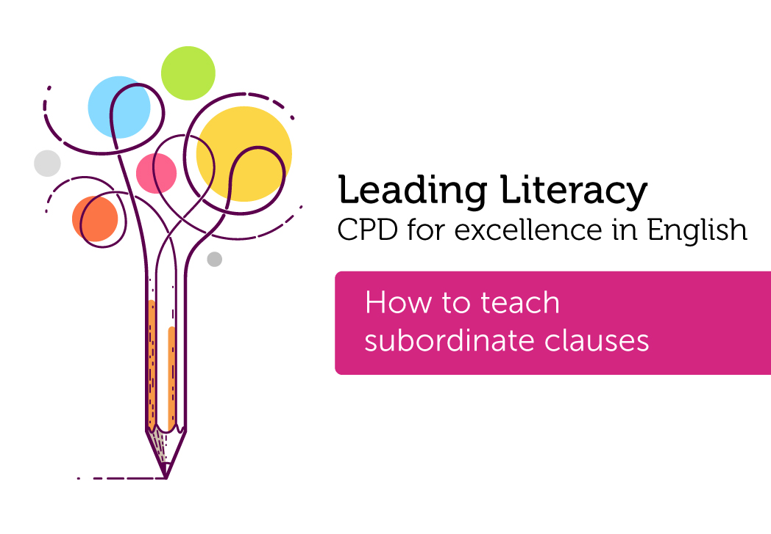

Course creator: Shareen Wilkinson
@ShareenAdvice
Notes:
1. Subordinate clauses
2. Prepositional phrases
3. Determiners
4. Statements, questions, commands and exclamations (might need to cut this down but wanted to try first)
5. Explicit vocabulary teaching
6. Spelling and vocabulary - exploring etymology
7. Proofreading and editing writing
8. Teaching paragraphs
9. Reading fluency skills
10.Phonics subject knowledge for KS2 teachers

Slide 2
Etymology
mid-15c., "having an inferior rank," from Medieval Latin subordinatus "placed in a lower order, made subject," past participle of subordinare "place in a lower order," from Latin sub "under" (see sub-)
+ ordinare "arrange, set in order," from ordo (genitive ordinis) "row, rank, series, arrangement“
Source: Etymonline.com
Notes:
mid-15c., "having an inferior rank," from Medieval Latin subordinatus "placed in a lower order, made subject," past participle of subordinare "place in a lower order," from Latin sub "under" (see sub-) + ordinare "arrange, set in order," from ordo (genitive ordinis) "row, rank, series, arrangement" (see order (n.)).

Slide 3
Subordinate clause
Fronted adverbial
Relative
clause
Other terms not used in the national curriculum: embedded clause, dropped in clause, complex sentence, dependent clause
Notes:
Source: Pixabay (copyright free images)

Slide 4
What makes this a good multi-clause sentence?
I think that…
This is because…
The children, who were chattering happily, played on the swings.
Notes:
Different type of verbs sheet
The (determiner) children (noun), who (relative pronoun), were chattering (verb – past progressive), happily (adverb)
Model how to write a multi-clause and then children practice and apply.
A main clause is complete on its own and can form a complete sentence. A subordinate clause -'when I forgot my purse' - is part of the main clause and cannot exist on its own. In the following examples, the subordinate clauses are in italics:
You'll hurt yourself if you're not careful.
Although it was cold, the morning was bright.
Where are the biscuits (that) I bought this morning?
John, who was losing his temper, began shouting.
Although most clauses require a subject and verb, some subordinate clauses do not. In many such cases, the verb can be understood. For example:
The morning, though cold, was bright. (= though it was cold)
When in Rome, do as the Romans do. (= when you are in Rome)
Most clauses require a subject and verb but some can be assumed.

Slide 5
What makes this a good
multi-clause sentence?
Subordinate clause in the middle.
Paul’s Auntie May, who loves to bake cakes, always has flour in the cupboard.

Slide 6
Tick one in box in each row to show if the underlined clause is a main clause or a subordinate clause
Sentence | Main clause | Subordinate clause
Billie, who was nine years old, loved to play tennis
Billie’s mum brought her a tennis racket so that she could play more often.
Billie could not play tennis with her friend Lana because Lana did not have a racket.
Notes:
Subordinate clause (extra information etc)
Subordinate clause (using the subordinating conjunction to introduce the subordinate clause)
Main clause in the sentence (‘because’ using the subordinating conjunction to introduce the subordinate clause)
Uses a subordinating conjunction to introduce a subordinate clause

Slide 7
How do you know?
Tick one in box in each row to show whether the word after is used as a subordinating conjunction or as a preposition
Sentence | Preposition | Subordinating conjunction
He moved here after the end of the war.
Entry is free after 5pm in the evening.
I went to the cinema after I had eaten my dinner.
Notes:
Subordinate clause (extra information etc)
Subordinate clause (using the subordinating conjunction to introduce the subordinate clause)
Main clause in the sentence (‘because’ using the subordinating conjunction to introduce the subordinate clause)
Uses a subordinating conjunction to introduce a subordinate clause

Slide 8
Main Clause
Our teacher wore a suit today.
The children had to walk to school.
Our computer went to the repair shop.
Relative
pronouns:
who
which
whose
whom
that
Subordinate Clause
He is usually scruffy.
They had missed the bus.
It has stopped working.

Slide 9
,
who works at Plazoom Primary School
Miss Richardson
.
was late for work
,

Slide 10
Relative clauses defining and non-defining
My sister, who lives in Spain, is a medical doctor.
My sister who lives in Spain is a medical doctor.
Notes:
A subordinate clause tells us ‘extra information’ within a sentence. It is not until year 5 in the English programmes of study that pupils are expected to learn about relative clauses and relative pronouns. According to the National Curriculum glossary, a relative clause is a special type of subordinate clause that contains a relative pronoun (e.g. who, which, that, etc). Therefore, the subordinate clause is an umbrella term.
My brother, who lives in America, is a medical doctor.
Subordinate clause is the umbrella term but this is a relative clause using the relative pronoun ‘who’ and the verb ‘lives’. The commas denote that this is additional information (parenthesis) or a non-defining relative clause.
My brother who lives in America is a medical doctor.
Subordinate clause is the umbrella term but this is a relative clause using the relative pronoun ‘who’. This is about a specific brother and is known as a defining relative clause.

Slide 11
Explain the use of the commas
Mangoes, which are grown in hot countries, taste delicious.
Mangoes which are grown in hot countries taste delicious.
I think that…
This is because…
Notes:
Both of these sentences contain relative clauses.
Example answer from the 2016 sample mark scheme:
The commas in the first sentence mean that all mangoes taste delicious / all mangoes are grown in hot countries (non-defining relative clause). There are no commas in the second sentence, so it means that only mangoes grown in hot countries taste delicious (defining relative clause).
Note: Pupils do not need to know the terms defining and non-defining relative clauses.
KS2 sample 2016 grammar test example:
https://www.gov.uk/government/uploads/system/uploads/attachment_data/file/439299/Sample_ks2_EnglishGPS_paper1_questions.pdf

Slide 12
Fronted adverbials
Adverb: ‘Hurriedly turning away, the woman hid the purse in her bag.’
Prepositional phrase ‘Underneath the bridge, the woman hid the purse in her bag.’
A subordinating conjunction: ‘Although she was ashamed, the woman hid the purse in her bag.’
Non-finite verbs
An –ed: ‘Exhausted, the woman hid the purse in her bag.’
An –ing: ‘Gazing into the distance, the woman hid the purse in her bag.’
Notes:
Form and function is important when teaching grammar.
Different forms can function as adverbials.
Important to note both.
Non-finite – not limited by time or place (tense)

Slide 13
Note: the subject and verb can be assumed and the relative pronoun can be omitted.
The children, who were chattering happily, played on the swings.
The children, chattering happily, played on the swings.
It was the best movie that I’ve seen.
It was the best movie I’ve seen.
(Year 5, English programmes of study)
Notes:
It was the best film (that) I've ever seen.
As long as the relative pronoun is the object of the sentence.
Whom is only used for the object of the sentence.
Chattering is still a verb.
My sister works at Harvard University.
We would accept any of the following as a subordinate clause in the response:
My sister, who lives in America, works at Harvard University. (As you say, non-defining relative clause – which is a subtype of subordinate clause)
My sister who lives in America works at Harvard University. (Again, as your example, defining relative clause – which is also subtype of subordinate clause)
My sister works at Harvard University because it has a world-class research department. (Subordinate clause starting because – any other subordinate clause would also be creditworthy)
Similarly, when we ask children to circle / identify the subordinate clause, this could be a relative clause (although it is more likely not to be, as we would tend to call a relative clause what it is!)

Slide 14
Underline the relative clause in each sentence.
59.9%
We visited the funfair that came to our town.
My uncle who lives in Australia has sent me a present.
My friend whose rabbit I look after is on holiday.

Slide 15
Thank you!
Course creator: Shareen Wilkinson
@ShareenAdvice
Notes:
1. Subordinate clauses
2. Prepositional phrases
3. Determiners
4. Statements, questions, commands and exclamations (might need to cut this down but wanted to try first)
5. Explicit vocabulary teaching
6. Spelling and vocabulary - exploring etymology
7. Proofreading and editing writing
8. Teaching paragraphs
9. Reading fluency skills
10.Phonics subject knowledge for KS2 teachers

