Slide 1
Course creator: Shareen Wilkinson
@ShareenAdvice

Slide 2
What is etymology?
A word’s etymology is its history: its origins in earlier forms of English or other languages, and how its form and meaning have changed. Many words in English have come from Greek, Latin or French.
Source: NC glossary

Slide 3
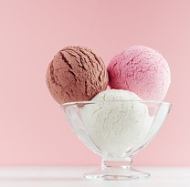
What is morphology?
A word’s morphology is its internal make-up in terms of root words and suffixes or prefixes, as well as other kinds of change such as the change of mouse to mice.
Morphology may be used to produce different inflections of the same word (e.g. boy – boys), or entirely new words (e.g. boy – boyish) belonging to the same word family.
A word that contains two or more root words is a compound (e.g. news+paper, ice+cream).
Source: NC glossary
Notes:
Some vocabulary books
‹#›

Slide 4
Etymology in the national curriculum
Years 3 and 4 English programme of study
apply their growing knowledge of root words, prefixes and suffixes (etymology and morphology) as listed in English Appendix 1, both to read aloud and to understand the meaning of new words they meet
read further exception words, noting the unusual correspondences between spelling and sound, and where these occur in the word.

Slide 5
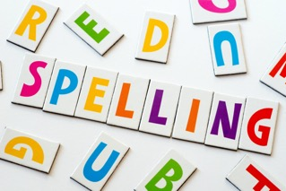
Etymology in the national curriculum
Years 5 and 6 English programme of study
apply their growing knowledge of root words, prefixes and suffixes (morphology and etymology), as listed in English Appendix 1, both to read aloud and to understand the meaning of new words that they meet.
Notes:
Implicit teaching – steps encourage reading across the school.
Class reader – reading aloud.
Explicitly teaching an exploring new words.
‹#›

Slide 6
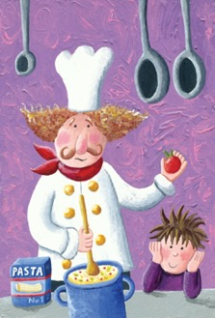
Etymology for spelling
Years 3 and 4 spelling appendix
Words with the /k/ sound spelt ch (Greek in origin)
scheme, chorus, chemist, echo, character
Words with the /ʃ/ sound spelt ch (mostly French in origin)
chef, chalet, machine, brochure
Words ending with the /g/ sound spelt –gue and the /k/ sound spelt –que (French in origin)
league, tongue
Notes:
‹#›

Slide 7
Etymology for spelling
‘Etymology also helps with spelling and pronunciation. In ‘chlorophyll’, ‘ch’ comes from the Greek letter Χ (chi, pronounced ‘kai’) and ‘ph’ from the Greek letter Φ (phi, pronounced ‘fai’). The spelling of many abbreviations reflects the full form of a Latin word, for example ‘lb’ (libra ‘pound’) and ‘a.m.’ and ‘p.m.’ (ante and post meridiem, ‘before and after midday’).’
Source: https://www.teachprimary.com/learning_resources/view/let-kids-play-dictionary-detective-by-teaching-them-etymology
Notes:
was free to do what he wanted.
Stresses the importance of teaching idioms and figurative language.
‹#›

Slide 8
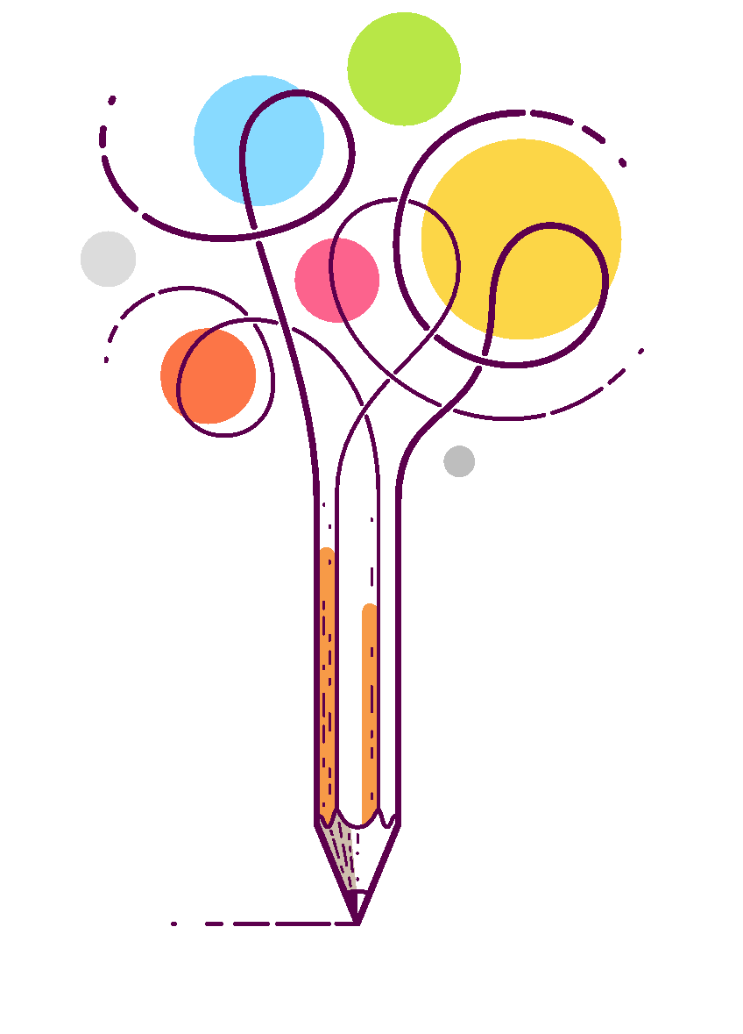
Etymology for vocabulary development

Slide 9
Word RESCUE
Read it
Explore it
Spell it
Check it
Understand it
Explain it in different contexts
Notes:
IDIOM: you reap what you sow
MEANING: your actions dictate the consequences
FROM: “Rolling in the Deep” (2011)
‹#›

Slide 10
Glint
Read it
Explore it (synonyms)
Thesaurus work
shine, gleam, glitter, sparkle, twinkle, blink, wink,
glimmer, shimmer, glow, flicker, glisten, flash
Spell it
Use spelling strategies (e.g. phonics, sound out and blend)
Check it (e.g. g-l-i-n-t)
Understand it
Dictionary work
Give out or reflect small flashes of light
Explain it in context (apply grammar)
He immediately began searching for the glint of gold or silver
It is the sparkle from the gold or silver
- Only need to find the word in the text rather than explain it

Slide 11
Course
Read it
Explore it (synonyms, antonyms and any homophones)
route, way, track, direction, tack, path, line, journey, itinerary, channel, trail, trajectory, flight path, bearing, heading, orbit, circuit, beat, round, run
dish, menu item
Homophones: coarse (adjective)
Spell it
Use spelling strategies (e.g. break down into syllables, mnemonics, prefixes and/or suffixes)
Check it
Understand it
Dictionary work
A set of classes or a plan of study on a particular subject, usually leading to an exam or qualification.
A part of a meal that is served separately from the other parts.
Movement in time; duration: in the course of a year.
Explain it in different contexts Crucial to explore the range of ways that it can be used. She completed her training course in one day.

Slide 12
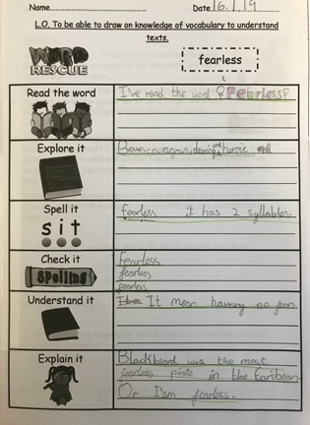
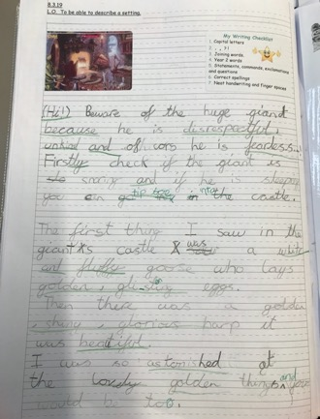
Hackbrigde Primary School, Sutton Amanda Hazelgrove

Slide 13
Teach the meanings for prefixes and root words
Prefix | Meaning
auto | self or own
anti | against
inter | between
bi | two
mis | wrong
contra | against
non | not
de | undo
pre | before
in | not (also ‘in’ and ‘into’)
sub | under
sus | under (a version of ‘sub’)
re | again
un | not

Slide 14
Roots that can stand alone
Act: to move or do (actor, acting, reenact)
Arbor: tree (arboreal, arboretum, arborist)
Crypt: to hide (apocryphal, cryptic, cryptography)
Ego: "I" (egotist, egocentric, egomaniac)
Form: shape (conform, formulate, reform)

Slide 15
Roots words as word stems
Metre: measure (kilometre, millimetre, pedometer)
Micro: small (microbiology, microcosm, microscope)
Multi: many (multilingual, multiple, multifaceted)
Port: carry (portal, portable, transport)
Sect: cut apart (dissect, sectional, transect)

Slide 16
Roots words and base words
A base word is a standalone English word that can also form other words with affixes (prefixes and suffixes). A root word is the Latin or Greek basis of a word that, generally speaking, can't be used as a standalone word. You may also see just "root" used to refer to the basic Greek or Latin word part that cannot stand alone.
Source: https://examples.yourdictionary.com/examples-of-root-words.html

Slide 17
What does the root graph mean in the word family below?
graphics autograph photography paragraph
Tick one
moving pictures
writing or drawing
colourful or bright
in a group
1 mark
Notes:
‹#›

Slide 18
What does the prefix multi- mean in the words multicultural, multipurpose and multicoloured?
Tick one
some
few
all
many
Notes:
13% of pupils got this word.
‹#›

Slide 19
The prefix re- can be added to the word play to make the word replay.
Tick the meaning of the word replay.
Tick one
to play together
to play later
to play again
to play badly

Slide 20
Etymology in practice
Teach alongside spelling and vocabulary
Explicitly teach the meanings of root words and prefixes/suffixes
Allow children to do their own investigations (where appropriate)
Have fun exploring the origins of words
Good website: www.etymonline.com

Slide 21
Thank you!
Course creator: Shareen Wilkinson
@ShareenAdvice

