Slide 1


Course creator: Shareen Wilkinson
@ShareenAdvice

Slide 2
Paragraphs in the national curriculum
Year 1
Sequence sentences to form short narratives
Year 2
Correct choice and consistent use of present and past tense throughout writing
Progressive form of verbs (e.g. She is drumming, he was shouting)

Slide 3
Paragraphs in the national curriculum
Year 3
Introduction to paragraphs as a way of grouping related material
Year 4
Organise paragraphs around a theme
Year 5
Devices to build cohesion within a paragraph
Linking ideas across paragraphs using adverbials of time, place, number and tense choices
Year 6
Linking ideas across paragraphs using a wider range of cohesive devices: repetition of a word or phrase and grammatical connections, e.g. on the other hand, etc

Slide 4











Key aspects of teaching reading and writing
Read
Comprehension
Analyse
Plan
Reading &
Writing Journey
Draft
Write
Evaluate
and edit
Proofread
Read Aloud

Slide 5
Grouping relating material
How to have TiPToP paragraphing skills
TiPToP
Time
Person
Place
Topic
Notes:
Implicit teaching – steps encourage reading across the school.
Class reader – reading aloud.
Explicitly teaching an exploring new words.
5

Slide 6
Paragraphs
Learning objective
  To understand why we change paragraphs
Success criteria (model to children)
  Time, place, person, event, speaker
Review
  Ask the children what a paragraph is and explain by showing a paragraph. Before you begin, pull out some of the key vocabulary within the text
  so the children are familiar with some of the words.
Teach
  Show the children the picture of why paragraphs change.
  Model with the children and identify what the paragraph is about.
Practice
  Discuss and practise the next three paragraphs together. Check the
  children’s understanding through detailed questioning. Spend longer practising if children are unsure.
Apply
  Give the children another text (if time) to practise with their partners.
  What have you learnt today? Carry out self-assessment.

Slide 7
Identifying related material
Topic
  There are two gangs in my neighbourhood: the Hammers and the Nails.
  They are sworn enemies.
Time
  One day I was skateboarding home when the Hammer gang grabbed me. Their leader, Hammerhead, lifted me off the ground by my collar, pushed his face close to mine and showed me his fist. “You’re joining us,” he said. It wasn’t an invitation. It was a statement of fact. As I might want to smile again sometime,
  it was essential I had some teeth to do it with – so I nodded.
Talk (person speaking)
  “A wise decision,” Hammerhead said, putting me down. “Now wear this.”
  He handed me a red bandana, the Hammers’ colour. As I walked away, struggling to put it around my head, I noticed the Nail gang up ahead. I quickly stuffed the bandana into my pocket. Nailhead, the gang leader, looked me over. My foot tapped nervously on my skateboard. Nailhead’s eyes lowered to my board.
Source: KS3 Progress Units Writing Organisation

Slide 8
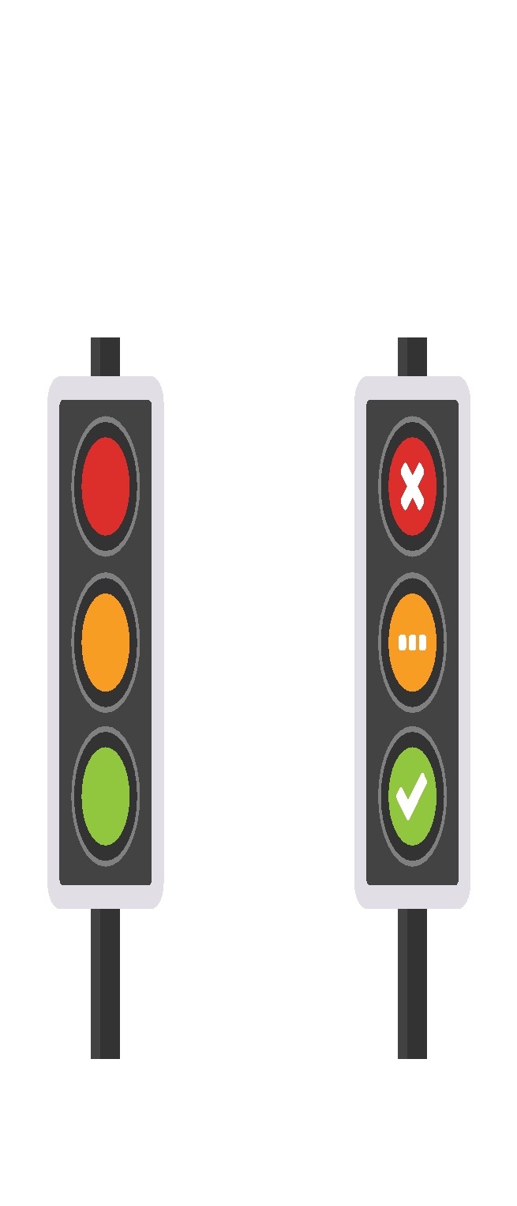
Topic Sentence
A topic sentence tells what your paragraph will be about.
Supporting Sentences
Supporting sentences add details. Each sentence needs
to be about your topic.
Ending Sentence
The ending sentence closes your paragraph. It means that your paragraph is finished.

Slide 9
Organising paragraphs around a theme
Crocodiles live in both tropical and sub-tropical areas of the world.
Crocodiles like to live in rivers and estuaries.
Crocodiles are very large. They can grow up to 7.5 metres (25ft) in length. When they are in water, you can only see a small part of them. Crocodiles have a long and powerful tail. Their snouts can be either long and thin or short and broad. They have 30 to 40 teeth, but only two of these can be seen when their jaws are closed.
Crocodiles are very good hunters and good survivors. They eat many different types of animals. They use their powerful tails to knock their prey into the water and then they crush them with their powerful jaws. After this, they swim in circles tearing up the prey.
Source: KS3 Progress Units Writing Organisation

Slide 10
Identifying topic sentences and supporting detail
Rats make excellent pets and can be easily and cheaply bought.
If you wish to keep rats as pets you should go to a good pet shop or contact an official breeder who can give you advice.
It is important to choose your pet rats carefully. Check that they are healthy. You will know because they will be alert and their eyes, nose and ears will be clean. Rats must be at least six weeks old before you buy them and they should be kept in pairs of either males or females.
Rats need a large cage which is at least 60 x 30 x 30 cm in size. The cage must contain somewhere cosy for your rats to sleep and have solid, not wire, flooring. Rats must have toys to play with such as ladders, tubes and ropes.
Source: KS3 Progress Units Writing Organisation

Slide 11

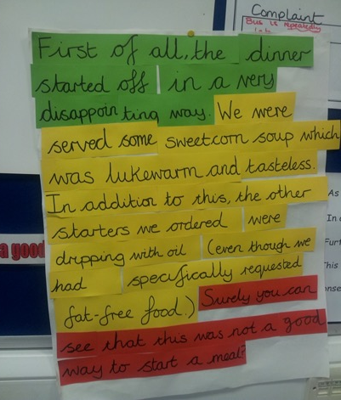
Green Wrythe Primary School, Sutton

Slide 12
Teach: Match the paragraph with the correct
topic sentence
Somebody was coming up the stairs!
The door opened and we could hear someone coming in.

Slide 13
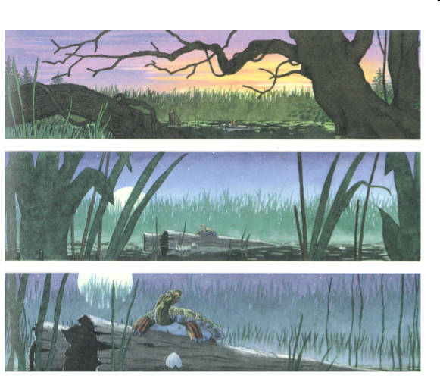
Topic sentences and supporting details

Slide 14
Year 6 child
One Tuesday evening, at around 8pm, the warm tired sun was fading silently over the calm sea. The reflection of the turquoise colour sea shone on all the passing visitors, as they walked along the edge of the warm sand. Dim and far, low and touching, the boiling sun drifted south slowly steadily like a snail.

Slide 15
What is cohesion?
A text has cohesion if it is clear how the meanings of its parts fit together. Cohesive devices can help to do this.
A visit has been arranged for Year 6 to the Mountain Peaks Field Study Centre, leaving school at 9.30am. This is an overnight visit. The centre has beautiful grounds and a nature trail. During the afternoon, the children will follow the trail.

Slide 16
What are cohesive devices?
Cohesive devices are words used to show how the different parts of a text fit together. In other words, they create cohesion.
Some examples of cohesive devices are:
determiners and pronouns, which can refer back to earlier words
conjunctions and adverbs, which can make relations between words clear
ellipsis of expected words.

Slide 17
Examples of cohesive devices
Joe was given a bike for Christmas. He liked it very much.
[the pronouns refer back to Joe and the bike]
We’ll be going shopping before we go to the park.
[conjunction; makes a relationship of time clear]
I’m afraid we’re going to have to wait for the next train.
Meanwhile, we could have a cup of tea.
[adverb; refers back to the time of waiting]
Where are you going? [ ] To school!
[ellipsis of the expected words ‘I’m going’; links the answer
back to the question]

Slide 18
Examples within paragraphs
A little while later, I go back to get my wife, and to my surprise, she is not there, so I pull up the rope and in the bucket there is a jinni. He grabs me and the next thing I am in China! “Whoa, what just happened?” I say. I breathe in the smell of cooking from the city below me. I can smell herbs, spices and raw, fresh fruit. Markets everywhere: pink, brown, green and more. A beautiful palace stands behind us, with glorious, shiny golden domes on each tower.

Slide 19
Wider range of cohesive devices
The Assassin
The gloomy silhouettes suddenly disappeared, as the crescent moon was released from its prison. The light shone weakly onto the building opposite… just enough for the killer to search the derelict alleyway below him. The assassin gave a sinister grin, his shaggy dark coat hiding him from anyone who dared to enter his domain.
“Any time now,” the murderer thought to himself. He lay low in the darkness, his eyes fixed upon the street in which the unfortunate culprit would creep out onto, waiting for the moment when he would strike. Blood raced through his body, his pulse quickening with every moment that passed.
After what felt like an eternity, with his limbs aching, the building to the right of him began to shake, before long doing so more vigorously and emitting odd noises: Grack! Rackt!
“Finally,” smiled the assassin, “my time to shine.”

Slide 20
Wider range of cohesive devices
Without warning, the noises abruptly came to a halt. Tensing his body, he steadied his legs, crouching low, preparing to pounce. And then...out flew a piece of sewage.
“Dang it” he wailed.
Now, more infuriated than he had ever been, he repositioned his body, determined to end this embarrassment of a murder.
He took a long, deep breath, cautiously scanning his surroundings, once again the gloom sweeping over him in a curtain of black. The victim suddenly appeared, oblivious to his whereabouts. Hovering above him, the assassin gave a smirk. Swoop! Rip!
“Easy as you like!” he laughed.
A dead rat lay on the cobbled street, the mud gradually oozing over the dry skin. With a sense of glee, the barn owl flew triumphantly back to its lookout, the rat dangling from his claws, as he readied for the feast ahead.

Slide 21

Topic sentence
Supporting sentence 1
Supporting sentence 2
Supporting sentence 3
Conclusion sentence

Slide 22
Cohesion across paragraphs
First Horrid Henry went to find the stink bomb he had made. Although it had taken a long time to make it, it was going to be worth it.
Next, Horrid Henry crept up to his parents’ room with the stink bomb hidden under his jumper.
Horrid Henry took the stink bomb from under his jumper and opened his mum’s wardrobe.
Opening the wardrobe was to be his first mistake. Mum had told him never to go in there and this would be a deliberate betrayal.

Slide 23
Openings and endings – contrast and turning points
Sachir stepped into the open courtyard. The lush green grass rippled, vibrations dancing on their tips in the wind. Hot and sticky the sun beat down on Sachir’s fair, freckly skin and a pair of misty glasses sat on the end of his twisted nose. He looked bedraggled: the rags of clothes hung off his arms, sweat running through the creases. His cold breaths out, cold, like ice on the hot air, evaporated. His brown hair licked at his hunched shoulders. There was an antique clock hung over the position of his heart, ticking just ticking.
As he entered his room, the vernacular changed drastically and there was an array of colours. His tick seemed less vigorous and he lay down and went to sleep.

Slide 24
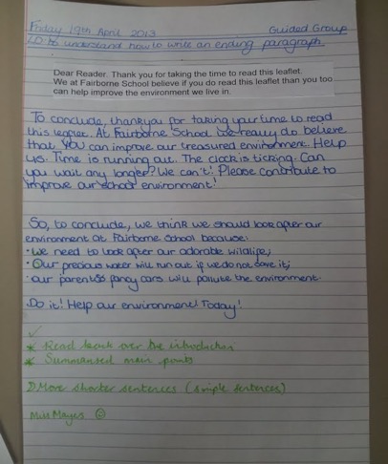
Camden Junior Academy

Slide 25
Thank you!
Course creator: Shareen Wilkinson
@ShareenAdvice

