Slide 1
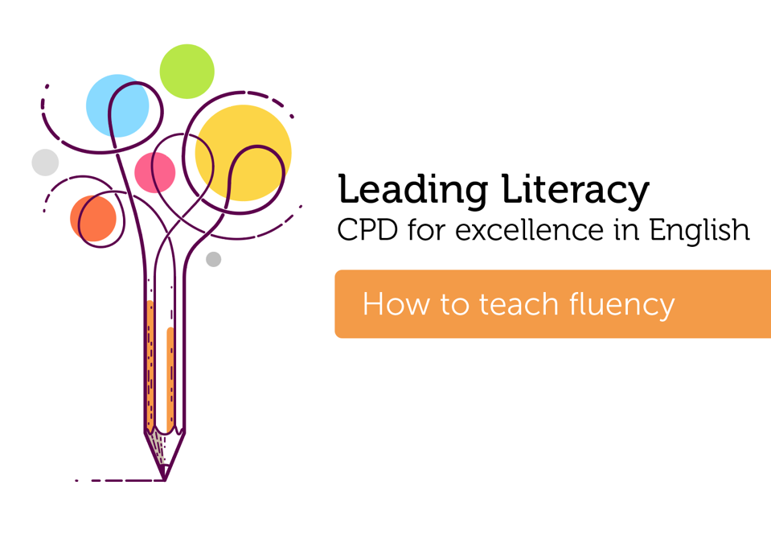

Course creator: Shareen Wilkinson
@ShareenAdvice

Slide 2
What is fluency?
‘Fluency is the ability to read with Expression, Automatic word recognition and Smoothness (EARS). Fluency is a critical link between word decoding (phonics) and comprehension.’
Rasinski, T. & Cheesman Smith, M. (2018)

Slide 3
EARS
Expression: prosody, intonation, tone, monotone, stress
Automatic word recognition: automaticity, pace/rate, words correct per minute
Rhythm and phrasing: phrasing/chunking, pausing
Smoothness: accuracy, self-correct
Rasinski, T. & Cheesman Smith, M. (2018)

Slide 4
Aims of the English programmes of study
read easily, fluently and with good understanding
develop the habit of reading widely and often, for both pleasure and information
acquire a wide vocabulary, an understanding of grammar and knowledge of linguistic conventions for reading, writing and spoken language
appreciate our rich and varied literary heritage
write clearly, accurately and coherently, adapting their language and style in and for a range of contexts, purposes and audiences
use discussion in order to learn; they should be able to elaborate and explain clearly their understanding and ideas
are competent in the arts of speaking and listening, making formal presentations, demonstrating to others and participating in debate

Slide 5
National curriculum Spoken language strand
speak audibly and fluently with an increasing command of Standard English
participate in discussions, presentations, performances, role play, improvisations and debates
gain, maintain and monitor the interest of the listener(s)

Slide 6
What does it mean to be fluent?
Independent level - relatively easy for the student to read (95% word accuracy).
Instructional level - challenging but manageable for the reader (90% word accuracy)
Frustration level - difficult text for the student to read (less than 90% word accuracy)
Source: https://www.readingrockets.org/article/fluency-introduction

Slide 7
Fluency and automaticity
‘Automaticity is the fast, effortless word recognition that comes with a great deal of reading practice. In the early stages of learning to read, readers may be accurate but slow and inefficient at recognizing words. Continued reading practice helps word recognition become more automatic, rapid, and effortless.’
‘Automaticity refers only to accurate, speedy word recognition, not to reading with expression. Therefore, automaticity (or automatic word recognition) is necessary, but not sufficient, for fluency.’
Source: https://www.readingrockets.org/article/fluency-introduction

Slide 8
The impact of ‘Reading Aloud’ to children
‘Being read to teaches children about fluency in speech patterns. It teaches them that sounds make words, words make sentences and sentences make stories. It demonstrates how to structure their own stories. All this leads them to eventually understand and interpret what they are reading.’
Source: https://worldliteracyfoundation.org/impact-reading-aloud

Slide 9





Wordless picture books

Slide 10
Emphasising words
Jerome wanted to practise the trumpet after school.
Jerome wanted to practise the trumpet after school.
Jerome wanted to practise the trumpet after school.
Jerome wanted to practise the trumpet after school.
Jerome wanted to practise the trumpet after school.

Slide 11
Alphabet
A?
B!
C?
D.
E, F, G
‘H, I, J’ K L.
M?
O!
P.

Slide 12
Numbers
1?
2!
3.
‘4,5,6’ 7

Slide 13
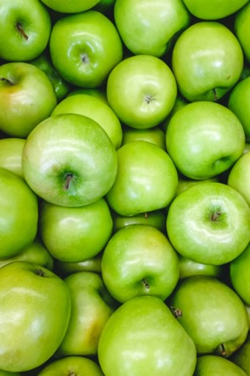
Using the same word
Apples?
Apples!
‘Apples’ Apples
Apples, apples, apples
APPLES!

Slide 14
Coral reading
Hickory, dickory, dock
The mouse ran up the clock
The clock struck one
The mouse ran down
Hickory, dickory, dock
Tick tock, tick tock, tick tock
Students read the same text at the same time
Call and response choral reading
Two groups: one group does a ‘call’ and the other a ‘response’

Slide 15
Reader’s theatre
Cinderella
The wife of a rich man fell sick, and as she felt that her end was drawing near, she called her only daughter to her bedside and said, “Dear child, be good and pious, and then the good God will always protect you, and I will look down on you from heaven and be near you.”
Thereupon she closed her eyes and departed. Every day the maiden went out to her mother’s grave and wept, and she remained pious and good. When winter came the snow spread a white sheet over the grave, and when the spring sun had drawn it off again, the man had taken another wife.
Source: https://fairytalez.com/cinderella/

Slide 16


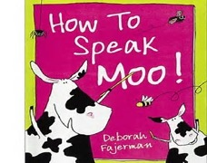
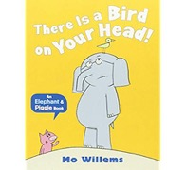
Books for teaching fluency skills – KS1

Slide 17











Key aspects of teaching reading and writing
Read
Comprehension
Analyse
Plan
Reading &
Writing Journey
Draft
Write
Evaluate
and edit
Proofread
Read Aloud

Slide 18
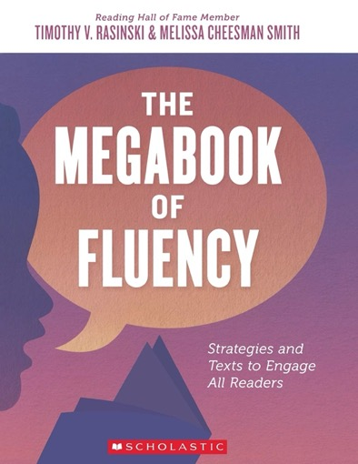

Slide 19
Thank you!
Course creator: Shareen Wilkinson
@ShareenAdvice

