Slide 1
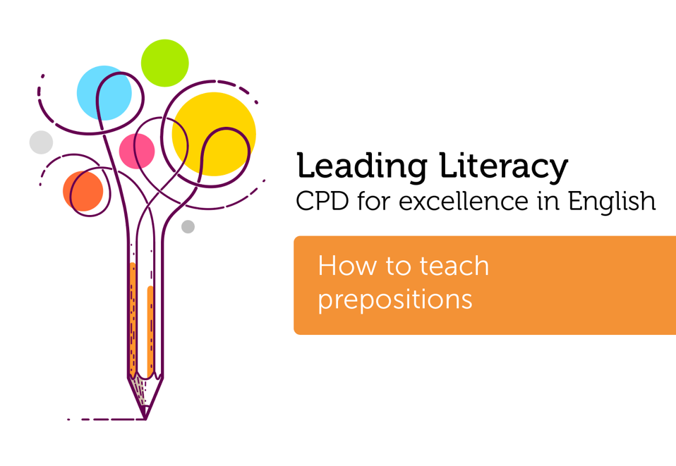

Course creator: Shareen Wilkinson
@ShareenAdvice

Slide 2

What is a preposition?
A word that is used before a noun, a noun phrase,
or a pronoun to show how things are related or connected
to one another.
She was in bed.
I met her after the meeting.
Notes:
First mentioned in Year 3 in the national curriculum.

Slide 3
Etymology
preposition (n.)
late 14c., from Latin praepositionem (nominative praepositio) "a putting before, a prefixing," noun of action from past participle stem of praeponere "put before," from prae "before" (see pre-) + ponere "put, set, place" (past participle positus; see position (n.)). In grammatical use, a loan-translation of Greek prothesis, literally "a setting before." Old English used foresetnys as a loan-translation of Latin praepositio.
Source: etymonline.com

Slide 4
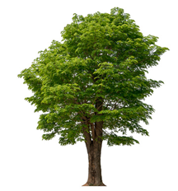
Prepositions of place
under, on, next to, up, at, into, behind, underneath, with, of, through
The pencils are under the table.
He got soaked in the rain.
The girl hid behind the tree.
Notes:
Perhaps the most common prepositions.
Gives the position.
Verbally say other sentences.
With (accompanied by).

Slide 5
Prepositions of time after, as, before, since, until
She arrived after dinner.
She arrived after the meeting had finished.
The meeting will take place at 11am.
The dance sessions will take place during the autumn term.
The film didn’t end until midnight.
We will wait here until she collects the car.
Notes:
Not to be confused with subordinate clauses.
The function of a subordinating conjunction is to introduce a subordinate clause.
after, as, before, since, until – these can function as prepositions or conjunctions depending how they are used in a sentence.

Slide 6
Fronted adverbials
Adverb: ‘Hurriedly turning away, the woman hid the purse in her bag.’
Prepositional phrase ‘Underneath the bridge, the woman hid the purse in her bag.’
A subordinating conjunction: ‘Although she was ashamed, the woman hid the purse in her bag.’
Non-finite verbs
An –ed: ‘Exhausted, the woman hid the purse in her bag.’
An –ing: ‘Gazing into the distance, the woman hid the purse in her bag.’
Notes:
Form and function is important when teaching grammar.
Different forms can function as adverbials.
Important to note both.
Non-finite – not limited by time or place (tense)

Slide 7
Circle the three prepositions in the sentence below.
After the game, Omar and Alisha walked home with their grandparents, who lived across the road.
1 mark
Notes:
After (time)
With (accompanied by)
Across (position)

Slide 8
How do you know?
Tick one option in each row to show whether the word after is used as a subordinating conjunction or as a preposition.
Sentence | Preposition | Subordinating conjunction
He moved here after the end of the war.
Entry is free after 5pm in the evening.
I went to the cinema after I had eaten my dinner.
Notes:
Year 3 – Preposition of time, place and cause. She brought an umbrella because of the rain (preposition of cause).
I think that...because...
Preposition
Preposition
Subordinating conjunction (subject and verb)

Slide 9
Prepositions of cause
to, for, because of
She wanted to ask for a pay rise.
Sport’s day was cancelled because of the rain.
Notes:
Source: https://www.toppr.com/guides/english/prepositions/preposition-of-cause-reason-purpose/
She wanted to ask for a pay rise (reason for the pay rise). ‘for’ to obtain something.
Sport’s day was cancelled because of the rain. (reason for it)
Can also use owing to.
They generally answer the question of why. They basically show the cause of something happening or the purpose of an action. As the name suggests, these show the reason in a sentence.
A train is used for travelling to different places. ( Why is a train used? The purpose of a train is to travel. The preposition for is the preposition of cause in this sentence as it is showing the purpose of a train.)
Virat Kohli received a Padma Shri for his exceptional performance in the field of cricket. (Why was Virat Kohli given Padma Shri? The award was given because of his exceptional performance. The reason of the Padma Shri award is being indicated by the preposition for.)
Let’s see some Prepositions of Cause:
To: Usually used to show the purpose of the noun. This preposition joins a noun with a verb.
We use coal in hydraulic plants to make electricity.
She ran to deliver the mail before the bus left.
My baby sister always goes to our father to ask for sweets.
2. For: This is also used to show the purpose of the noun. This preposition joins a noun with usually another noun or an adjective. If it joins the noun with a verb, usually the verb is in it’s gerund form.
I need a fine profile for getting a job at the Wall street.
Thank you for bringing us a casserole while our mom is out of town.
My cat goes out in the garden for emptying her bowels.
3. Because of/ on account of : Joining a verb with the noun, this preposition is pretty straight up. It shows the reason of the happening.
I need to stay home because of my naughty brother.
The moon shines because of the sun.
On account of the flight delay caused, the Prime minister will reach the office later than expected.
4. Owing to: Shows a cause
Owing to the brilliant example set by Ellen Degeneres, she received a Medal of Freedom by President Obama.

Slide 10
Riddles
Choose from the following word classes:
pronoun adjective determiner preposition
What am I?
I can replace a noun.
I can be in the possessive form.
I can be within a relative clause.
What am I?
Further subject knowledge: UCL English grammar knowledge organiser
I think that…
This is because…
Notes:
pronoun

Slide 11
Riddles
Choose from the following word classes:
pronoun adjective determiner preposition
What am I?
I can express time, place or cause.
I am normally placed before a noun,
noun phrase or pronoun.
What am I?
Further subject knowledge: UCL English grammar knowledge organiser
I think that…
This is because…
Notes:
pronoun

Slide 12
Circle the four prepositions in the sentence below.
On a mountain bike, you can cycle across rocky ground, along muddy paths and over harsh terrain.
1 mark
Notes:
After (time)
With (accompanied by)
Across (position)

Slide 13

Apply to writing
Notes:
Get children to identify prepositions being used in writing.
Check whether they are conjunctions or prepositions.
Model using prepositions in shared writing so the children can see these being used in practice and your thought-process.

Slide 14
Separate the prepositions
Time | Place | Cause | Movement
after before | in on | because of for | through up

Slide 15
Act out the prepositions
Get children to model the action.
She hid behind the table.

Slide 16
Model using prepositions
During shared writing, model your thought-process.

Slide 17
Thank you!
Course creator: Shareen Wilkinson
@ShareenAdvice

