Slide 1


Course creator: Ruth Baker-Leask

Slide 2
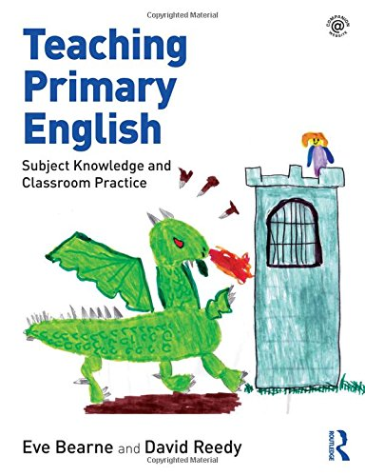
What to expect…
It is important to recognise the teacher’s role in creating a space for children to explore the world of narrative through role play and drama.
‘…the teacher has a key role to play, not only in setting up the possibilities of the drama by creating imaginative and interactive role-play areas and situations but also as Teacher in Role [TIR], improvising and exploring issues alongside the children.’
Bearne, E. Ready, D. (2018) Teaching Primary English, Abingdon:Routledge, pp 75

Slide 3

What to expect…
During this session we will explore how to:
maximise the use of role play in English lessons to support children’s understanding of narrative
Make the most of teacher in role activities such as Mantel of the Expert

Slide 4
What is role play?
From an early age, children explore worlds, real and imagined, through the act of role play. Early years practitioners provide children with a range of opportunities to engage in imaginative play: in role-play areas; with puppets and props; and through the act of table top, small world play.
Role play becomes more structured for older children but still provides the same benefits. When exploring narrative through role play, children make connections to their own realities and those of the fictional world, an essential skill every reader must develop. They are able to explore scenarios, considering their importance and consequences within the context of narrative and thereby strengthening their comprehension skills.
In addition, role play contributes to children’s language and literacy development as well as developing confidence, creative thinking and strengthening collaborative relationships within the classroom.

Slide 5
Familiar characters
    Overheard conversations: in groups or pairs, children improvise conversations between key characters. The teacher and other class members eavesdrop and report back what they heard
    Telephone conversation: Children mock call each other in role as characters from the story using the appropriate tone and language
    Flashback: Children role play a scene from before the beginning of a story
    Flashforward: Children role play what might happen next at the end of a story
    Gossip: In role as a chosen character, the children gossip about each other, making reference to key events in a story

Slide 6
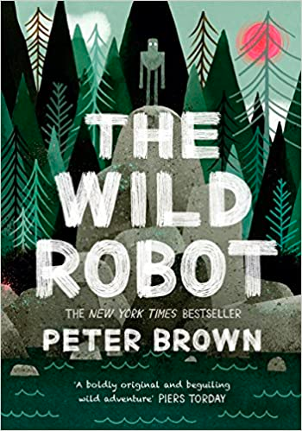

The Wild Robot by Peter Brown
“My face! My Beautiful Face! Fink the fox was lying on a log, howling in pain, with a face full of long sharp quills, when Roz appeared. “Isn’t there anyone else who can help?”
“Would you like me to leave?” said the robot.
“No! Please don’t go! I’ll take what I can get.”
The Wild Robot, Peter Brown, Piccadilly Press (2018)

Slide 7
The Wild Robot by Peter Brown
Otter: Have you met it, ummm…her yet?
Fox: Who?
Otter: That big hunk of metal that has made its home on our island!
Fox: Yes…you mean Roz. I didn’t like the look of her to be honest but she helped me out of a real pickle the other day. Pesky porcupine quills again. She’s OK you know.
Otter: I’m not so sure – she only caused a rockslide the other day. Have you heard about the poor Goose family?
Fox: The Goose family!
Otter: Yes, DEAD! I blame Uncle Ricky…if he hadn’t messed with that switch we wouldn’t be in this mess.

Slide 8

Imagined characters
A roving reporter
The local policeman
A character’s teacher
A town councillor
A parent
Bystanders
A time traveller…

Slide 9
What is Mantle of the Expert?
Mantle of the Expert was developed by Dorothy Heathcote MBE, drama teacher and academic. It is a popular strategy that is used by primary and secondary practitioners, across all subject areas.
The children take on the role of an expert in a particular field that relates to a text. The teacher (also in role), poses a problem for the ‘team of experts’ to solve, who then work together using information from the text, additional information, and their imaginations to propose a solution.
It takes courage and practice to perfect Mantle of the Expert but it’s worth it. The children quickly adapt to their newly acquired knowledge and status and become immersed in the detail of the story as a result.

Slide 10
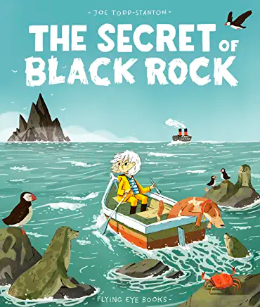
The Secret of Black Rock by Joe Todd-Stanton
You are part of a team of marine biologists. You must work with Erin to help preserve Black Rock and the creatures that live there.
  What is the problem?
  What might you do to solve it?
  What information do you need?

Slide 11
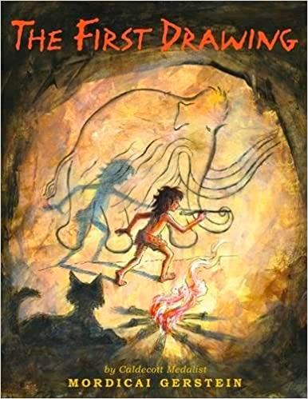
The First Drawing by Mordechai Gerstein
You are part of a team of palaeontologists who have uncovered the fossilised remains of a woolley mammoth. You must work together to find out everything you can about how it died and what life was like when it was alive.
What information do you need?
What clues do you have?
Where might you look to discover more?

Slide 12
The benefits of role play and improvisation
Thought tracking provides an opportunity for children to:
compare characters’ viewpoints
infer characters’ feelings and predict their actions
explore the relationships between characters and how this then influences the plot
imagine alternative endings (for writing)
compose internal dialogue (for writing)
compose convincing dialogue between characters

Slide 13
Benefits of drama in understanding narrative
Drama can support children to:
  engage with texts they might otherwise find ‘difficult’
  reflect on the text as a whole, giving a well-informed, personal response
  understand plot and action
  understand the setting (time and place) and how this influences action
  predict and discuss future actions and their consequences
  recognise themes and subtext
  understand and discuss mood atmosphere
  understand characters’ traits and infer their feelings, motives and intentions
  explore the language used by characters to express thoughts and feelings
  feel more confident when answering inference questions

Slide 14
Thank you!
Course creator: Ruth Baker-Leask

