Slide 1
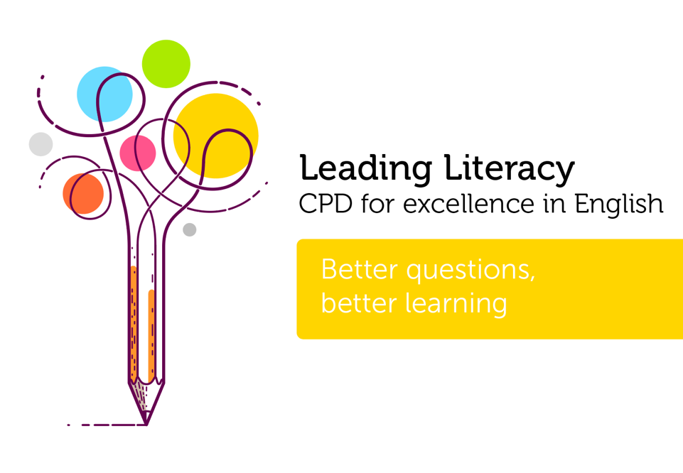

Course creator: James Clements
@MrJClements

Slide 2
Thinking about questioning
  Research suggests that questioning is a key element of classrooms, with teachers spending between thirty and fifty per cent of their time posing questions
  However, it has been suggested that these questions are often either:
    - procedural questions
    - rhetorical questions
    - questions to prompt the recall of facts
Brualdi, A. C. (1998). Classroom Questions. ERIC Clearinghouse on Assessment and Evaluation: Washington DC.
van Lier, L. (1998) The relationship between consciousness, interaction and language learning. Language Awareness. 7 (2/3), 128-316
Wilen, W. (1991) Questioning Skills for Teachers: What the research says to the teacher. Washington: National Education Association

Slide 3
Questioning and statements
  Closed questions and open-ended questions
  The purpose of questions
  Authentic questions
  Cascades of questions
  Statements
  Who asks the questions?

Slide 4
Closed questions vs. open questions
Closed questions:
Who…
When…
Where…
What…
Did…
Open questions:
Why do you think…
What if…
How did…
Which character would…
What might…

Slide 5
The Barrett Taxonomy
Literal comprehension
Reorganisation
Inferential comprehension
Evaluation
Appreciation
(Clymer, 1968)

Slide 6


Slide 7
The Barrett Taxonomy
Literal comprehension
  Find an example of…
  What happened when…
  Describe…
Reorganisation
  Retell…
  Where in the story…
(Clymer, 1968)

Slide 8
The Barrett Taxonomy
Inferential comprehension
  Why does…
  Why did the author include…
  What do you think will happen…
(Clymer, 1968)

Slide 9
The Barrett Taxonomy
Evaluation
  Who do you think…
  Do you think that…
Appreciation
  Which part of the story…
  Did the story…
(Clymer, 1968)

Slide 10
Authentic questions
Do you think Bernard’s
parents will notice he has
been eaten?
(Clymer, 1968)

Slide 11
Cascades of questions
The room in which the boys were fed, was a large stone hall, with a copper at one end; out of which the master, dressed in an apron for the purpose, and assisted by one or two women, ladled the gruel at meal-times. Of this festive composition each boy had one porringer, and no more – except on occasions of great public rejoicing, when he had two ounces and a quarter of bread besides. The bowls never wanted washing. The boys polished them with their spoons till they shone again.
Oliver Twist by Charles Dickens

Slide 12
Cascades of questions
What do we learn about the condition of the boys in the workhouse?
    What does ‘festive composition’ mean?
    Why does the author use this phrase?
    Which phrase tells you the boys had only one porringer except for special occasions?
    Why didn’t the bowls need washing?

Slide 13
Who asks the questions?
Oliver Twist and his companions suffered the tortures of slow starvation for three months: at last they got so voracious and wild with hunger, that one boy, who was tall for his age, and hadn’t been used to that sort of thing, hinted darkly to his companions, that unless he had another basin of gruel per dium, he was afraid he might some night happen to eat the boy who slept next to him, who happened to be a weakly youth of tender age. He had a wild hungry eye; and they implicitly believed him. A council was held; lots were cast who should walk up to the master after supper that evening, and ask for more; and it fell to Oliver Twist.
Oliver Twist by Charles Dickens

Slide 14
Cascades of questions
The room in which the boys were fed, was a large stone hall, with a copper at one end; out of which the master, dressed in an apron for the purpose, and assisted by one or two women, ladled the gruel at meal-times. Of this festive composition each boy had one porringer, and no more – except on occasions of great public rejoicing, when he had two ounces and a quarter of bread besides. The bowls never wanted washing. The boys polished them with their spoons till they shone again.
Oliver Twist by Charles Dickens

Slide 15
Statements
The monster is wrong to eat Bernard
The owners of the workhouse are helping the boys

Slide 16
Questioning and statements
  Closed questions and open-ended questions
  The purpose of questions
  Authentic questions
  Cascades of questions
  Statements
  Who asks the questions?

Slide 17
Key questions
How much attention do we give to the questions and discussion prompts we use in reading sessions?
Is there a balance between
    procedural questions and questions for learning?
    open-ended and closed questions?
    questions to make a teaching point and authentic questions?
To what extent does assessment drive our use of questions?

Slide 18
Thank you!
Course creator: James Clements
@MrJClements

