Slide 1
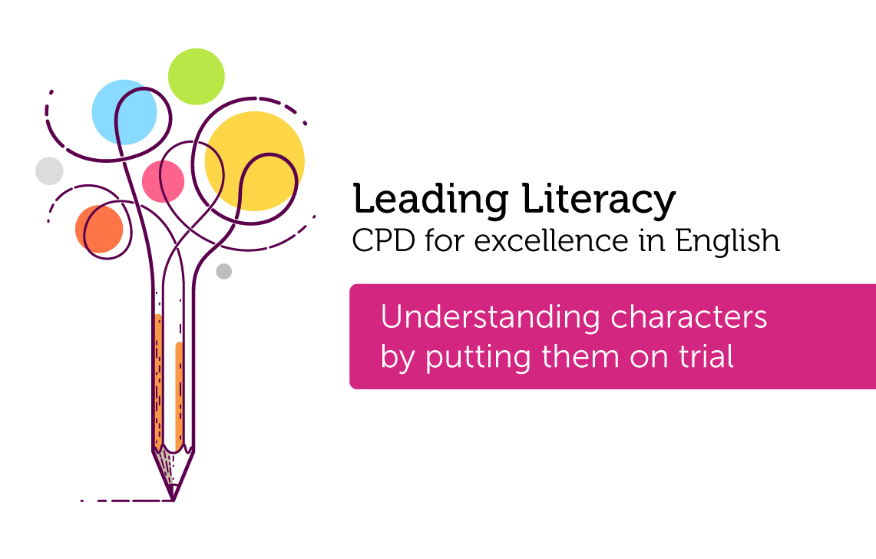

Course creator: Ruth Baker-Leask

Slide 2

What to expect…
Putting characters on trial is a useful strategy to support older children in understanding characters’ motives (particularly when these are ambiguous) as well as exploring complex themes such as good versus evil, sacrifice, injustice, transgression etc.
During this session we will explore how to:
set up a character trial
use trials and debates to deepen children's understanding of characters, plot and themes

Slide 3

What is a character trial?
The concept is straightforward: choose a character (the defendant), set up a courtroom with a team of defenders, a team of prosecutors, a judge and a jury.
Once children are used to the idea of putting characters on trial, it can be as short or long an activity as it needs to be.
It is useful to provide the class with sentences stems/starters that support children in using courtroom language.

Slide 4
What is a character trial?
Simple though it may sound, choosing your character is key. You want there to be an element of ambiguity or uncertainty around their character traits or action, otherwise, you may find that the trial is over before it begins.
Character trials are often useful when reading fractured (twisted) traditional tales, where familiar characters are often given a backstory or behave in unexpected ways.
They are also useful when exploring the ideas in classic literature which may now seem outdated or objectionable when compared to modern sensibilities and values.

Slide 5
Crimes and misdemeanours
  Truancy: Peter Pan
  Anti-social behaviour: The Tiger Who Came to Tea
  Vandalism: The Cat in the Hat
  Abduction: BFG, Charles (Rooftoppers), The Pied Piper
  Theft: Bilbo Baggins
  Trespassing: Beegu
  Stalking: Matthew Corbin (The Goldfish Boy)
  Criminal Damage: The Incredible Book Eating Boy
  Abandonment: Most parents in children’s literature!
  Fraud: The Millar’s Daughter (Rumpelstiltskin), Marinka (The House with Chicken Legs)
  Man (goose) slaughter: Roz (The Wild Robot)…and many characters from traditional tales
  Human Trafficking (forced labour): Willy Wonker
  Benefitting from the proceeds of crime: Robin Hood
  Animal Cruelty: Bogis, Bunce and Bean (Fantastic Mr Fox), Mr McGregor (Peter Rabbit)

Slide 6
Order in Court
  Case for the prosecution
  Case for the defence
  The prosecution team calls witnesses
  The defence team calls witnesses
  Closing statements
  The deliberation of the jury
  The verdict
  The sentence

Slide 7
For your consideration…
Study real or dramatised video clips of courtroom scenes.
Ask the children to take note of the language specifically used in a courtroom:
          How do you plead?
          I direct the jury to disregard the statement…
          I put it to you that…
          Is it true that…
Ask the children to take note of the tone of voice and the gestures of the people in court.

Slide 8
Character courts: some words of advice
Character courts do not always have to be a ‘main event’ of a lesson. You may just want to run the idea as a short debate or hot-seating activity.

Slide 9
Character courts: some words of advice
Choose your character carefully, or it may all end sooner than you imagined.

Slide 10
Character courts: some words of advice
Encourage the children to adopt the language and demeanour of their courtroom role.

Slide 11
Character courts: some words of advice
Give children plenty of time to plan and practise their part in the drama before staging the trial, particularly if this is an unfamiliar activity

Slide 12
The benefits of character courts
Character courts provide an opportunity for children to:
        dig deeper into the motives of key characters
        consider characters’ actions and their consequences
        explore the relationships between characters and how this then influences the plot
        consider the viewpoint from which a text is written; questioning the cultural values that underpin the context in which it was written
        formulate arguments that support their viewpoint, i.e. justifying opinions
        practise using formal language (for writing)

Slide 13
Benefits of drama in understanding narrative
Drama can support children to:
  engage with texts they might otherwise find ‘difficult’
  reflect on the text as a whole, giving a well-informed, personal response
  understand plot and action
  understand the setting (time and place) and how this influences action
  predict and discuss future actions and their consequences
  recognise themes and subtext
  understand and discuss mood atmosphere
  understand characters’ traits and infer their feelings, motives and intentions
  explore the language used by characters to express thoughts and feelings
  feel more confident when answering inference questions

Slide 14
Thank you!
Course creator: Ruth Baker-Leask

