Slide 1
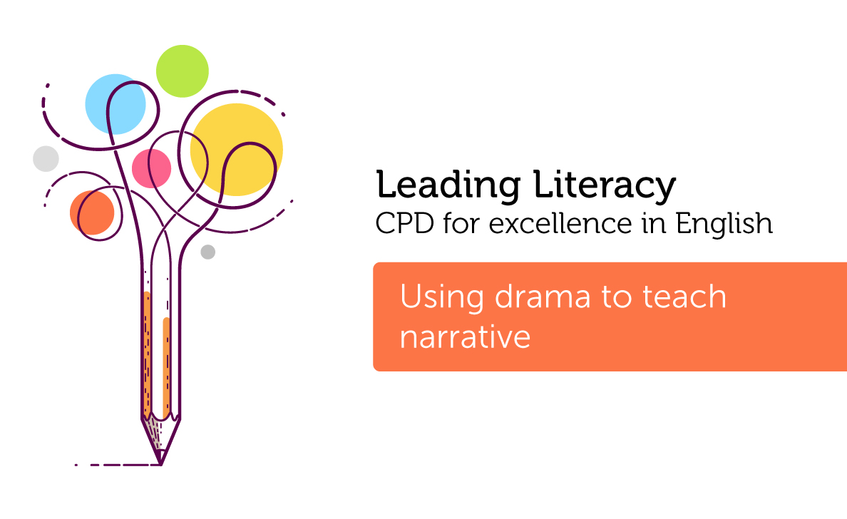

Course creator: Ruth Baker-Leask

Slide 2

Drama in the primary classroom
  Drama is both an art form in its own right and a useful method for teaching curriculum content across all subjects
  Teachers often feel ill equipped to teach drama if it is not their specialist subject
  Drama is not mentioned in the statutory requirements of the National Curriculum
  Drama is suggested as a pedagogical approach seven times in the guidance notes of the national curriculum, but only once in relation to reading: ‘role-play and other drama techniques can help pupils to identify with and explore characters’ (Year 2)

Slide 3
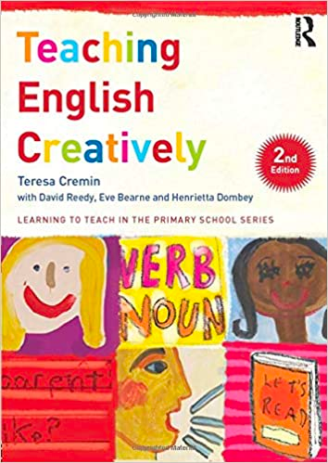
Drama is…
‘Drama, the art form of social encounters, offers children the chance to engage creatively in fictional world making play. Such play, whether in the role-play area or in classroom drama, involves making and shaping worlds, investigating issues within them and returning to the real world with more understanding and insight.’
Cremin, T (2015) Developing creativity through drama, in T, Cremin, D. Reedy, E.Bearne and H.Dombey (eds) Teaching English Creatively. Abingdon: Routledge, pp 25-40

Slide 4
Atticus Finch
“You never really understand a person until you consider things from his point of view...until you climb into his skin and walk around in it.”
To Kill a Mocking Bird by Harper Lee

Slide 5

The benefits of drama in understanding narrative
Drama can support teachers to: deepen children’s understanding of text in varied and engaging ways, thereby avoiding the temptation to only teach reading comprehension through the model of teacher questioning.
Notes:
Exploratory learning, experiencing the world through role play and interaction with others is at the heart of the eyfs curriculum..

Slide 6
Benefits of drama in understanding narrative
Drama can support children to:
  engage with texts they might otherwise find ‘difficult’
  reflect on the text as a whole, giving a well-informed, personal response
  understand plot and action
  understand the setting (time and place) and how this influences action
  predict and discuss future actions and their consequences
  recognise themes and subtext

Slide 7
Benefits of drama in understanding narrative
Drama can support children to:
  understand and discuss mood atmosphere
  understand characters’ traits and infer their feelings, motives and intentions
  explore the language used by characters to express thoughts and feeling
  feel more confident when answering inference questions

Slide 8
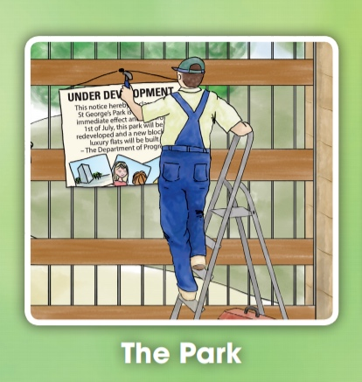
2019 KS2 Reading Test
Ajay was just about to tuck into his tea and toast dripping in sour rhubarb jam when there was a loud clatter from the letterbox as an important-looking brown envelope landed on the mat. ‘Bit early for the post isn’t it?’ Mum said. ‘Ooh, it says Special Delivery.’ Mum opened it, and unfolded the letter.
Joe knew instantly that something was wrong. He could see it on Mum’s face. ‘What is it, Mum?’ Joe asked.
‘Yeah, Mrs P, what’s happened?’ Ajay asked too.
‘It’s the park...they’ve shut it down.’
For a second no one said a word. Joe and Ajay looked at each other, then back at Joe’s mum. Her face was pale, her jaw dropped open. She stared at the letter, her eyes watery and ready to spill over with tears.
The Park: Taken from The Accidental Prime Minister, Oxford University Press, 2015. Author: Tom McLaughlin.

Slide 9
Qu. | Requirement | Mark
2 | How does Joe know that the letter contains bad news before his mum tells him what it says? Content domain: 2d - make inferences from the text / explain and justify inferences with evidence from the text Award 1 mark for reference to Joe seeing it on her face, e.g. he could tell because of his mum’s expression he could tell from her face by her face. Do not accept answers which refer to her facial expression after she tells him the park is closing, e.g. mum’s face went pale her jaw dropped her eyes were watery she started crying | 1m

Slide 10
Qu. | Requirement | Mark
7 | Look at page 8 Requirement What is Joe’s mother thinking after she reads the letter? Tick one thought. Content domain: 2d - make inferences from the text / explain and justify inferences with evidence from the text Award 1 mark for: | 1m
I’m happy that the boys have finished their breakfast.
I’ll cook sweet-and-sour spaghetti for the boys later.
I don’t want the boys to realise how upset I am.
I’m worried the boys will be late for school.

Slide 11
2019 KS2 Reading Test
She pulled on a pair of her father’s old boots, slung his brown coat over her nightdress, and opened the door. Wind blew a harsh breath of snow and ice crystals into her face. Piper wiped her eyes and fixed a look of annoyance on the boy huddled in the doorway.
‘I must be seeing things,’ Piper said. ‘This can’t be Micah Howell standing at my door, dragging me out of bed in the drop dead of night. Look at me - I’m stunned stiff. I’m speechless.’
Micah snorted. ‘That’ll be the day, then. Let me in, Piper, will ya?’ He stomped snow off his boots. ‘Stinks out here, and it’s so cold my teeth are cracking together.’
Music Box: Taken from The Mark of the Dragonfy, Delacorte Press, 2014. Author: Jaleigh Johnson.

Slide 12
Qu. | Requirement | Mark
30 | Look at page 8 Why is the boy huddled in the doorway while he waits for Piper to open the door? Content domain: 2d - make inferences from the text / explain and justify inferences with evidence from the text Award 1 mark for reference to either of the following: the weather / the effect of the weather on Micah, e.g. he was really cold so was trying to keep warm because it is snowy and windy outside the smell, e.g. it smells bad outside. Do not accept answers about Micah being scared, e.g. he was probably frightened of the storm. | 1m

Slide 13

Drama is…
‘Drama in all its forms can support understanding in reading, provide a model for writing and develop children’s spoken language. But the best primary drama also allows children to work creatively and collaboratively.’
Clements, J (2018) Teaching English by the Book: Putting Literature at the
Heart of the Primary Curriculum. Abingdon: Routledge, pp 155

Slide 14
Understanding narrative through role-play and drama
Session 1 Introduction
Session 2 Getting to know you: mastering role on the wall and hot seating
Session 3 The little voice in your head: mastering conscience alley
Session 4 The little voice in your head: freeze framing and thought tracking
Session 5 Order in court: characters on trial and debating in role

Slide 15
Understanding narrative through role-play and drama
Session 6 All the world’s a stage: reader’s theatre and scripting, forum theatre
Session 7 Improvisation: role play and Mantle of the Expert
Session 8 Setting the scene: guided tours, ‘jump right in’ and soundscapes
Session 9 Writing in role
Session 10 Summary: 10 ways to get drama started in your classroom

Slide 16
Thank you!
Course creator: Ruth Baker-Leask

