Slide 1
Course creator: Ruth Baker-Leask

Slide 2
What to expect…
Writing in role is a worthwhile extension to most drama activities. It offers children a further opportunity to express a character’s thoughts and feelings and allows them to reflect on the text as a whole. Writing in role provides children with an authentic purpose for their writing as well as giving them the opportunity to write freely, unrestrained by the expectations of more formal writing lessons.
During this session we will explore how to:
engage children in informal writing activities
plan for a range of writing in role opportunities

Slide 3
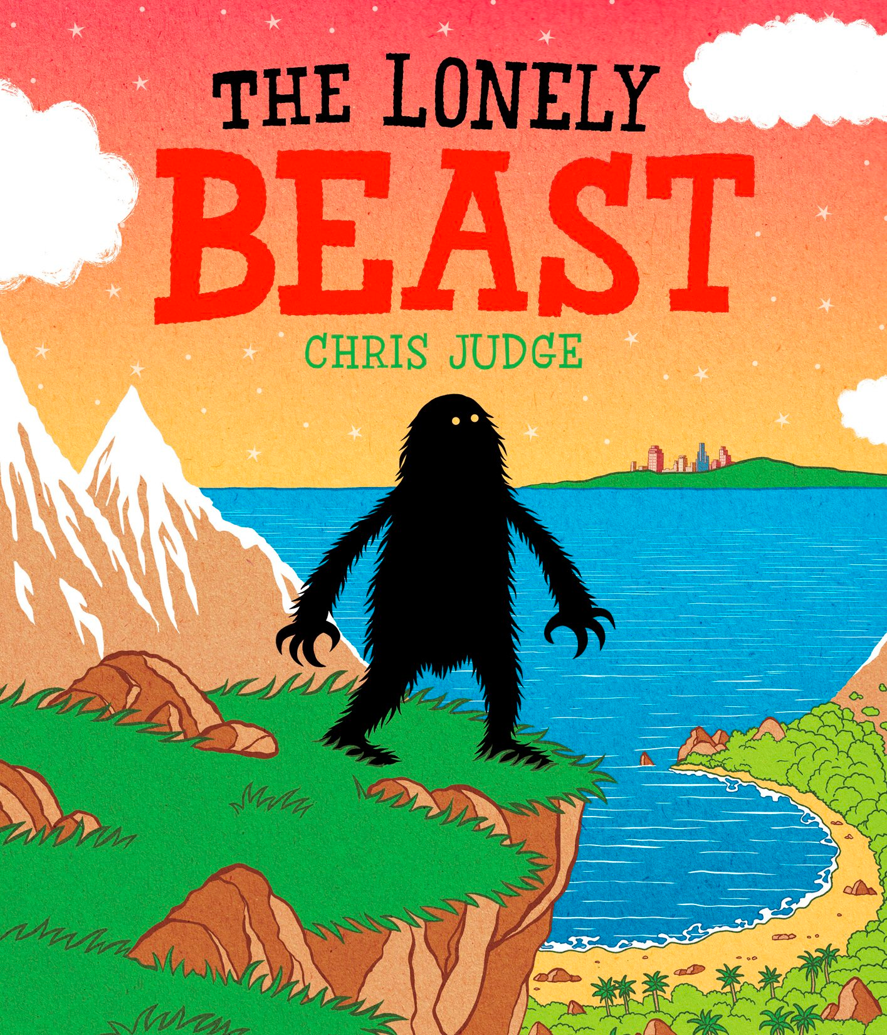
The Lonely Beast by Chris Judge
The Beasts are very rare. Not many people have heard of them. In fact they are so rare that there is only one Beast in each country…and they don’t even know each other.
They are very quiet creatures, who live alone high in the mountains or deep in the woods. They like nothing more than tending to their beautiful gardens..
The Lonely Beast, Chris Judge, Andersen Press (2011)

Slide 4
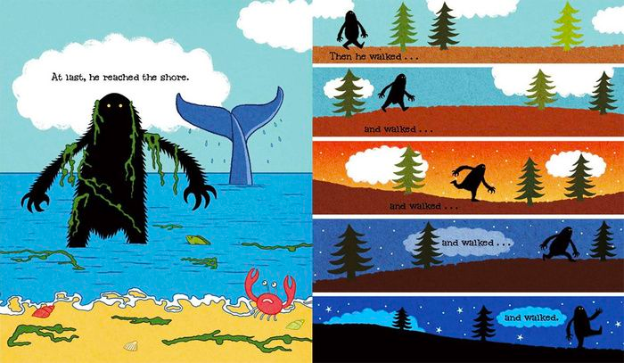
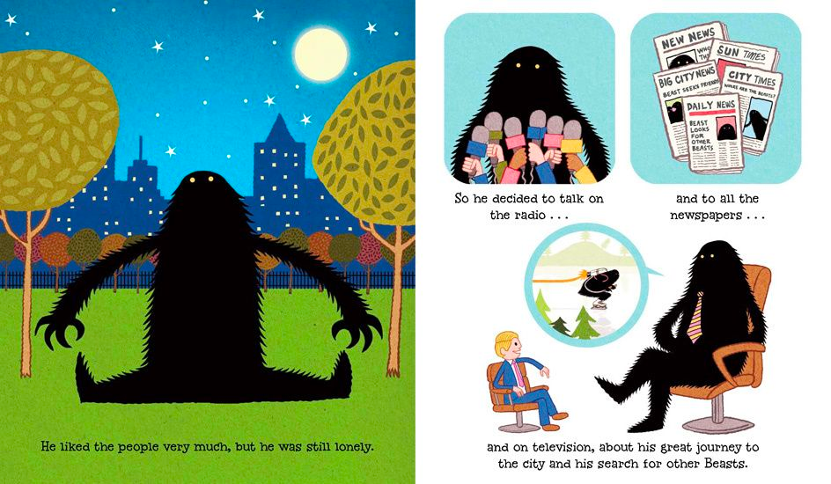
The Lonely Beast by Chris Judge
This is the story of one such Beast who, one day, suddenly felt very lonely. He made up his mind there and then that he would go and find some other Beasts.

Slide 5
Opportunities for writing in role
A social media post
A packing list
A travel blog including survival tips
A diary of life in New York
A TV interview
A resignation letter
An informal note slipped under Beast’s door
A thank you card
Writing inspired by the text:
An advert for an event at the park
A glossy magazine feature

Slide 6
The Lonely Beast by Chris Judge
Dear Director of Parks and Gardens,
I’m sad to tell you that I will be leaving the city on Saturday and therefore must resign from my post as head gardener.
I have enjoyed being part of this wonderful community and can’t thank you enough for your kindness in welcoming me to the city and finding me work.
I’m leaving because I am home sick and have my own garden to attend to.
Please keep in touch.
Best wishes,
Beast

Slide 7
The Lonely Beast by Chris Judge
Beast,
I missed you earlier so thought I slip this under your door. The head gardener has told me you’re leaving and I can’t believe it! What will the park become without your dedication and skills. Can we have a chat about this over a coffee?
Thanks
Bob (Flat 6)

Slide 8
Eastbourne by Joseph Coelho
My baby sister toddles alongside my grandmother,
the years between them
like the ghosts of waves already ebbed
and the years to come
like the promise of tides,
as their silhouettes whisper in the sunshine.
“What do I want to be when I’m older?”
The question bounces around my head
like light and wind and water and time
and I smile…
“I don’t know.”
Kicking the pebbles along Eastbourne beach
as the orange-pink of sunset
plays with the ebbing tide,
my mother asks…
“What do you want to do when you’re older?”
There is every colour of pebble beneath my feet,
grey lumps of flint winking their sharp, shining
cores,
gritty ovals of sandstone, pregnant with fossils,
worn amulets of glass of every sparkle.
They crunch and shift under synced steps
as we stroll, towels wrapped around sand-dusted
bodies.
The sea sings with the pebbles,
knocking a tone from each,
forming a hushing melody.
Sunbursts dip into the wispy clouds,
bounce from the greens, blacks and purples of the rock pools, shine red and gold and white from the sea.
There is every colour in the sun.

Slide 9
Opportunities for writing in role
A postcard from the seaside
A text conversation
A note to or from Mum
A diary
A school report
A letter from a careers advisor
Writing inspired by the text:
An Eastbourne tourist board advert
A spotter’s guide to the beach

Slide 10
Writing in role: some words of advice
Make sure that the task has a clear purpose in relation to deepening children’s understanding of the text
The writing task must be in response to reading or a drama activity. It is an informal opportunity for children to express themselves creatively. The neatness of the children’s handwriting or the accuracy of their spelling and punctuation must not hinder the children’s responses
Find opportunities to give the children choice in how to respond, e.g. the character they adopt, the form of writing they choose
Writing in role should not be seen as the main event but rather an opportunity to initiate a response to, and deepen understanding of, what they have read

Slide 11
The benefits of writing in role
Writing in role provides an opportunity for children to:
continue to explore character following a drama activity
infer characters’ feelings and predict their actions
write for a clearly defined audience
experience writing in a new and authentic context
develop a passion for writing
practise using newly learned vocabulary and patterns of language

Slide 12
Benefits of drama in understanding narrative
Drama can support children to:
engage with texts that they might otherwise find ‘difficult’
reflect on the text as a whole, giving a well-informed, personal response
understand plot and action
understand the setting (time and place) and how this influences action
predict and discuss future actions and their consequences
recognise themes and subtext
understand and discuss mood atmosphere
understand characters’ traits and infer their feelings, motives and intentions
explore the language used by characters to express thoughts and feelings
feel more confident when answering inference questions

Slide 13
Thank you!
Course creator: Ruth Baker-Leask

