Slide 1
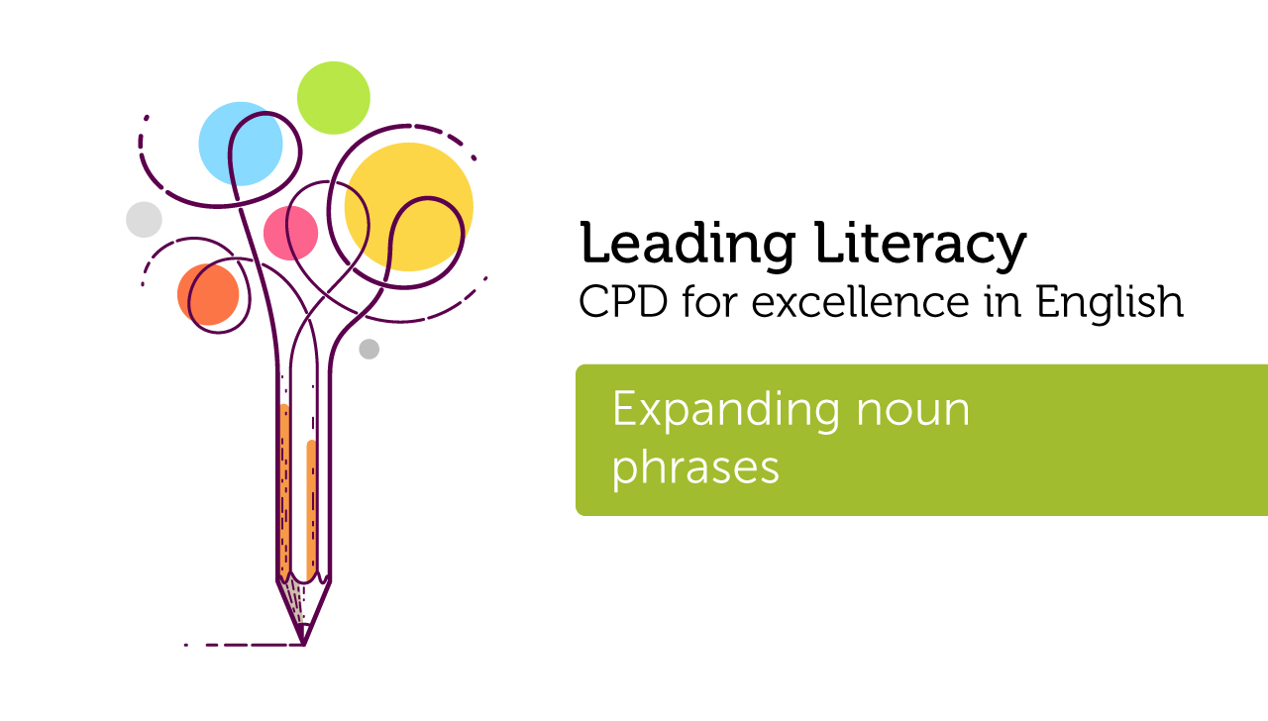

Course creator: Rachel Clarke: https://primaryenglished.co.uk

Slide 2
A noun is a word that names a person, place or thing
Concrete nouns refer to things that can be seen, touched, smelled, heard or tasted (e.g. tower, cat, snow)
Abstract nouns refer to things that cannot be seen or touched (e.g. love, fear, community)

Slide 3
Quiz
A noun phrase is a group of words that behave as a noun.
Which of the following are noun phrases?
  a fluffy, white kitten
  the wobbly, old table
  the gingerbread man
  the old football by the shed
  those cars in the street

Slide 4
Quiz
A noun phrase is a group of words that behave as a noun.
Which of the following are noun phrases?
  a fluffy, white kitten
  the wobbly, old table
  the gingerbread man
  the old football by the shed
  those cars in the street

Slide 5
Specificity and description
Noun phrases enable us to be more specific in our descriptions.
  a kitten becomes a fluffy, white kitten
  the table becomes the wobbly, old table
  the man becomes the gingerbread man
  the football becomes the old football by the shed
  those cars becomes those cars in the street

Slide 6
Expanding nouns before the noun
noun
tower
The tower
The very tall tower
noun
phrase
noun
phrase
tells us more about the noun

Slide 7
Adding adjectives
The most common way of creating noun phrases is to add adjectives.
The tall tower
The tall, brown tower
The old, tall, brown tower

Slide 8
But…
Adding adjectives is not the only way to expand a noun phrase.
Can you spot the other word classes that have been used to expand the noun phrases?
The very tall tower
The tall church tower

Slide 9
But…
Adding adjectives is not the only way to expand a noun phrase.
Can you spot the other word classes that have been used to expand the noun phrases?
The very tall tower
The tall church tower
‘very’ is an adverb specifying the tallness of the tower
'church’ is a noun telling us more about the tower

Slide 10
Expanding nouns after the noun.
We can also expand noun phrases after the noun.
The tower in our village
The church tower by our school
The very tall church tower with a flag on top

Slide 11
Expanding nouns after the noun.
We can also expand noun phrases after the noun.
The tower in our village
The church tower by our school
The very tall church tower with a flag on top
‘tower’ has been expanded by adding prepositional phrases to tell where the tower is and what else is on it

Slide 12
How could you expand this noun phrase?
The very tall church tower with…

Slide 13
Noun phrases in authentic writing
Expand noun phrases to make descriptions specific and to help a reader visualise.
The little red hen… a tiny person with wings the size of a butterfly’s wings… the mysterious house in the middle of the deep, dark wood.
Expand noun phrases to communicate complicated information in a concise manner.
The northern most parts of Canada with their rugged landscape … the Everglades is a natural region of tropical wetlands in the southern portion of the U.S. state of Florida

Slide 14
To summarise
  Nouns name concrete objects such as people, places and things and abstract ideas such as emotions and beliefs.
  Noun phrases are groups of words that behave as a noun.
  Noun phrases can be formed by adding information before and/ or after a noun.

Slide 15
Thank you!
Course creator: Rachel Clarke: https://primaryenglished.co.uk

